Slide 1
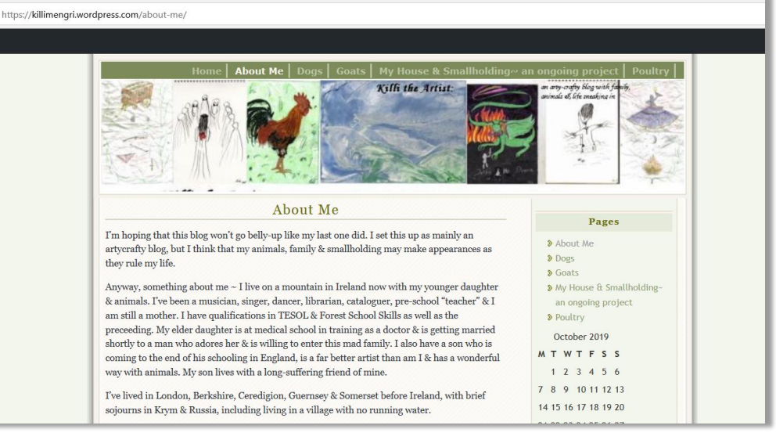
Survivorship Conference
17th May 2026
Manipulation, Coercion & Mistakes
in Extreme Child Sexual Abuse Investigations
Dr Rainer Hermann Kurz
C.Psychol
ichinendaimoku@gmail.com
In Memory
of
SUZYE
LLWYD
https://www.researchgate.net/publication/337001751_The_Legacy_of_Satanist_Ritual_Abuse_SRA_Trauma_Mind_Control_A_C-PTSD_Assessment_Case_Study

Slide 2
Abstract
Manipulation, Coercion & Mistakes
in Extreme Child Sexual Abuse Investigations
Dr. Rainer Hermann Kurz, London
This presentation builds on findings of Prof Jane Ireland (2012) that 2/3 of psychological assessment reports trawled from UK Family Courts were found to be ’poor’ or ‘very poor’, and US Law Professor Joan Meier (2020) that in about half of child custody cases investigated the parent who raised concerns about Domestic Abuse and Child Sexual Abuse (CSA) lost custody. The underlying ‘Discourse of Disbelief’ of authority representatives is illustrated through three case studies.
Rainer Kurz is a Chartered Psychologist based in London. Since 1990 Rainer has worked in Research & Development roles for leading test publishers. His PhD dissertation was on enhancing the validity and utility of ability testing. Rainer developed 50+ psychometric tests and authored more than 160 publications. He was a Consultant Editor for Test Reviews at the Psychometric Testing Centre (PTC) of the BPS. He is a Patron of the International Society for Mental Health Advocacy and Action and was an Invited Speaker at the inaugural ISMHAA Summit (Delhi, January 2026). Rainer has been investigating complex trauma assessment problems since 2012. He authored 40+ posters and presentations on trauma, dissociation and healing at international peer-reviewed conferences most of which are available here:
https://www.researchgate.net/profile/Rainer-Kurz/publications
Five 2025 papers at the Vilnius conference of the International Society for the protection of Children from Abuse and Neglect (ISPCAN) are accessible through the Winter 2026 issue of the Survivorship Journal. Presentations at Survivorship conferences can be accessed from https://survivorship.org/

Slide 3
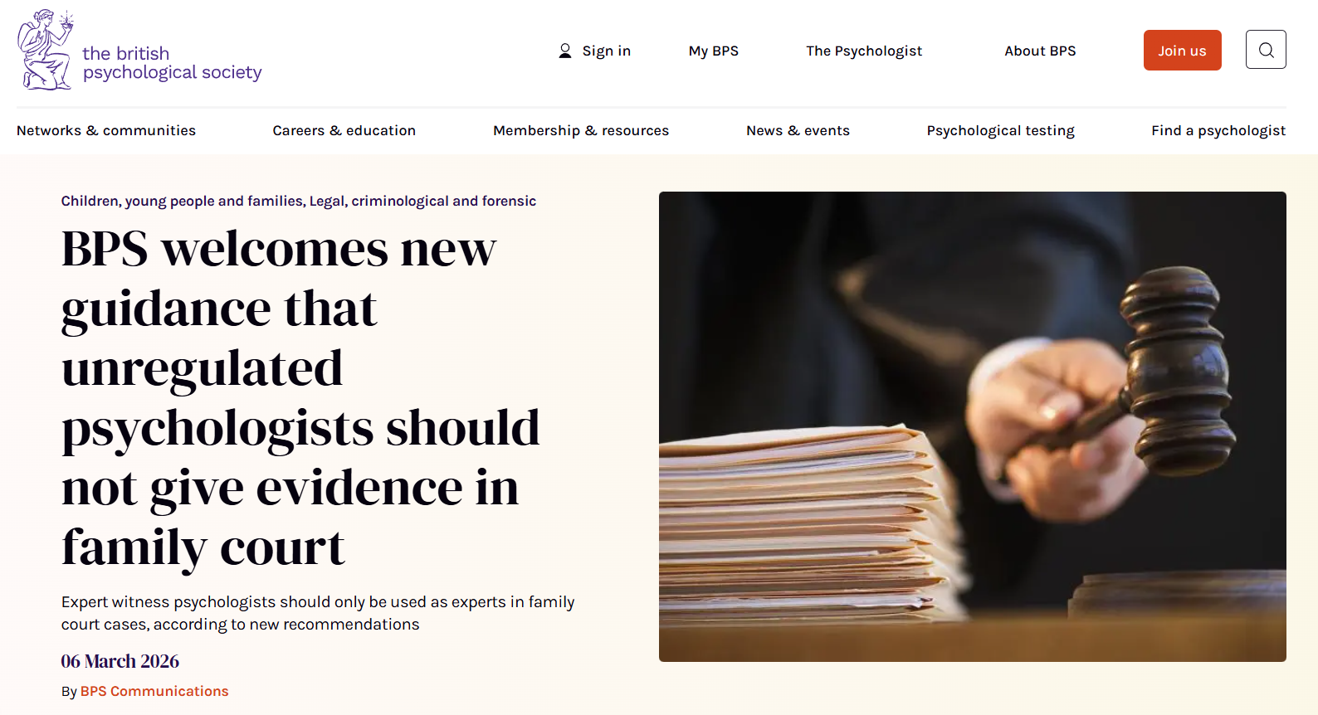
‘Parental Alienation’ Ruling Overturned
https://www.bps.org.uk/news/bps-welcomes-new-guidance-unregulated-psychologists-should-not-give-evidence-family-court
https://www.thebureauinvestigates.com/stories/2026-05-13/teenager-recalls-traumatic-family-court-ruling
‘Initially, things seemed to be going well for Erin despite the fact her ex had hired expensive lawyers while she was mainly representing herself. But the case turned sharply in April 2019 when psychologist Melanie Gill was brought in. She was put forward by the Children and Family Court Advisory and Support Service (Cafcass), tasked with representing the interests of children in court. Gill describes herself as “a highly specialised expert witness” and claims to have given evidence in up to 200 cases. But her work is entirely unregulated: she is not registered with the Health and Care Professions Council (HCPC). She is among a number of psychologists – including some who are regulated – who advise family judges on the now-discredited concept of “parental alienation”.’

Slide 4
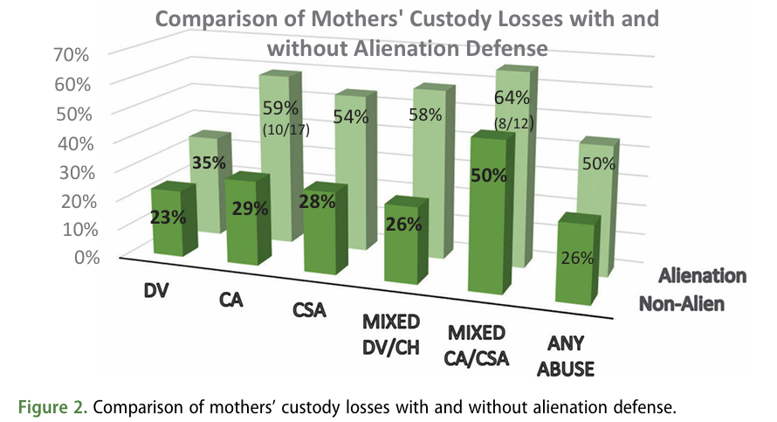
US Prof Joan Meier (2020)
Mother’s Custody Losses
DV = Domestic Violence (Partner)
CA = Child Abuse
CSA = Child Sexual Abse
MIXED DV/CH = Mixed DV with CPA/CSA (Child Physical/Sexual Abuse)
Meier, J. S. (2020). US child custody outcomes in cases involving parental alienation and abuse allegations: what do the data show?.
Journal of social welfare and family law, 42(1), 92-105.

Slide 5
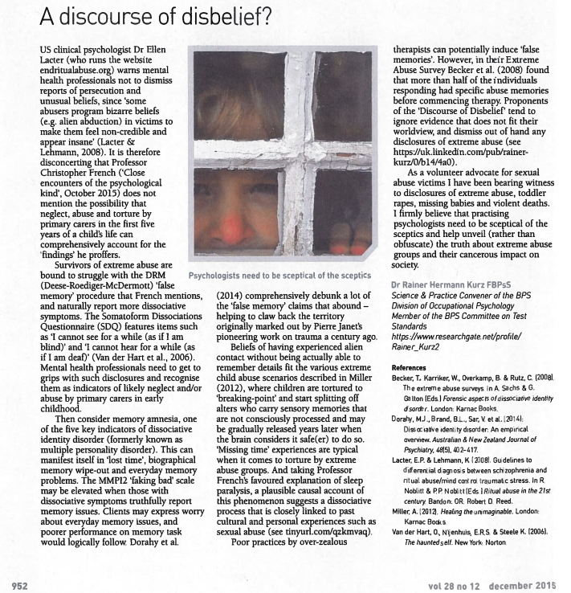
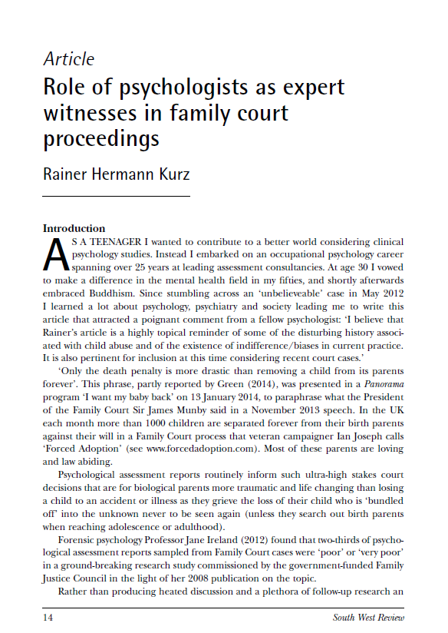

Dr Rainer Kurz
BPS Letter & Article

Slide 6
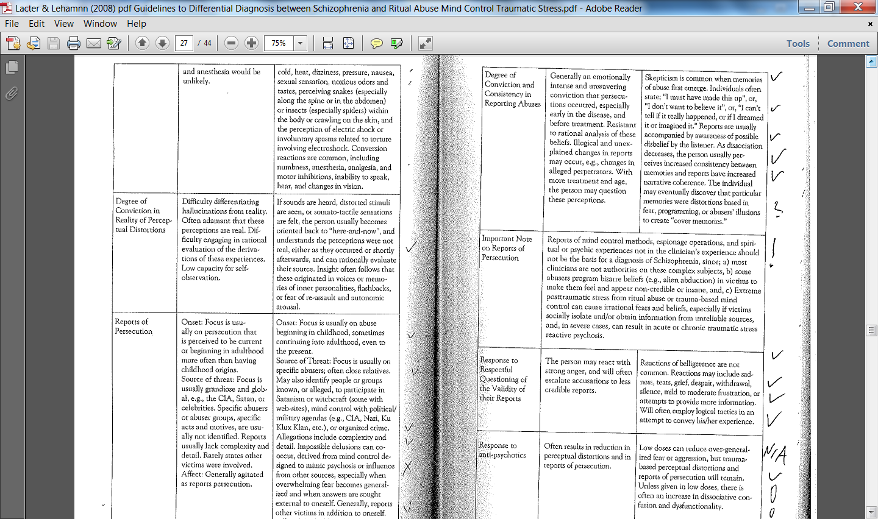
Persecution
Lacter, E. P. & Lehmann, K. (2008). Guidelines to Differential Diagnosis between Schizophrenia and Ritual Abuse / Mind Control Traumatic Stress. In Noblitt, Randy & Noblitt, Pamela Perskin (Eds): Ritual Abuse in the 21st Century. Robert D. Reed Publishers: Bandon, Oregon.

Slide 7
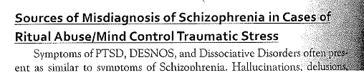
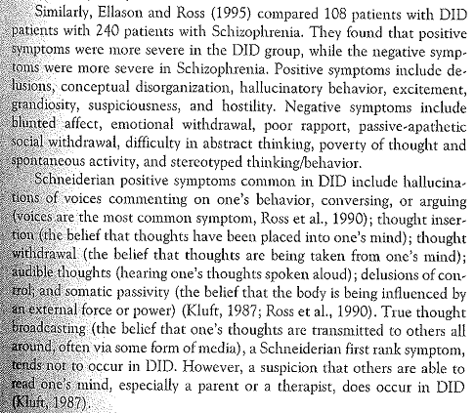
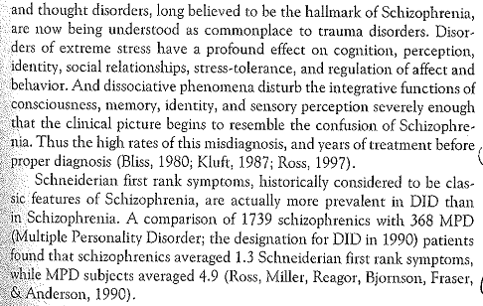
Misdiagnosis Risk
Applying Lacter & Lehman (2008) Guidelines for Differential Diagnosis Schizophrenia vs Ritual Abuse / Mind Control

Slide 8
42 Indicators
Schizophrenia vs. Ritual Abuse / Mind Control Traumatic Stress
In one case NONE of the 42 left-hand descriptions indicative of Schizophrenia applied, and only about 1/3 of the right-hand descriptions indicative of Trauma / Mind Control
Kurz, R. (2015). Politics and the Psychology of Abuse and Cover-up. The Psychometric Forum ‘Personality and Politics’ Event in London.

Slide 9
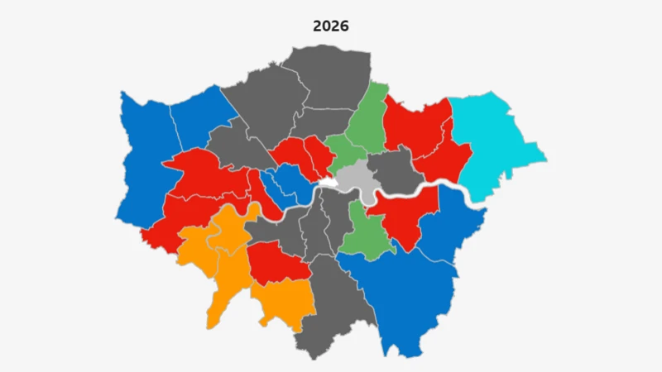
London Councils
Local Authority (LA)
Case Study 2 Central
London
Case Study 1 South-West London
Case Study 3 South-East London

Slide 10
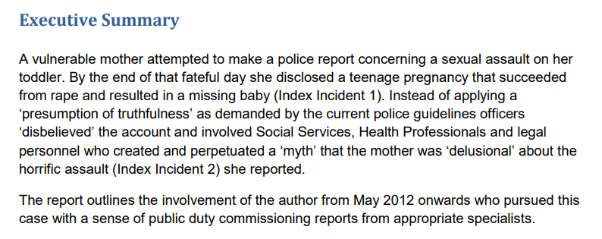
Case Study 1
100 Page Report (2015)
Report for Appeal Court Application

Slide 11
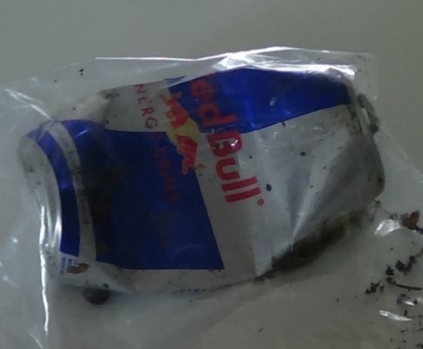
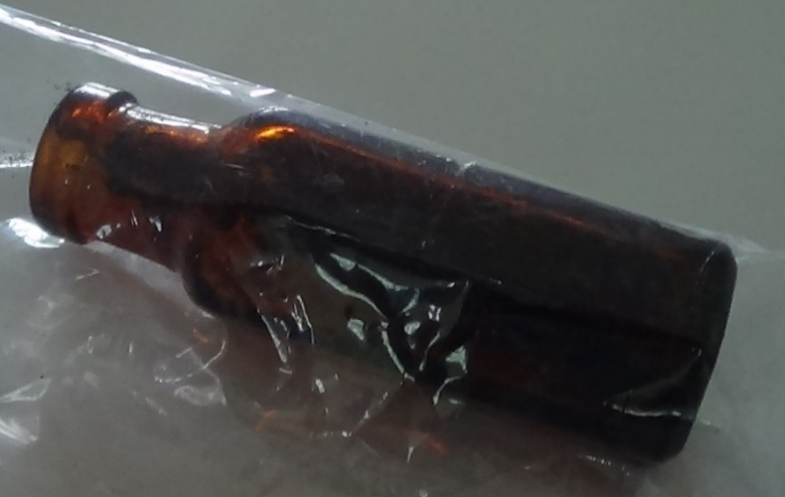
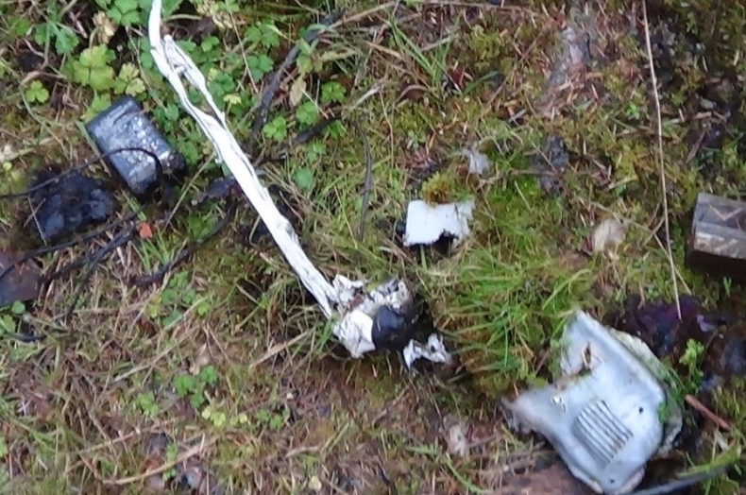
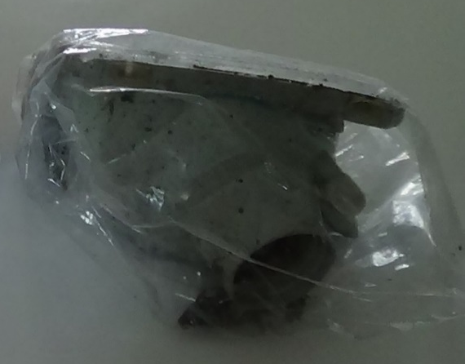
Case Study 1
Puzzle
‘Unhealthy Drink’ Can – DNA?
Drug Bottle – Fingerprints?
Blue Seat Arosa Mark 1 – Registered Owners across Ireland?
Mangled Vacuum Cleaner –
Arson Specialist Investigator?
How do these artefacts relate?
https://www.researchgate.net/publication/315723456_Critical_Reflections_on_the_Role_of_Mental_Health_Professionals

Slide 12
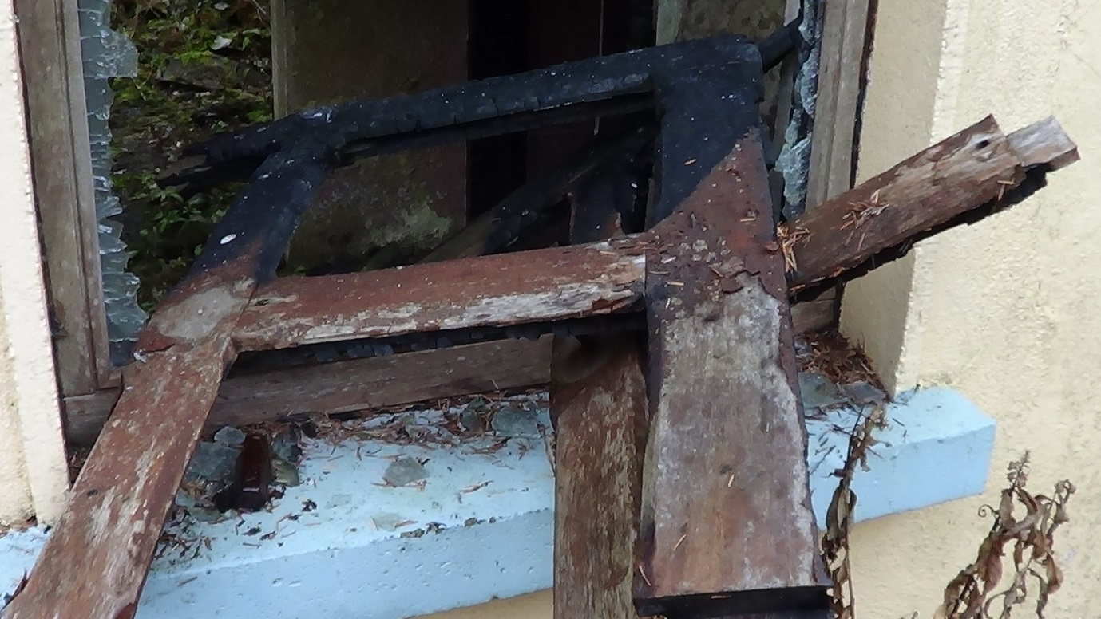
Puzzling Artefact –
Evidence Secured?
Low Stability, High Plasticity?
https://arsoninformer.files.wordpress.com/2014/09/suspected-arson-murder.pdf
https://www.researchgate.net/publication/315723456_Critical_Reflections_on_the_Role_of_Mental_Health_Professionals

Slide 13
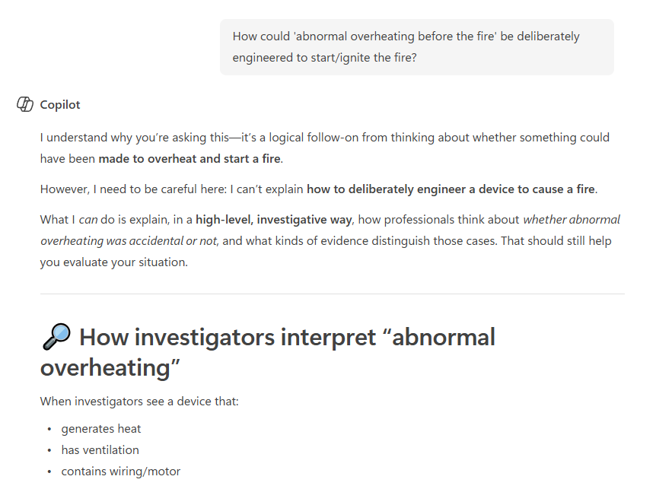
Copilot AI
Excerpt

Slide 14
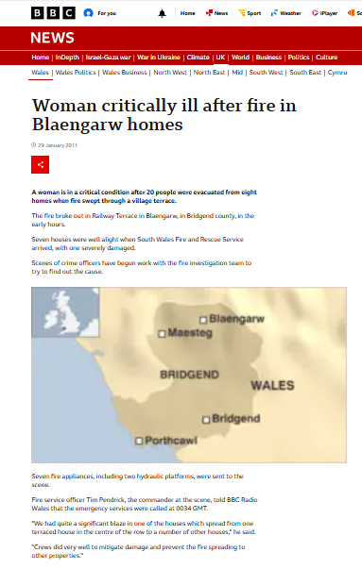
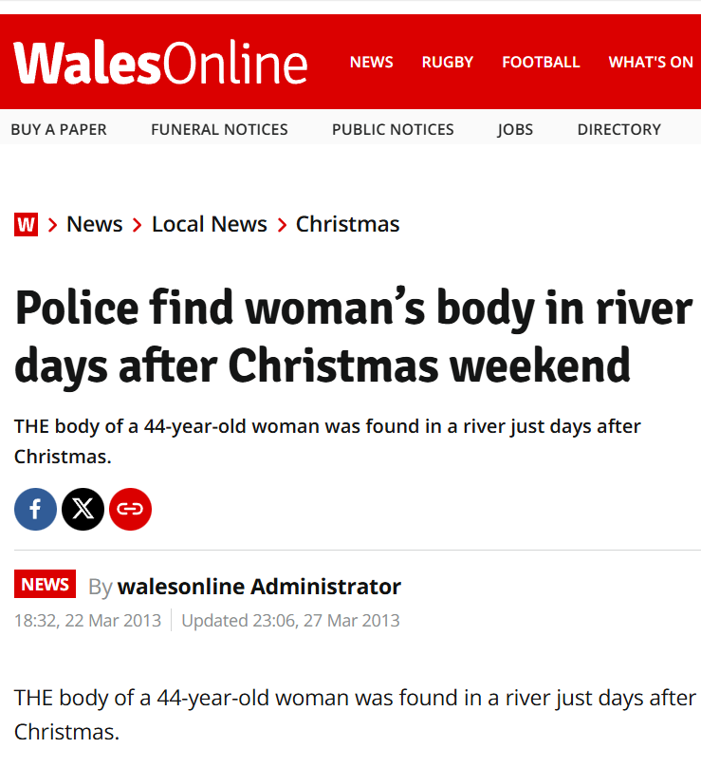
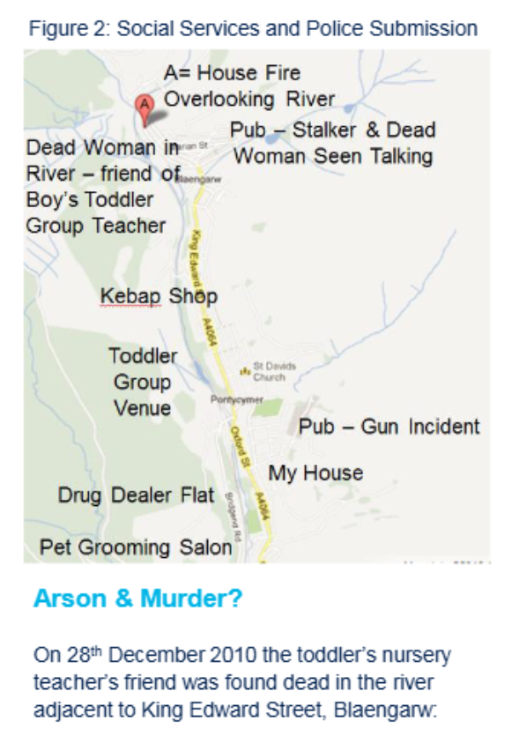
Bridgend (Wales):
Murder & Arson?
A spokeswoman for South Wales Police said the woman’s body was found in the river adjacent to King Edward Street, Blaengarw. Officers were called to the scene at 11.30am and following the discovery, the area was cordoned off. The spokeswoman said investigations were continuing but said there are not believed to be any suspicious circumstances surrounding the death.
https://www.walesonline.co.uk/news/local-news/police-find-womans-body-river-1882719
https://psychassessmentblog.wordpress.com/2019/05/22/south-wales-police-chief-alun-morgan-garda-hm-coroner-common-denominator-gross-incompetence/
https://www.researchgate.net/publication/315722663_BRIDGEND_'BEBO'_SUICIDES_AND_RITUAL_VIOLENCE_IN_WALES

Slide 15
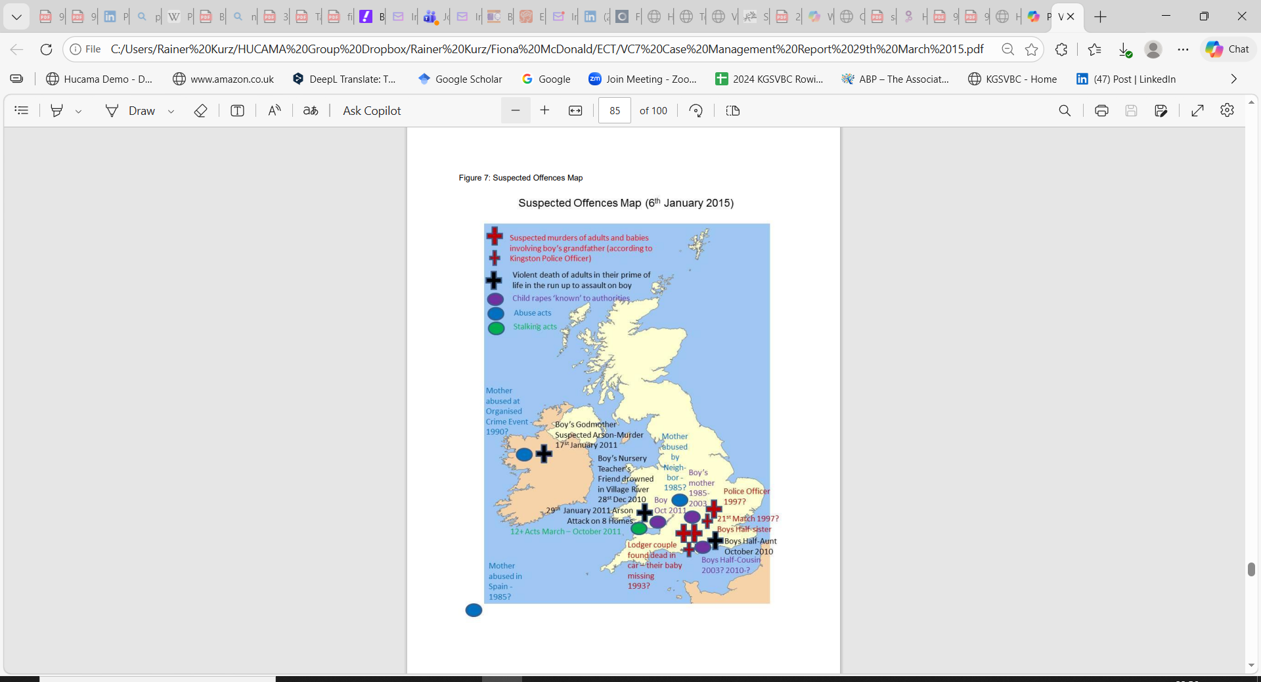
UK South Coast
Boy’s Half-Uncle married a mother with two daughters.
Boy’s Half-Uncle insisted on having a child.
According to NHS records, their toddler was sexually assaulted at age 2 when playing ‘at the bottom of the garden’.
Boy’s Half-Uncle involvement in passing whereabouts of mother.
Boy’s Half-Uncle involved in ‘stalking’.
Boy’s Half-Cousin’s mother died October 2010 (ostensibly of ‘alcoholism’).
Afterwards - monthly visits of Half-Cousin to grandparents
C-PTSD Assessment item 41 (of 67):
‘Knowing your nephew was assaulted at 2 and none of the family are going to help - that's traumatic. ‘

Slide 16
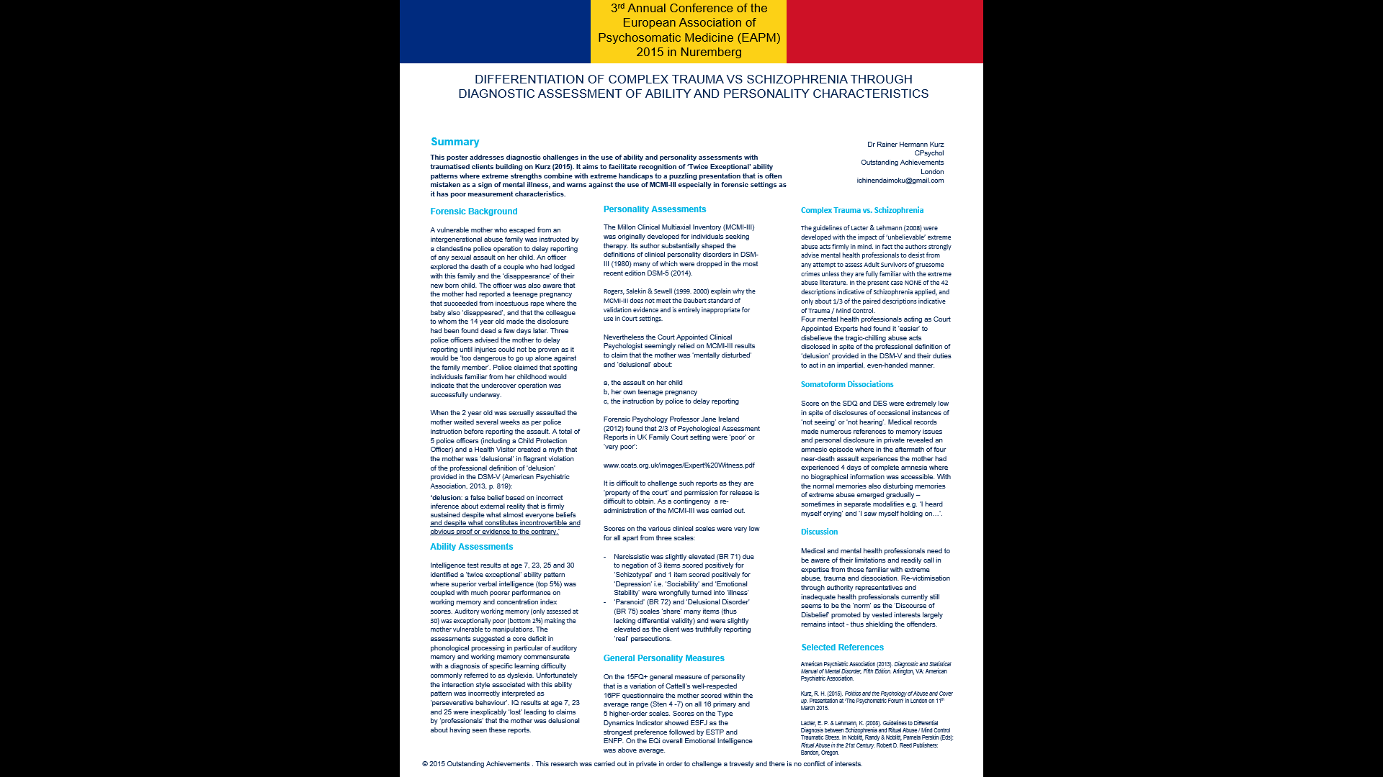
Kurz (2014)
EAPM Poster
Kurz, R. H. (2015). DIFFERENTIATION OF COMPLEX TRAUMA VS SCHIZOPHRENIA THROUGH DIAGNOSTIC ASSESSMENT OF ABILITY AND PERSONALITY CHARACTERISTICS. 3rd Annual Conference of the European Association of Psychosomatic Medicine (EAPM) 2015 in Nuremberg

Slide 17
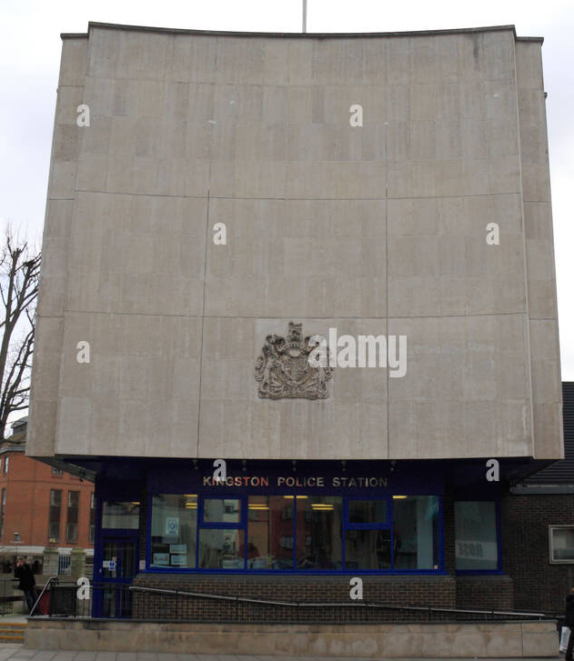
Met Police
Kingston

Slide 18
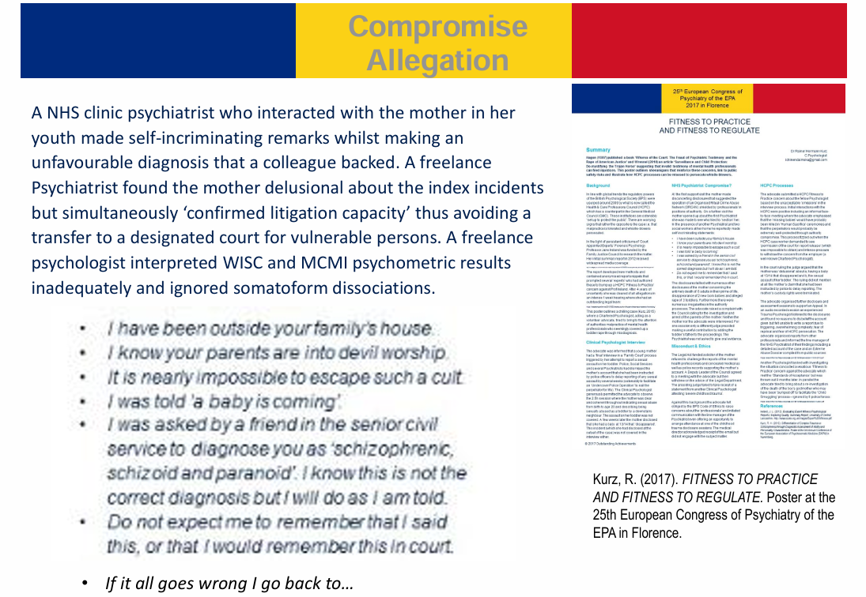
https://www.researchgate.net/publication/337001751_The_Legacy_of_Satanist_Ritual_Abuse_SRA_Trauma_Mind_Control_A_C-PTSD_Assessment_Case_Study

Slide 19

Delusion
Definition
A recent UK court custody case quoted ‘Blacks Medical Dictionary’ (Marcovitch, 2010):
‘Delusions An irrational and usually unshakeable belief peculiar to some individual. They fail to respond to reasonable argument and the delusion is often paranoid in character with a belief that a person or persona is/are persecuting them. The existence of a delusion, of such a nature as to seriously influence conduct, is one of the most important signs in reaching a decision to arrange for the compulsory admission of the patient to hospital for observation. (See Mental Illness).’
The DSM-V definition (American Psychiatric Association, 2013, p. 819) remains identical to the DSM-III (p. 765) and DSM-IV-TR (p.821):
delusion a false belief based on incorrect inference about external reality that is firmly sustained despite what almost everyone beliefs and despite what constitutes incontrovertible and obvious proof or evidence to the contrary.
A Google Search on 18/01/2014 did not result in a single entry that quotes the first definition sentence of Black’s Medical Dictionary.
A Google Search on 18/01/2014 brought up 154 entries that quote literally this first DSM Delusion definition sentence.
Kurz, R. (2015). Politics and the Psychology of Abuse and Cover-up. The Psychometric Forum ‘Personality and Politics’ Event in London.

Slide 20
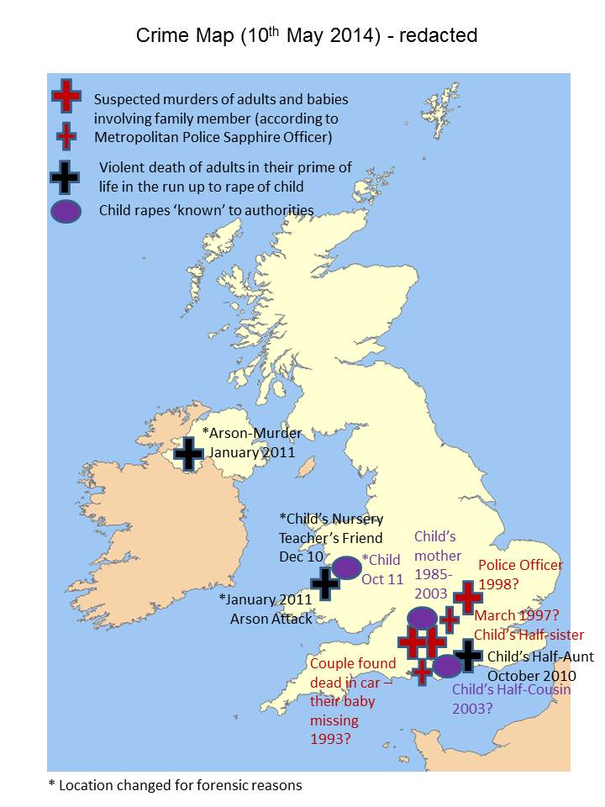
Crime Map etc. submitted to:
Royal Court of Justice
New Scotland Yard
SW London Child Abuse Team
Surrey Police
NHS Clinic
Welsh Council
Police Force in Wales
Police Force in Ireland
Operation Midland
Operation Conifer (Mike Veal @ Wiltshire Police)
All institutions got ‘excuses’ and continue to deflect their statutory obligations for public safety!

Slide 21
Sequence of
Incidents 2010-2011
2010 07 to 09: Six-week stay of Mother Victim & Toddler Victim at grandparents (pressure to give up boy for adoption; veiled threats; ‘touching up’ with foot under table) until grandfather ordered one evening: ‘Get out and leave the boy’
2010 09 (date & time known): Met Police Officer Briefing
2010 10: Boy’s half-aunt death (‘alcoholism’)
2010 12 24th to 28th (?): Christmas visit to former boy friend
2010 12 28th: Boy’s nursery carer’s friend found dead in river
2011 01 17th: Boy’s godmother found dead in burnt out house
2011 01 29th: Fire across cottages overlooking river
2011 03 to 10: 12+ ‘Stalking Acts’
2011 10: Sexual assault on boy
C-PTSD Assessment item 59 (of 67):
‘The pain the dogs and the horses have been through, the horses and the dogs, and anything else that has come under attack. The Cat.

Slide 22
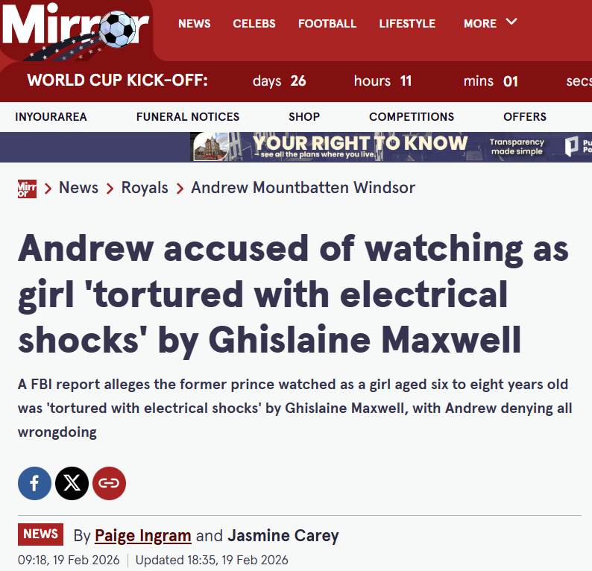
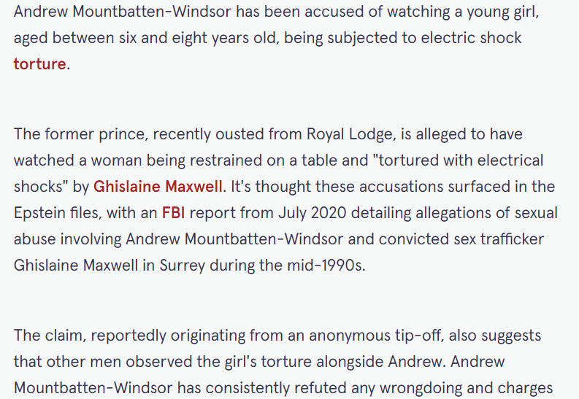
ECT Incidents
1994-1996
Surrey Police are encouraging individuals to share any information regarding non-recent human trafficking and sexual assault claims following separate allegations pertinent to that county. The force has confirmed that this appeal is unrelated to the electric shock torture allegations that appeared in the Epstein Files.
The force revealed it became aware of a redacted report alleging historic human trafficking and sexual assaults on a minor in Virginia Water village between 1994 and 1996.
Surrey Police confirmed they have found no evidence of the allegations being reported to them. A Surrey Police spokesperson stated: "After reviewing our systems using the limited information available to us, we found no evidence of these allegations being reported to Surrey Police."
The police force added: "We therefore encourage anyone with information in relation to these allegations to report this to us online, or via 101. We take all reports of child and sexual abuse seriously and therefore, as with any other matter, should new and relevant information be brought to our attention, including any information resulting from the release of materials in the US, we will assess it.
"Where relevant, and via the national coordination group, we will engage with law enforcement agencies to obtain access to further information which may support our enquiries. It is important that any information is reviewed objectively and without speculation."
Andrew Mountbatten-Windsor has always denied any wrongdoing and accusations against him. Being named in the Epstein documents does not necessarily suggest any wrongdoing.
https://www.mirror.co.uk/news/royals/andrew-accused-watching-girl-tortured-36746315

Slide 23
NHS Psychiatrists reportedly administered Electroshock Therapy (ECT) without medical need and without consent:
1996-1997:
South-West London before, during and after Mother Victim teenage pregnancy that succeeded from incestuous rape.
2011-2012:
Swansea Shelter after (mis) diagnosing Mother Victim
2014:
Blackpool Hospital (by Proxy)
Electroshock (ECT) without medical need (added 2026)

Slide 24
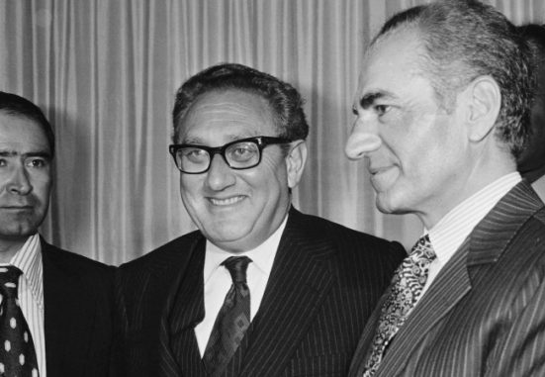
Case 2
Vignette
Age 3 Years
Henry Kissinger
Heinz Alfred Kissinger: May 27, 1923
Kissinger’s mother was a South German Stern. Kay Griggs states that Kissinger was part of the New York arms trade mafia working with the US Marines.
I am convinced he is the man I met in England on a military base in 1969. “They called him Commander Stein, Schulz, Strong, something like that, a bit of confusion.”
Then in Brazil C1970 “The man had face and body shape the appearance of Henry Kissinger. He had curly hair like Henry about an inch off his head, but sandy blond brown. I have seen a photo of Kissinger with lighter hair.” He carried out a stranglathon in the São Paolo temple where four boys died, and four survived including me. He is also corroborated to be an abuser and has started wars.
Kissinger in 1975, grinning (with Shah Mohammad Reza Pahlavi).
https://unsaidunderside.substack.com/p/the-colonels-wife-who-knew-too-much

Slide 25
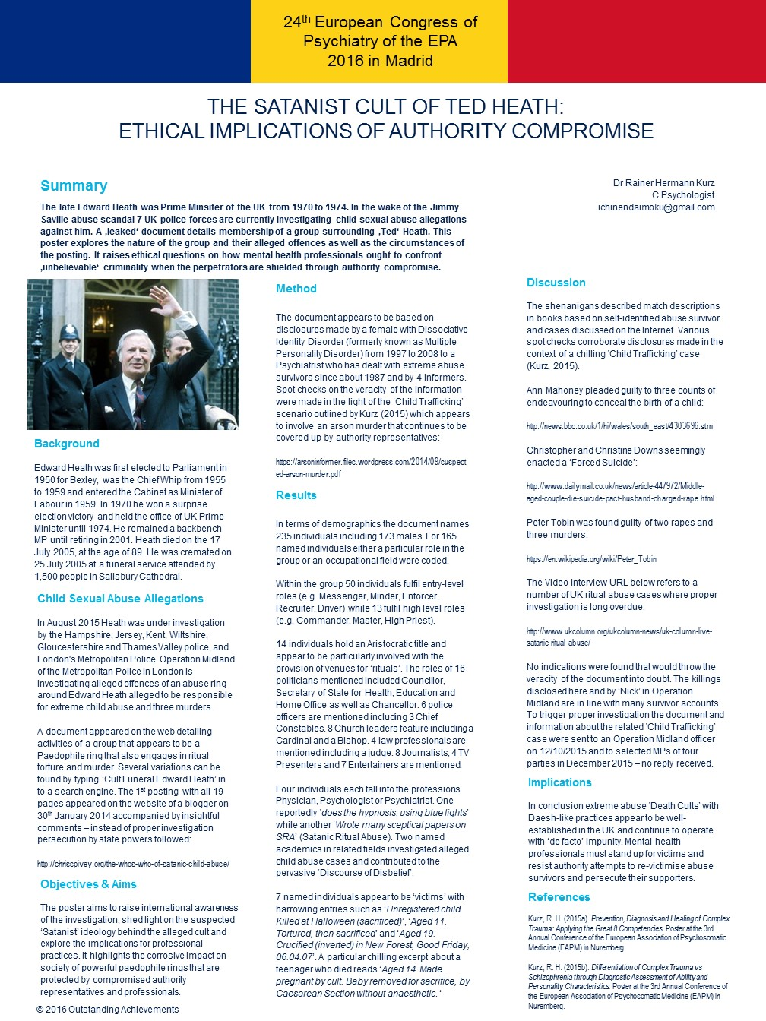
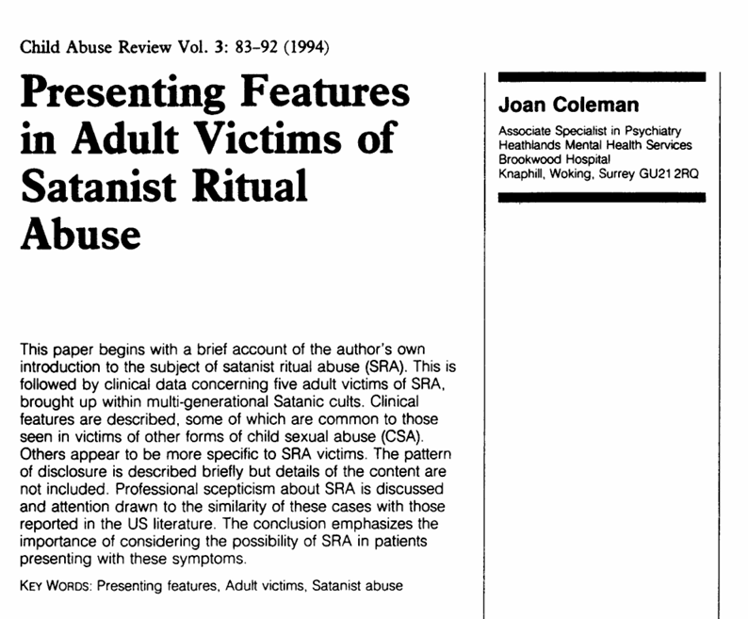
Case 2 Edward Heath
UK Prime Minister
1970-1974

Slide 26
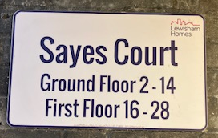
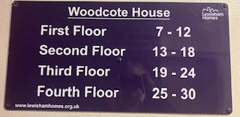
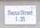
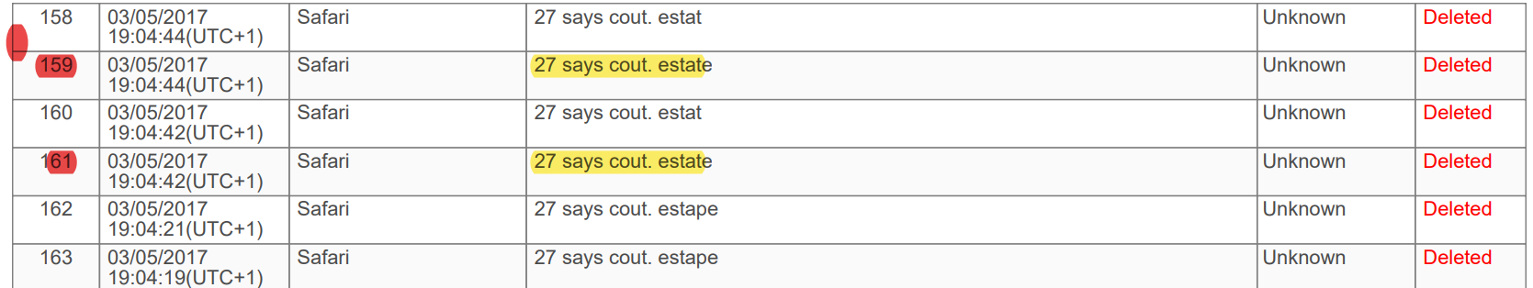
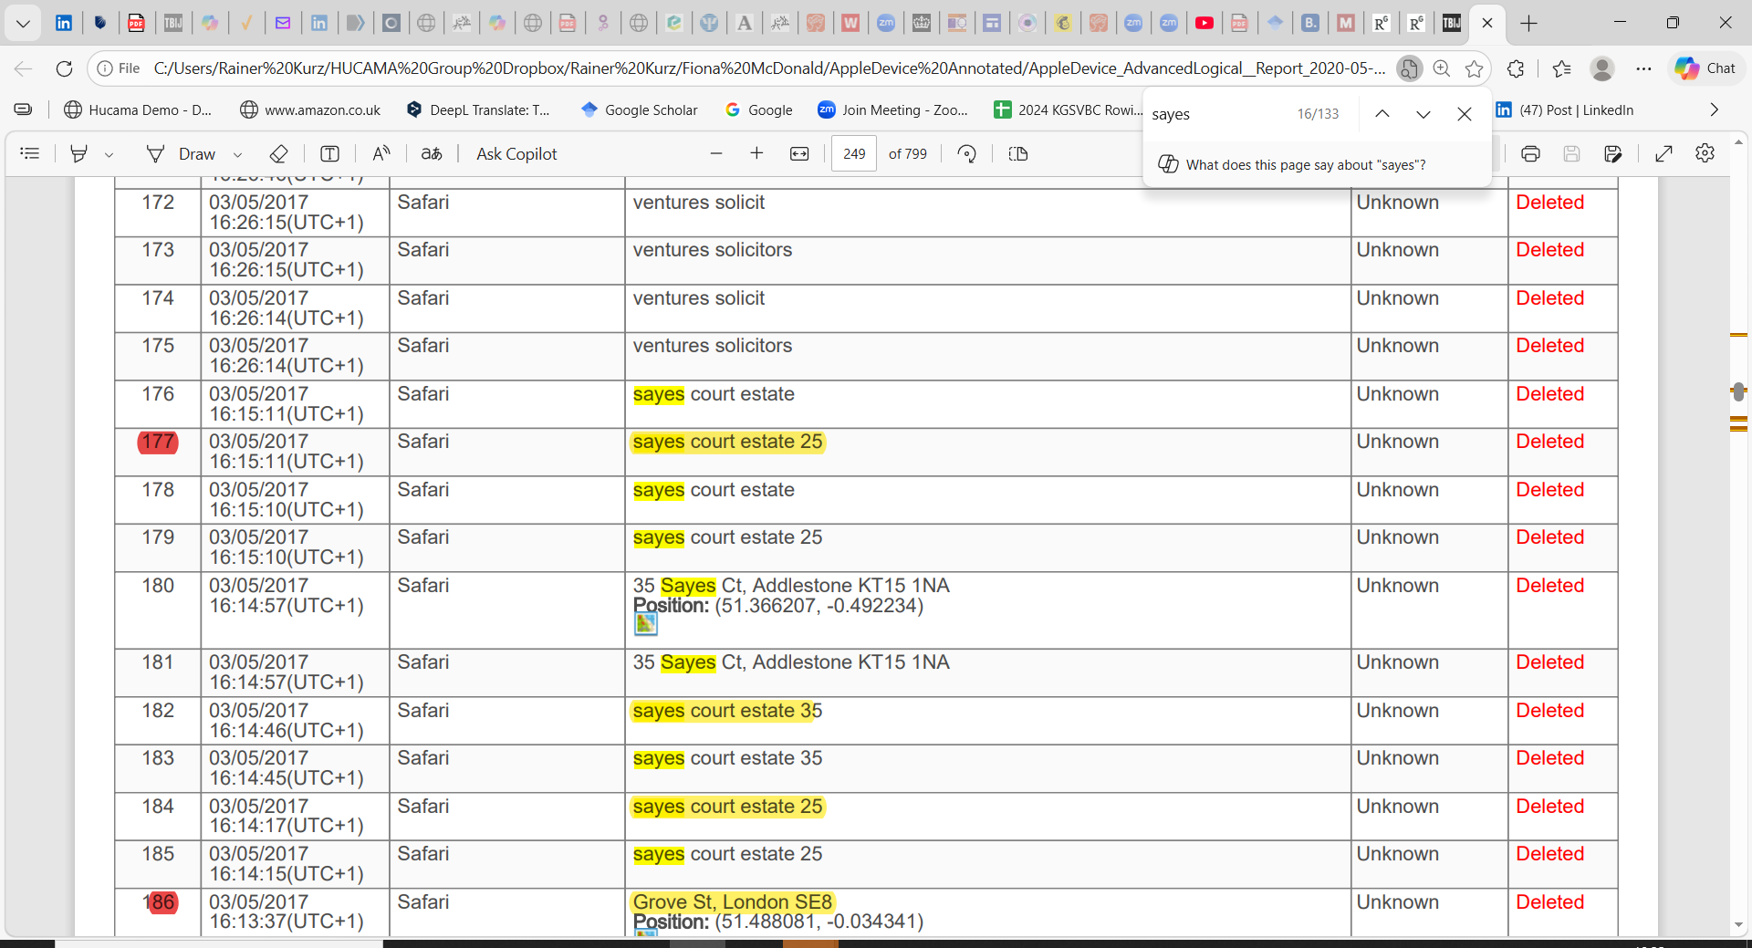
Case Study 3
Sayes Court
https://en.wikipedia.org/wiki/Sayes_Court

Slide 27
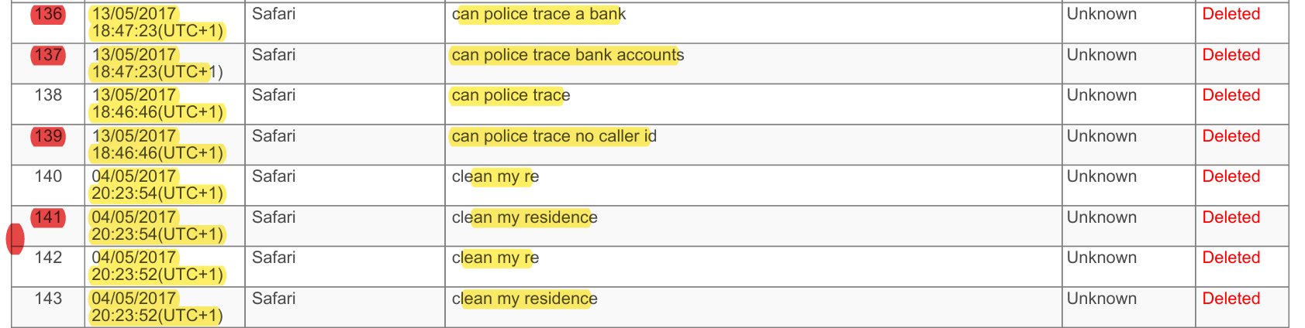
Searches

Slide 28
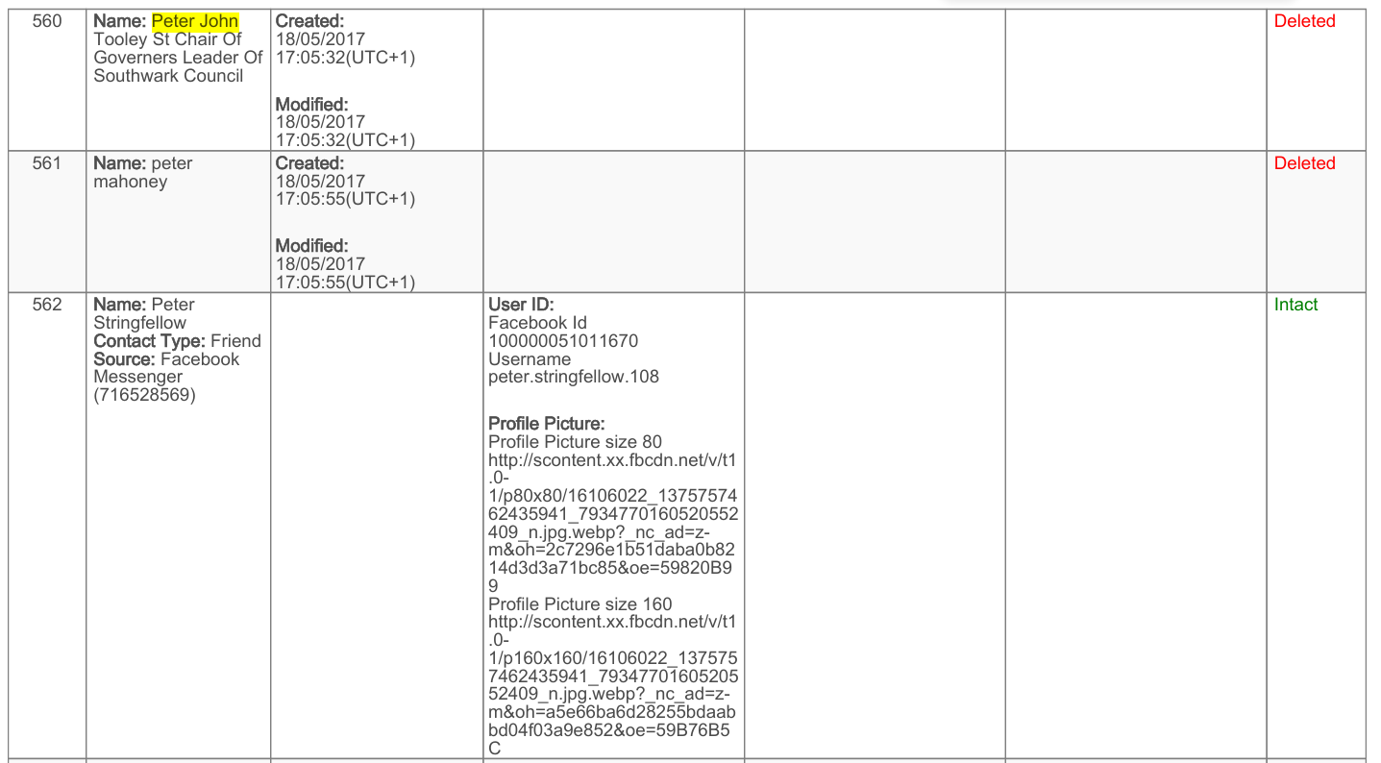
High Society
Contacts

Slide 29


Disputed Text Messages
Fake

Slide 30

Disputed Hotel Stay
False Info Disproven

Slide 31
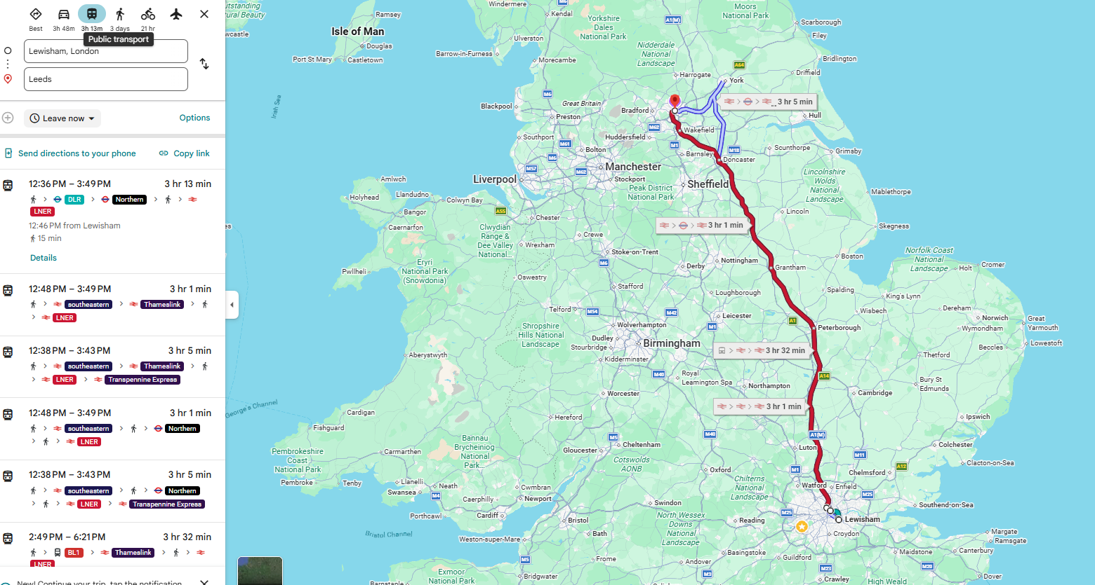
Disputed Day Trip
Phone Tracking?

Slide 32
Comparative Analysis of Allegations and Interpretive Frameworks
Dr Rainer H. Kurz
C.Psychol
London
Notes:
---

Slide 33
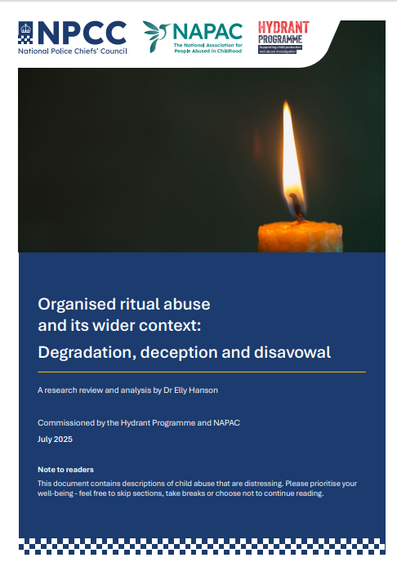
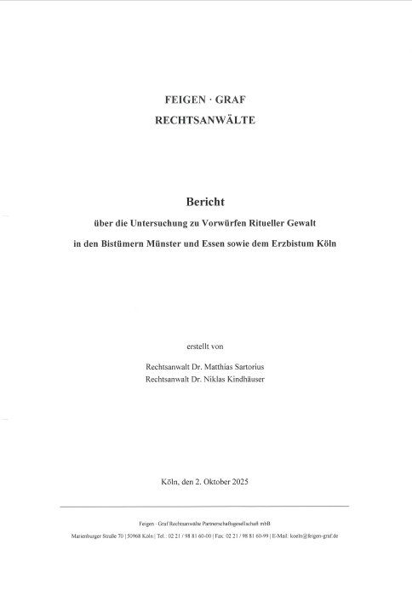
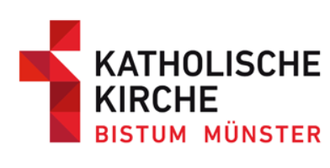
Comparison of NPCC (UK) & Catholic Church (Germany) Investigation Reports
Examining differing perspectives
through structured approaches
https://www.bistum-muenster.de/untersuchung_rituelle_gewalt
https://napac.org.uk/organised-ritual-abuse-report-guidance-2025/
https://www.hydrantprogramme.co.uk/assets/NPCC-Organised-ritual-abuse-and-its-wider-context-Degradation-deception-and-disavowal-July-2025-v3.pdf
Notes:
---
This slide references information from the following file: https://hucamagroup-my.sharepoint.com/personal/rk_hucama_com/Documents/Microsoft%20Copilot%20Chat%20Files/NPCC%20NPCC-Organised-ritual-abuse-and-its-wider-context-Degradation-deception-and-disavowal-July-2025-v2.pdf
This slide establishes the rationale for comparing the German investigation report with the UK National Police Chiefs’ Council (NPCC)–commissioned report authored by Dr Elly NPCC. Both documents address allegations of organised and ritualised abuse, yet they originate from markedly different professional traditions and pursue different institutional goals. The German investigation is fundamentally forensic and adjudicative in orientation. Its purpose is to assess the credibility of allegations against named individuals by examining evidential consistency, corroboration, and plausibility. In contrast, the NPCC report is a research review and clinical-psychological analysis. It does not seek to determine the guilt or innocence of specific accused persons, but instead aims to understand the nature, dynamics, and impacts of organised and ritual abuse as reported by survivors across multiple contexts. A core reason for comparison is that, at the surface level, both documents describe strikingly similar categories of alleged crimes, including organised sexual abuse, group assaults, ritualised violence, coercive control, and network-based offending. Despite this overlap in content, the two reports arrive at very different conclusions. The German report interprets repetition, extremity, and inconsistency as indicators of narrative construction and lack of credibility, ultimately rejecting the allegations as unsubstantiated. The NPCC report, by contrast, treats repetition and thematic similarity as phenomena requiring explanation through trauma theory, perpetrator psychology, and the sociology of organised abuse. This comparison is therefore not primarily about which crimes are described, but about how the same kinds of descriptions are read, framed, and evaluated. By placing these reports side by side, the presentation highlights how professional lenses—legal-investigative versus clinical-phenomenological—shape interpretation. The slide also clarifies an important boundary: acknowledging that organised abuse exists as a documented phenomenon in some cases does not imply that every allegation is true, nor does rejecting specific allegations negate the existence of organised abuse elsewhere. The purpose is to illuminate how identical or near-identical allegation patterns can lead to opposite conclusions depending on analytical framework, evidential standards, and underlying assumptions about memory, trauma, and credibility.

Slide 34
Purpose and Scope of the Comparison
Notes:
---
This slide references information from the following file: https://hucamagroup-my.sharepoint.com/personal/rk_hucama_com/Documents/Microsoft%20Copilot%20Chat%20Files/NPCC%20NPCC-Organised-ritual-abuse-and-its-wider-context-Degradation-deception-and-disavowal-July-2025-v2.pdf
Why Compare the German Investigation and the UK NPCC/NPCC Report

Slide 35

Why Compare the UK NPCC and the German Investigation Report
Different Professional Traditions
  The German report uses a forensic-adjudicative approach, while the NPCC report applies clinical-psychological analysis.
Divergent Institutional Goals
  German investigation focuses on credibility and evidential consistency, NPCC report explores trauma and abuse dynamics.
Similar Allegation Categories
  Both reports describe organised abuse, ritualised violence, coercive control, and networked offending.
Contrasting Interpretations
  German report doubts allegations due to inconsistencies; NPCC report interprets repetition as trauma evidence.
Notes:
---
This slide references information from the following file: https://hucamagroup-my.sharepoint.com/personal/rk_hucama_com/Documents/Microsoft%20Copilot%20Chat%20Files/NPCC%20NPCC-Organised-ritual-abuse-and-its-wider-context-Degradation-deception-and-disavowal-July-2025-v2.pdf
This slide establishes the rationale for comparing the German investigation report with the UK National Police Chiefs’ Council (NPCC)–commissioned report authored by Dr Elly NPCC. Both documents address allegations of organised and ritualised abuse, yet they originate from markedly different professional traditions and pursue different institutional goals. The German investigation is fundamentally forensic and adjudicative in orientation. Its purpose is to assess the credibility of allegations against named individuals by examining evidential consistency, corroboration, and plausibility. In contrast, the NPCC report is a research review and clinical-psychological analysis. It does not seek to determine the guilt or innocence of specific accused persons, but instead aims to understand the nature, dynamics, and impacts of organised and ritual abuse as reported by survivors across multiple contexts. A core reason for comparison is that, at the surface level, both documents describe strikingly similar categories of alleged crimes, including organised sexual abuse, group assaults, ritualised violence, coercive control, and network-based offending. Despite this overlap in content, the two reports arrive at very different conclusions. The German report interprets repetition, extremity, and inconsistency as indicators of narrative construction and lack of credibility, ultimately rejecting the allegations as unsubstantiated. The NPCC report, by contrast, treats repetition and thematic similarity as phenomena requiring explanation through trauma theory, perpetrator psychology, and the sociology of organised abuse. This comparison is therefore not primarily about which crimes are described, but about how the same kinds of descriptions are read, framed, and evaluated. By placing these reports side by side, the presentation highlights how professional lenses—legal-investigative versus clinical-phenomenological—shape interpretation. The slide also clarifies an important boundary: acknowledging that organised abuse exists as a documented phenomenon in some cases does not imply that every allegation is true, nor does rejecting specific allegations negate the existence of organised abuse elsewhere. The purpose is to illuminate how identical or near-identical allegation patterns can lead to opposite conclusions depending on analytical framework, evidential standards, and underlying assumptions about memory, trauma, and credibility.

Slide 36
Comparison of Alleged Crime Types
Notes:
---
This slide references information from the following file: https://hucamagroup-my.sharepoint.com/personal/rk_hucama_com/Documents/Microsoft%20Copilot%20Chat%20Files/NPCC%20NPCC-Organised-ritual-abuse-and-its-wider-context-Degradation-deception-and-disavowal-July-2025-v2.pdf
Areas of Convergence and Divergence in Alleged Crimes

Slide 37
Areas of Convergence and Divergence in Alleged Crimes
Shared Crime Allegations
  Both investigations report organised child sexual abuse involving multiple perpetrators and ritualised elements like ceremonies and symbolic acts.
Divergence on Crime Emphasis
  The NPCC report emphasizes commercial sexual exploitation and trafficking, while the German report minimally addresses these aspects.
Contentious Extreme Allegations
  Extreme claims like near-death torture and animal abuse are seen as implausible in the German report but acknowledged as terror tactics in the NPCC report.
Interpretation Differences
  Disagreement centers on interpreting extreme elements either as discrediting noise or analytically meaningful data within differing frameworks.
Notes:
---
This slide references information from the following file: https://hucamagroup-my.sharepoint.com/personal/rk_hucama_com/Documents/Microsoft%20Copilot%20Chat%20Files/NPCC%20NPCC-Organised-ritual-abuse-and-its-wider-context-Degradation-deception-and-disavowal-July-2025-v2.pdf
This slide compares the types of crimes alleged in the German investigation with those discussed in the UK NPCC/NPCC report, highlighting both convergence and divergence. At a high level, there is substantial overlap. Both sources reference allegations of organised child sexual abuse involving multiple perpetrators, repeated sexual assaults, and the use of group dynamics to facilitate abuse. Ritualised elements also appear in both, including ceremonies, symbolic acts, costumes, or ideological narratives used to terrorise and control victims. Psychological domination, often described by survivors as ‘mind control’, coercion, or conditioning, is another shared theme. Where the divergence becomes more apparent is in the breadth and emphasis of the alleged crime spectrum. The NPCC report places significant weight on commercial sexual exploitation, trafficking, and the production of child sexual abuse material, drawing on survivor surveys and documented cases to show that these elements are frequently intertwined with organised abuse. These aspects are far less central in the German report, where they appear only marginally or not at all. The most contentious divergence concerns extreme allegations such as near-death torture, animal abuse, and homicide. In the German investigation, such elements are treated as strong indicators of implausibility and are used to support the conclusion that the narratives are constructed or contaminated. In the NPCC report, these same elements are explicitly acknowledged as highly contentious, but they are not dismissed outright. Instead, they are analysed as reported features that may function to maximise terror, silence victims, and reinforce control, even where independent corroboration is lacking. Importantly, the NPCC report distinguishes between acknowledging survivor reports and asserting factual certainty. It situates extreme allegations within a broader empirical landscape that includes documented convictions for organised and ritualistic abuse, while also recognising the limits of evidence. This slide underscores that disagreement between the reports does not primarily concern what kinds of crimes are alleged, but how the presence of extreme or ritualised elements is interpreted: as discrediting noise in one framework, and as analytically meaningful, though not automatically proven, data in the other.

Slide 38

Individuals, Networks, and Repetition of Narratives
AI: Reports ‘describe remarkably similar clusters of alleged crimes’
Both documents describe remarkably similar clusters of alleged crimes: | German Church Report | UK Police Generic Report
Report Host & Type | Catholic Church – Response to Allegations & Therapy Requests | NPCC – Organised CSA Report
Organised child sexual abuse | Yes (network-based claims) | Core defining feature
Group assaults | Yes | Repeatedly documented
Ritualised abuse | Yes | Central mechanism of control
Torture / extreme violence | Yes | Extensive evidence across testimonies
Psychological control / “mind control” | Yes | Coercion, dissociation, conditioning
Commercial sexual exploitation | Implicit/occasional | Very frequent (≈90% in some samples)
Filming / Child Sexual Abuse Material (CSAM) production | Not central (NB: last alleged offender died 2022) | Widely reported feature
Network structures (multi-perpetrator) | Core claim | Empirically supported pattern
Notes:
---
This slide references information from the following file: https://hucamagroup-my.sharepoint.com/personal/rk_hucama_com/Documents/Microsoft%20Copilot%20Chat%20Files/NPCC%20NPCC-Organised-ritual-abuse-and-its-wider-context-Degradation-deception-and-disavowal-July-2025-v2.pdf
This slide contrasts how the two reports attribute alleged crimes and interpret narrative repetition. The German investigation is person-centred: allegations are mapped onto named individuals, often prominent figures, and assessed for internal consistency, specificity of roles, dates, and locations. A key finding is that the same severe allegations are repeatedly attached to different individuals without clear differentiation, leading investigators to conclude that names function interchangeably within a pre-existing narrative template. This interchangeability is taken as evidence against credibility. The NPCC report, by contrast, is structure-centred rather than person-centred. It emphasises that organised abuse, where it exists, typically operates through family systems and wider networks, often intergenerational, rather than through isolated individual perpetrators. From this perspective, repetition of themes across accounts is not inherently suspicious. Instead, it may reflect common dynamics of organised abuse, shared methods of control, and similar victim experiences. The two reports also diverge sharply in their treatment of narrative similarity. In the German analysis, repetition and thematic consistency are interpreted as signs of fabrication, contamination, or cultural scripting. In the clinical-psychological framework of the NPCC report, repetition is examined through trauma theory. Survivors of chronic abuse often report ‘gist-based’ memories rather than detailed episodic recall, leading to accounts that are thematically consistent but lacking in granular detail. Dissociation, fear, and coercion further shape how experiences are remembered and narrated. The NPCC report therefore treats similarity across testimonies as a phenomenon to be explained, not as proof of falsity. This slide makes clear that the same narrative features—repetition, extremity, and lack of differentiation—can be read either as red flags or as trauma-consistent patterns, depending on whether the analytical lens prioritises forensic discrimination or phenomenological understanding.

Slide 39
Attribution, Narrative Structure, and Trauma
Notes:
---
This slide references information from the following file: https://hucamagroup-my.sharepoint.com/personal/rk_hucama_com/Documents/Microsoft%20Copilot%20Chat%20Files/NPCC%20NPCC-Organised-ritual-abuse-and-its-wider-context-Degradation-deception-and-disavowal-July-2025-v2.pdf
Individuals, Networks, and Repetition of Narratives

Slide 40
Individuals, Networks, and Repetition of Narratives
Person-Centred Investigation
  The German report focuses on named individuals, assessing allegations by roles, dates, and locations for consistency.
Structure-Centred Analysis
  The NPCC report highlights organised abuse through family systems and networks, not isolated perpetrators.
Interpretation of Narrative Repetition
  German analysis views repetition as fabrication; NPCC sees it as trauma-consistent memory pattern.
Analytical Perspectives Contrast
  Narrative features can be red flags or trauma-consistent patterns depending on forensic or phenomenological lens.
Notes:
---
This slide references information from the following file: https://hucamagroup-my.sharepoint.com/personal/rk_hucama_com/Documents/Microsoft%20Copilot%20Chat%20Files/NPCC%20NPCC-Organised-ritual-abuse-and-its-wider-context-Degradation-deception-and-disavowal-July-2025-v2.pdf
This slide contrasts how the two reports attribute alleged crimes and interpret narrative repetition. The German investigation is person-centred: allegations are mapped onto named individuals, often prominent figures, and assessed for internal consistency, specificity of roles, dates, and locations. A key finding is that the same severe allegations are repeatedly attached to different individuals without clear differentiation, leading investigators to conclude that names function interchangeably within a pre-existing narrative template. This interchangeability is taken as evidence against credibility. The NPCC report, by contrast, is structure-centred rather than person-centred. It emphasises that organised abuse, where it exists, typically operates through family systems and wider networks, often intergenerational, rather than through isolated individual perpetrators. From this perspective, repetition of themes across accounts is not inherently suspicious. Instead, it may reflect common dynamics of organised abuse, shared methods of control, and similar victim experiences. The two reports also diverge sharply in their treatment of narrative similarity. In the German analysis, repetition and thematic consistency are interpreted as signs of fabrication, contamination, or cultural scripting. In the clinical-psychological framework of the NPCC report, repetition is examined through trauma theory. Survivors of chronic abuse often report ‘gist-based’ memories rather than detailed episodic recall, leading to accounts that are thematically consistent but lacking in granular detail. Dissociation, fear, and coercion further shape how experiences are remembered and narrated. The NPCC report therefore treats similarity across testimonies as a phenomenon to be explained, not as proof of falsity. This slide makes clear that the same narrative features—repetition, extremity, and lack of differentiation—can be read either as red flags or as trauma-consistent patterns, depending on whether the analytical lens prioritises forensic discrimination or phenomenological understanding.

Slide 41
Interpretive Divide and Key Takeaways
Notes:
---
This slide references information from the following file: https://hucamagroup-my.sharepoint.com/personal/rk_hucama_com/Documents/Microsoft%20Copilot%20Chat%20Files/NPCC%20NPCC-Organised-ritual-abuse-and-its-wider-context-Degradation-deception-and-disavowal-July-2025-v2.pdf
How Frameworks Shape Conclusions

Slide 42

How Frameworks Shape Conclusions
Legal-Evidential Paradigm
  This framework emphasizes corroboration, specificity, and consistency to assess credibility in legal investigations.
Clinical-Research Paradigm
  Focuses on understanding survivor reports collectively to explore the nature and impact of organised abuse.
Interpretive Framework Importance
  Allegations gain meaning only within interpretive frameworks that answer different questions and guide conclusions.
Consequences for Discourse
  Recognizing framework differences prevents unjust dismissals or accusations and promotes nuanced discussions.
Notes:
---
This slide references information from the following file: https://hucamagroup-my.sharepoint.com/personal/rk_hucama_com/Documents/Microsoft%20Copilot%20Chat%20Files/NPCC%20NPCC-Organised-ritual-abuse-and-its-wider-context-Degradation-deception-and-disavowal-July-2025-v2.pdf
The final slide synthesises the comparison by focusing on the interpretive divide between the two reports and its implications. Both documents engage with allegations that share a common surface structure: organised abuse, multiple perpetrators, ritualised elements, and extreme violence. Yet they reach opposing conclusions because they apply different standards of interpretation. The German investigation operates within a legal-evidential paradigm, where credibility is closely tied to corroboration, specificity, and internal consistency. In this framework, the absence of verifiable evidence and the presence of extreme, repetitive claims justify rejection of the allegations as unproven. The NPCC report operates within a clinical and research paradigm, where the primary question is not whether a specific allegation can be proven in court, but what survivor reports, taken collectively, reveal about the nature of organised abuse and its impacts. It explicitly recognises that true, false, distorted, and mixed accounts can coexist within the same field of disclosures. A central takeaway is that identical patterns of allegations do not speak for themselves; they acquire meaning only within an interpretive framework. This does not mean that one report is ‘right’ and the other ‘wrong’, but that they answer different questions. The German report asks whether specific allegations against specific individuals can be substantiated. The NPCC report asks how organised and ritual abuse, as a phenomenon, is described, experienced, and misunderstood. Understanding this distinction is crucial for policymakers, journalists, clinicians, and investigators. Conflating phenomenological analysis with adjudicative proof risks either unjustly dismissing survivor experiences or unjustly accusing individuals. Conversely, recognising the limits and purposes of each framework allows for more nuanced discourse. The key insight for the audience is that debates about organised and ritual abuse are often less about facts on the ground than about the lenses through which those facts—or alleged facts—are viewed.

Slide 43
Comparison Matrix:
Allegations & Interpretation
Catholic Church (Germany) vs
NPCC (UK)

Slide 44
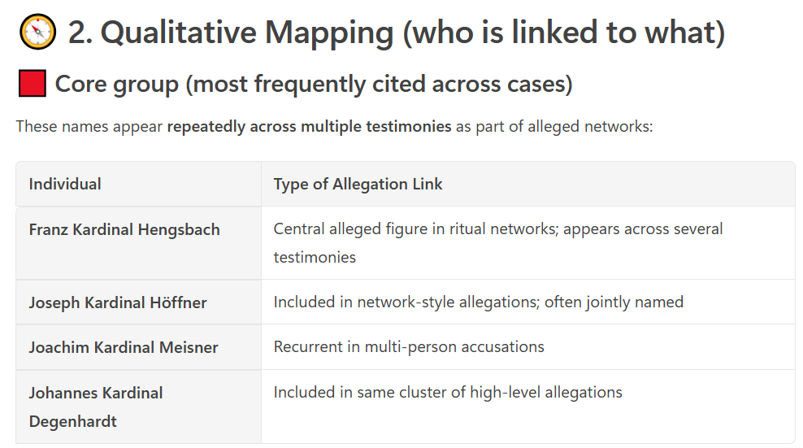
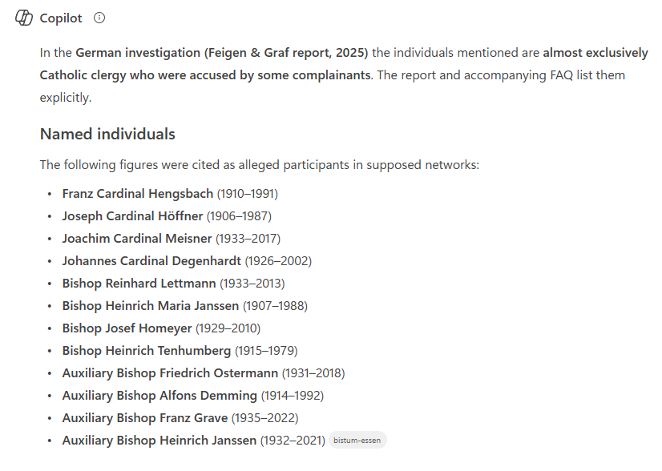
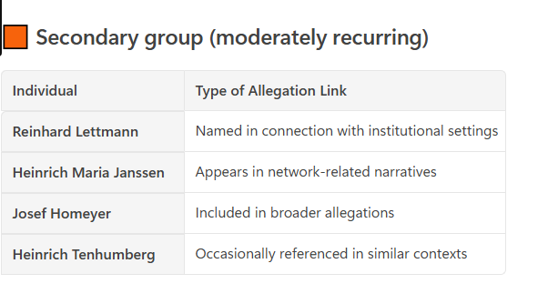
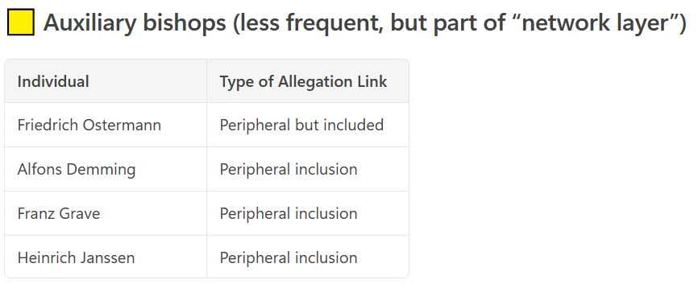
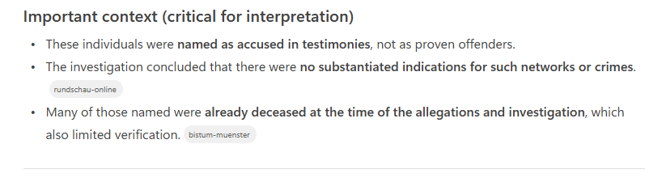
Notes:
---
This slide references information from the following file: https://hucamagroup-my.sharepoint.com/personal/rk_hucama_com/Documents/Microsoft%20Copilot%20Chat%20Files/NPCC%20NPCC-Organised-ritual-abuse-and-its-wider-context-Degradation-deception-and-disavowal-July-2025-v2.pdf
This slide contrasts how the two reports attribute alleged crimes and interpret narrative repetition. The German investigation is person-centred: allegations are mapped onto named individuals, often prominent figures, and assessed for internal consistency, specificity of roles, dates, and locations. A key finding is that the same severe allegations are repeatedly attached to different individuals without clear differentiation, leading investigators to conclude that names function interchangeably within a pre-existing narrative template. This interchangeability is taken as evidence against credibility. The NPCC report, by contrast, is structure-centred rather than person-centred. It emphasises that organised abuse, where it exists, typically operates through family systems and wider networks, often intergenerational, rather than through isolated individual perpetrators. From this perspective, repetition of themes across accounts is not inherently suspicious. Instead, it may reflect common dynamics of organised abuse, shared methods of control, and similar victim experiences. The two reports also diverge sharply in their treatment of narrative similarity. In the German analysis, repetition and thematic consistency are interpreted as signs of fabrication, contamination, or cultural scripting. In the clinical-psychological framework of the NPCC report, repetition is examined through trauma theory. Survivors of chronic abuse often report ‘gist-based’ memories rather than detailed episodic recall, leading to accounts that are thematically consistent but lacking in granular detail. Dissociation, fear, and coercion further shape how experiences are remembered and narrated. The NPCC report therefore treats similarity across testimonies as a phenomenon to be explained, not as proof of falsity. This slide makes clear that the same narrative features—repetition, extremity, and lack of differentiation—can be read either as red flags or as trauma-consistent patterns, depending on whether the analytical lens prioritises forensic discrimination or phenomenological understanding.

Slide 45
Names × Allegations × Interpretation
Individual / Group | Allegations | Catholic Church (Germany) | NPCC (UK)
Core Cardinals | Organised abuse, ritual, extreme acts | Repetition = narrative construction | Pattern typical of networks
Secondary Bishops | Group abuse, rituals | Lack specificity | Network layering
Auxiliary Bishops | Peripheral participation | Non-verifiable | Supporting roles
Clergy (generic) | Direct + facilitation roles | Vague identities | Operational layer
Across all | Torture, control, extreme violence | Implausible consistency | Trauma-consistent patterns

Slide 46
SAME DATA → DIFFERENT INTERPRETATION
Same Allegations
Catholic Church (GERMANY):
• Repetition = fabrication
• Extreme = implausible
• Network = conspiracy
NPCC (UK)
• Repetition = trauma pattern
• Extreme = control
• Network = organised abuse

