Slide 1

Survivorship Trafficking and Extreme Abuse Online Conference
May 16-17, 2026
Spinning Deeper into the Background:
Traces of Western Practices of Ritual Abuse in Mary Daly’s Gyn/Ecology and Other Texts
Lynn Brunet (PhD)

Slide 2
Psychobiography and the cultural historian
Goldwater Rule in the US:
“Nothing in this opinion precludes the psychological profiling of historical figures aimed at enhancing public and governmental understanding of these individuals.”
(American Psychiatric Association Ethics Committee. 2017).
Mary Daly (1928-2010)
A case study of a high-profile contemporary woman who emerged from the Catholic tradition.
The rise of occult practices within the Catholic religion
Leaders from the International Association of Exorcists (AIE) recently met with Pope Leo XIV to present their concerns and called for “every Catholic diocese worldwide to appoint at least one trained exorcist to handle complex cases.”
The Express, citing reports from EWTN Vatican and InfoVaticana. March 29, 2026.

Slide 3

Mary Daly
“Mary Daly was a Positively Revolting Hag, Amazonian adventurer, and Radical Lesbian-Feminist Philosopher. She Spun Her Webs on this Planet from 1928 until 2010.”
Mary Daly Reader, 450.
Born in Schenectady, New York, which she called a Catholic ghetto.
Educated in Catholic schools and even as a child she said she wanted to be a philosopher.
Her training to become a philosopher and theologian began in Catholic colleges and a Catholic university where she earned an Arts degree, followed by an MA in English and then a PhD in religion.
She then went to Fribourg University in Switzerland to complete two more PhDs, one in philosophy and one in sacred theology. She spent the early 1960s in Europe studying and teaching.
Coming back to the US, she was then employed at the Jesuit-run Boston College from 1966 to 1999.
Her first book was The Church and the Second Sex (1968). Mary Daly Reader, 2017

Slide 4

Childhood experiences
In Outercourse: The Bedazzling Voyage, published in 1992, Daly looked back on her upbringing during the Great Depression in the Catholic ghetto, her strong sense of her Irish nationality and her vague feelings, then, that something was terribly wrong.
Various holidays such as Christmas, Easter and Halloween, rather than producing a sense of delight, produce uneasy feelings, and movies like Dracula haunted her for many years. When she talks of Christmas Day, she also mentions the torture of her two white rabbits and being harassed by ‘dirty old men’ in parks.
“I knew that it was tapping into some horrible truth”.
Daly, Outercourse, 32.
Daly also notes that she was occasionally struck by intense magical or mystical states and experiences of complete wonder, such as when looking at a block of ice in the snow or a flower.
She coined one experience ‘The Dream of Green’ and thought that it had been inspired by her reading of mystical themes in Middle English texts such as Sir Gawain and the Green Knight.
Daly, Outercourse, 48.

Slide 5
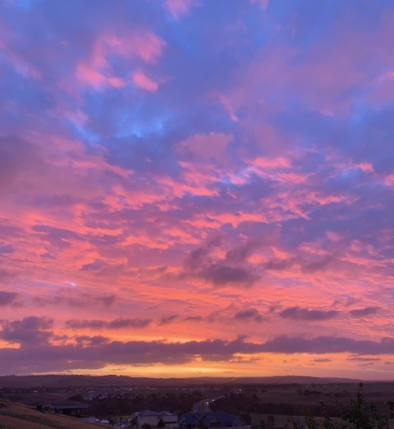
Beyond God the Father (1973)
“As long as God is imaged exclusively as male, then the male can feel justified in playing God.”
Mary Daly Reader, 40.
Daly gave a speech in 1971, during the presidency of Richard Nixon (1969-1974). Here, she described Christianity in the US as “a civil religion in which ‘God’, the Savior-President, and ‘our nation’ more or less merge … Under God, the president becomes a Christ figure.”
Mary Daly Reader, 64.
Later, she states “patriarchy is the prevailing religion of the entire planet.”
Daly, Gyn/Ecology, 39.

Slide 6
What is Radical Feminism?
Definitions of Radical Feminism vary with different emphasis on dismantling the Patriarchy as the root cause of women’s oppression, challenging gender roles, ending sexual violence, emphasising reproductive control, and so on.
Daly’s definition is “a way of be-ing” characterised by:
a) an Awesome and Ecstatic sense of Otherness from patriarchal norms and values
b) conscious awareness
c) moral outrage
d) commitment
She defines “be-ing” as participatory divine energy or God the Verb.
Daly & Caputi, Webster’s First New Intergalactic Wickedary of the English Language, 1987.

Slide 7

Gyn/Ecology: the Metaethics of Radical Feminism (1978)
“My thunderbolt of rage” and “an invitation to the Wild Witch in all women who long to spin” Daly, Gyn/Ecology, xv.
Primary metaphor – spinning; she talks about “ecstatic spiral journeys” that involve exorcism.
Exorcism: a series of A-mazing Acts of Dispossession, expelling both internal and external manifestations of the godfather; Naming the demons who block each passage of the Otherworld Journey and thereby ousting these obstacles to the Ecstatic Process.
Daly & Caputi, Wickedary, 75.

Slide 8
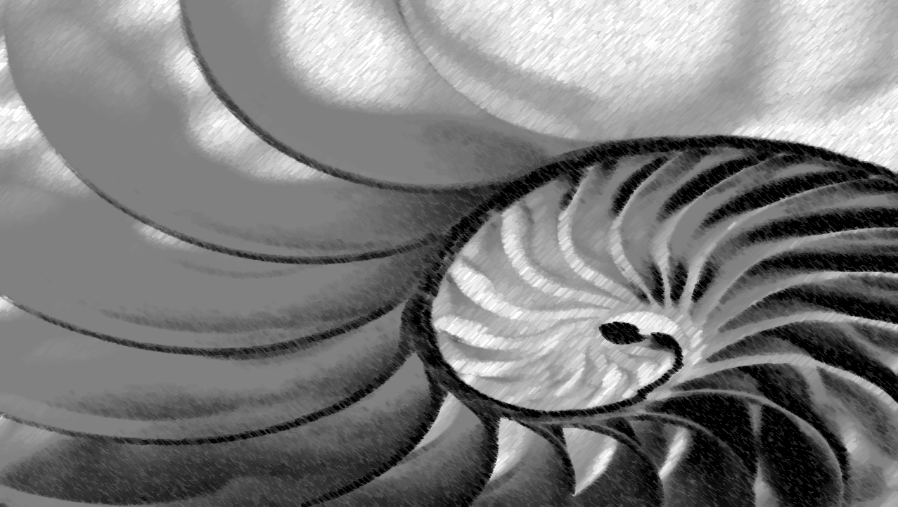
Spinning and the Mystical Tradition
At the beginning of Gyn/Ecology Daly mentions the Whirling Dervishes, the 13th century Turkish practitioners of Sufism, where spinning is aimed at achieving a state of spiritual ecstasy and divine love. She relates them to the concept of the Spinster, which she defines as a woman who is Self-identified, spinning in a new time/space, and places the journeying necessary for this newly identified radical feminist in the context of mystical journeys, quests and the creation of cosmic tapestries.
Daly, Gyn/Ecology, 3-4.
She also acknowledges the Classical tradition of initiation in the myths of Athena who was ‘twice-born’ and of Persephone, who was reborn through the act of rape.
Daly, Gyn/Ecology, 8, 40.
So, at the outset of this book Daly is placing spinning in the same category as the spiritual and initiatory practices of the medieval and ancient worlds.

Slide 9

The Irish Initiatory Tradition
Daly called Ireland “that Treasure Island which I recognize deeply as the wellspring of my Background” Mary Daly Reader, 356.
The Irish Initiatory tradition was overseen by the Druids, the priests and teachers of the ancient Celts in Ireland.
Druidic initiation was where initiates, often warriors, would emerge ‘twice-born’. It was euphemistically known as the ‘mystic fire’, finally leading to the emergence into a blaze of light.
It allowed its initiates to enter the Irish Otherworld.
Tírna nÓg, the Land of Youth
Tir Tairngiré, the Land of Promise
Tir inna mBan, the Land of Women or Maidens.
Rutherford, Celtic Lore. The History of the Druids and Their Timeless Traditions, 1995.
Ritual Abuse is said to be connected with Gnostic practices as well as the Scottish and Irish Druidic tradition that spread across the western world in the course of migration.
Sakheim & Devine, Out of Darkness, 1992;
Noblitt & Perskin, Cult and Ritual Abuse, 1995.

Slide 10

St Patrick in Ireland
5th Century Christian Missionary
St Patrick’s Purgatory was celebrated at Lough Derg in County Donegal in Ireland. For Catholics, Lough Derg is the most sacred lake in Ireland and pilgrimages to the lake are continued to this day. In its earlier forms it was a practice whereby a priest would be locked up for long periods in a cave, known as the Cave of Death. It would serve as an entry to Purgatory or Hell and was used for intense spiritual penance. This involved a series of frightening trials, in order to test his faith.
Dames, Ireland. A Sacred Journey,15-39.
From the perspective of modern Druids, Lough Derg was also thought to have been a site of Druidic initiation.
Wright, Druidism, 62; Matthews, Druid Source Book, 266.
By the 20th century the concept of St Patrick’s Purgatory as the ‘Cave of Death’ had become a doctrine that was taught to Catholic children where they were expected to enter “the Cave of Death where they too would be required to stride into the flames”.
Dames, Ireland, 24.

Slide 11
Cathy O’Brien
Trance Formation of America. The True Life Story of a CIA Mind Control Slave, 1995
At the age of 9 she was dressed in white for her first holy communion. After the ceremony she was told by the priest and another man that she was a Chosen One.
Travelling through dimensions
“Christ saw them all … They are dimensions, places you see on your way to death. That’s why they are called die-mentions. You must remember that Christ died and came back to tell us everything he saw on his way to Heaven … Purgatory is one. Hell is one … Oz is another … You can travel in and out of all these dimensions, learning the secrets of the universe. You have been chosen to explore these other worlds for the church. Listen in the stillness and you will hear his voice guiding you on your missions.”
Phillips & O’Brien, 1995, 88.

Slide 12
Gyn/Ecology
A blend of the Druidic tradition, St Patrick’s Purgatory,
and Gnostic practices
Travel through gateways
“The demons who attempt to block the gateways to the deep spaces of this realm often take ghostly/ghastly forms, comparable to noxious gases not noticeable by ordinary sense perception. Each time we move into deeper space, these numbing ghostly gases work to paralyse us, to trap us, so that we will be unable to move further. Each time we succeed in overcoming their numbing effect more dormant senses come alive. Our inner eyes open, our inner ears become unblocked. We are strengthened to move through the next gateway and the next. This movement inward/outward is be-ing. It is spinning cosmic tapestries. It is spinning and whirling into the Background.” Daly, Gyn/Ecology, 2.
Locked up in coffins
“Since Gyn/Ecology Spins around, past, and through the established fields, opening the coffers/coffins in which ‘knowledge’ has been stored, re-stored, re-covered, its meaning will be hidden from the Grave Keepers of tradition”. Daly, Gyn/Ecology, xiii.

Slide 13
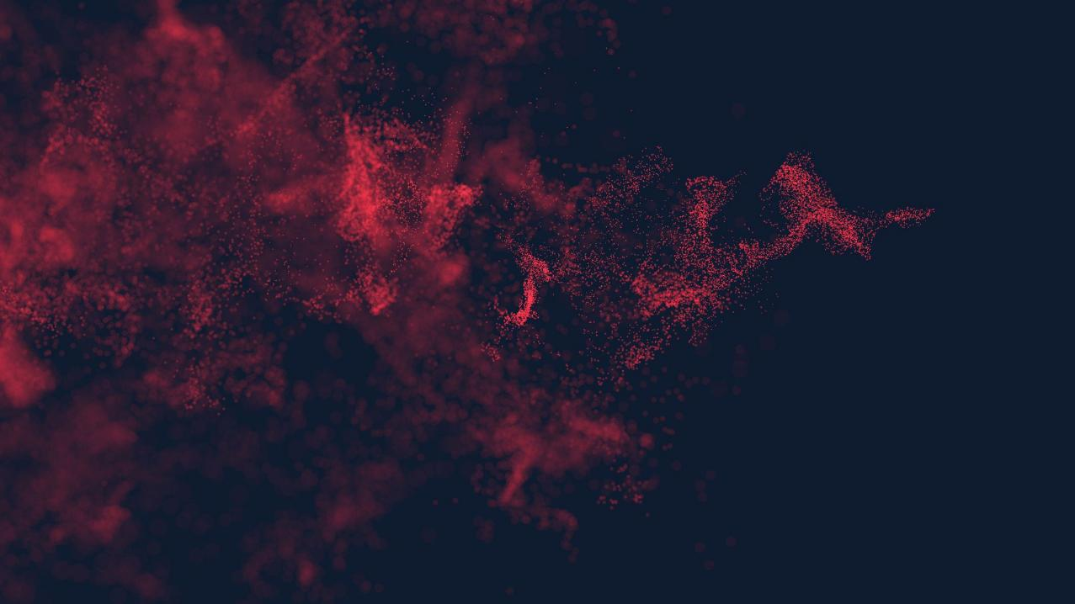
Passage through Fire
Daly’s idiosyncratic language describes this part of the passage in terms of ‘Pyrospheres’, and women voyagers as Pyrognostic seekers. When exhorting the Pyrognostic seeker to practice Pyrosophic Temperance she states, “Wild Temperance is Salamandrous … living as it were in fire: fiery, hot, passionate”. Daly, Pure Lust. Elemental Feminist Philosophy, 1984, 221, 224.
Salamander - an important symbolic animal all through the medieval period. Used as a symbol in the Gnostic tradition because of its capacity to survive in fire due to its tough asbestos-like skin.
Marty-Dufaut, Les Animaux du Moyen Age réels et mythiques , 2005, 125-129..
The ‘mystic fire’ of the Druidic and Gnostic traditions thus appeared to be associated with a toughening process.
A former Chief Druid of a contemporary order of Druidry, Ross Nichols, notes that the magicians of pre-Christian Ireland sometimes dipped or annealed children in the mystic fire in a form of baptism:
I set the child on the red-hot coal
to burn the human from his soul
Nichols, The Book of Druidry, 1992, 36..

Slide 14
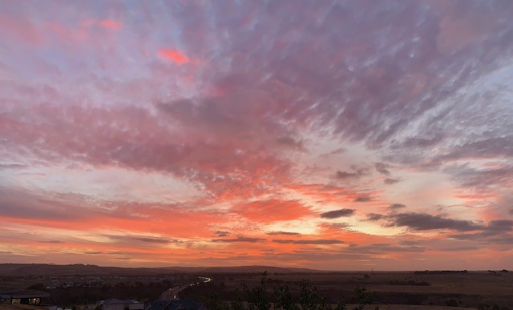
Emergence into a blaze of light
“As the Voyager Moves farther and farther Out, the light becomes brighter. The foreground fades and its demon inhabitants/rulers are overcome by the power of the Background. They are eclipsed by the brilliance of being – which is participation in Be-ing”.
Daly, Outercourse, 6.
Daly defines this Otherworld Journey as the “Metapatriarchal Labyrinthine Journey of Exorcism and Ecstasy in the course of which patriarchal demons are dispelled by Voyagers, discovery of a world Other than patriarchy”.
Daly & Caputi, Wickedary, 87.
In Daly’s language “this exorcising Passage gives the Voyager the right of passage into the Otherworld”.
Daly, Gyn/Ecology, 41.

Slide 15

The realm of Sado-Ritual tortures
Foreground, she says, is male-centred and mono-dimensional; it is the realm of Sado-Ritual tortures. “Breaking through the Male Maze is both exorcism and ecstasy. It is spinning through and beyond the fathers’ foreground which is the arena of games”.
Daly, Gyn/Ecology, xiii, 2.
The Sado-Sublime - “a system of symbols which allows believers to indulge self-righteously in refined, perfected, heightened lechery”. Daly, Wickedary, 94. She notes that, “the journey is rough”. Gyn/Ecology, 112.
The Background is “the realm of the wild reality of women’s Selves”. Daly, Gyn/Ecology, 2.
By letting go of the Foreground the Voyager on this part of the Journey can move into the Background or the Otherworld, “the world of her own Enspiriting, Sparking, Spinning Ecstasy”. Daly, Gyn/Ecology, 112.
Later, in Gyn/Ecology she describes a sense of splitting as a result of this patriarchal invasion: “Consciousness split against itself … her consciousness is fragmented, so that she loses the thread of connectedness in her being.”
Daly, Gyn/Ecology, 386.

Slide 16
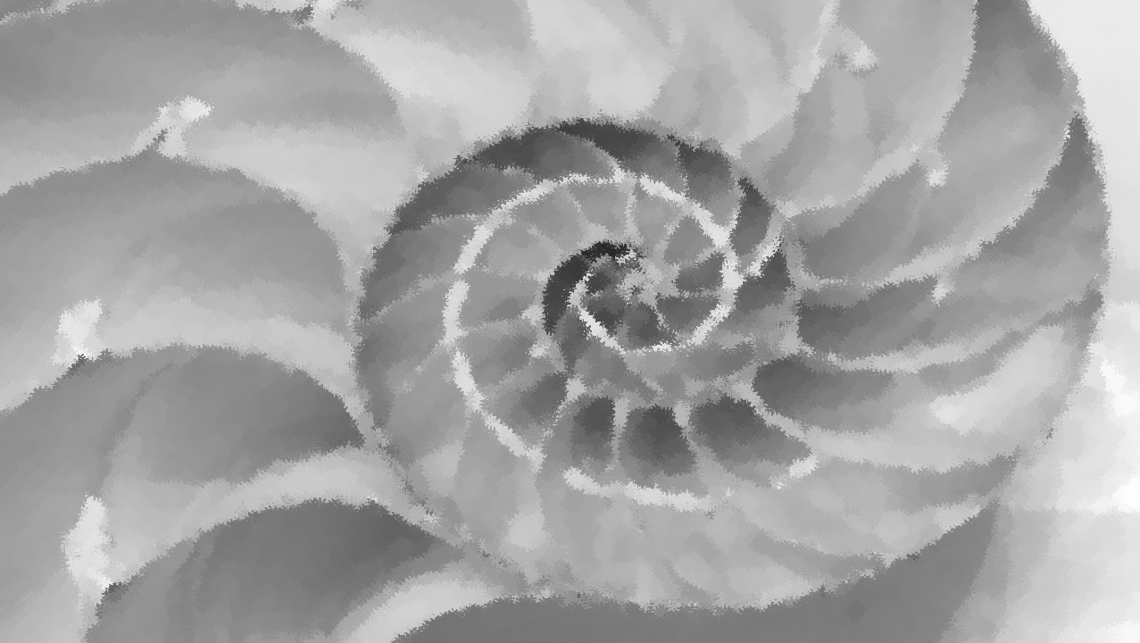
Spinning Counterclockwise
“Women spinning counterclockwise counter the ‘wisdom’ of Father Time … Spinsters are spiralling columns. At the same time, we are the eye of the cyclone - centering, seeing. This cyclone moves counterclockwise, countering the grandfathers’ clocks that clog the movement of being …”
Daly, Gyn/Ecology, 390-392.
In Outercourse she refers to the Voyage of Radical Feminist Philosophy as “moving Counterclockwise … that is, knowing how to Live, Move, Act in Fairy Time/Tidal Time”.
Daly, Outercourse, 2.
In early Ireland, the pagans who turned ‘left-hand’ were known as sidhaighi or ‘mound-dwellers’ and were regarded as a race of tricksters who performed initiatory rites in or around the many sacred mounds or tumuli in Ireland. They became known as the ‘fairies’.
´O h´Ogáin, The Sacred Isle, 1999, 213;
Bonwick, Irish Druids and the Old Irish Religions, 1894, 104.

Slide 17

Trickery, Deception and Winding Sheets
She talks of the trickery and Deception of the Fathers: “The basic sin of Phallocracy is deception”.
Daly, Gyn/Ecology, 30.
“I Sensed subliminally that there was a plot afoot – that this was a Dirty Trick”.
Daly, Outercourse, 17.
Daly refers to winding sheets when she says: “Spinning deeper into the Background is courageous sinning against the Sins of the Fathers. As our senses become more alive we can see/hear/feel how we have been tricked by their texts. We begin unweaving our winding sheets …When women unwind our veils, our winding sheets, our attention is at first fixed upon the unwinding”.
Daly, Gyn/Ecology, 6, 339.

Slide 18

“Re-membering is the remedy”
“Re-membering is the remedy … No longer comatose, the Self refuses to be a ‘candidate’ for such sacraments … The dis-covered Self refuses the white robes of these initiations into the rank realms of the living dead”.
Daly, Gyn/Ecology, 338.
“She forgets the identity of her torturer – and often the fact that there was/is a torturer – who gave her the problem she now seeks to solve … Women often deeply forget who they were before the destruction inflicted upon them in rapist society and they forget the destruction. This forgetting, interlaced with partial memory, debilitates, and it is rooted in fear … For memories do come in ribbons/chains and, as we have seen, many of these – if a woman allows herself to really feel them – are excruciating … a woman who Names deep Memory – any part of it that she can catch – makes the hope of Memory more accessible to other women, for, as we have seen, memories are connected … This re-membering is the most radical, the most necessary activism”.
Daly, Pure Lust, 1984, 170; Gyn/Ecology, 178.

Slide 19
Looking for answers elsewhere and the backlash against her work
Three case studies in Gyn/Ecology:
Indian suttee – Chinese foot-binding – African genital mutilation
She also mentions attacks on Japanese girls spinning yarn in a textile factory by men’s secret societies and European witch-burning
The closest she gets to her own society is in her mention of American gynecology.
“Open Letter to Mary Daly” from Audre Lorde – saying that Daly’s position was very Eurocentric.
Uma Narayan – said that Daly’s discussions of Third World women’s situations lacked depth.
Weedon, Feminism, Theory and the Politics of Difference, 2000, 39, 192.
“Third World women, women of color, and transgender people all had well-publicized disagreements with Daly, some of them resulting in permanent severing of connections and conversations”.
Mary Daly Reader, 2.
One of the outcomes of projection onto, and identification with another’s pain without acknowledging one’s own, can be the problem of misinterpretation, over-generalisation and a failure to allow the victim to speak from her own perspective.

Slide 20

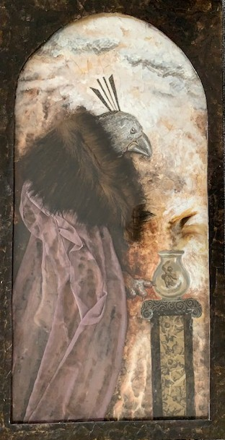
Furies, Crones and Hags
“The Background into which feminist journeying spins”, she says, “is the wild realm of Hags and Crones. It is Hagocracy”. Daly, Gyn/Ecology, 2.
The Roman historian Tacitus says:
“On the shore stood the opposing army with its dense array of armed warriors, while between the ranks dashed women in black attire like Furies, with hair dishevelled waving brands”. The Druidesses ferociously promoted war and many of the Irish goddesses, also known as the Furies, were warmongers.
´O h´Ogáin, The Sacred Isle, 95; Bonwick, Irish Druids, 140.
Lynn Brunet, “The Crone”, 1999.

Slide 21

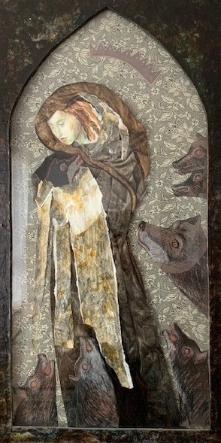
Feminist Goddess worship
In her summary of the development of feminist spirituality in the 1990s Annette Van Dyke states:
“For Euro-American women seeking a woman-centred spiritual heritage, Celtic traditions offer real possibilities”.
Van Dyke, The Search for a Woman Identified Spirituality, 1992, 89.
The Celtic Fairy tradition was embraced by self-identified witches such as Starhawk (Miriam Simos) who, like Daly, adhered to the concept of the Irish Otherworld as the Land of Women and incorporates many references to spinning and whirling themes, set in the context of cosmic consciousness. Starhawk regards the Goddess peoples as the Sidhe, the Picts or Pixies, the Fair Folk or Faeries.
Van Dyke, 1992.
Lynn Brunet, “The Morrigan” (Celtic goddess), 1999.

Slide 22

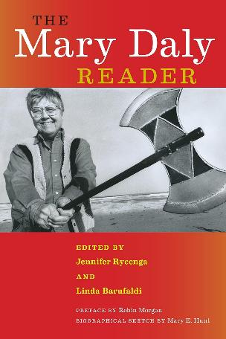
Mary Daly
Passionate, fiery warrior for the rights of women
Victor Turner notes one of the by-products of the liminal state of initiation is the ludic, in which the mind is thrust into a state of associative thinking.
Liminality: “the realm of primitive hypothesis, where there is a certain freedom to juggle with the factors of existence”. Playful free association leading to ingenuity, novelty, and fresh ways of seeing the world.
Carus Mahdi et al, Betwixt and Between:
Patterns of Masculine and Feminine Initiation, 15.
Daly uses the term Ludic Cerebration:
“thinking out of the experience of being; the free playful intuition in New Space, giving rise to thinking that is vigorous, informed, multidimensional, independent, creative, tough”
Daly, Gyn/Ecology, 143.
Credit: Gail Bryan, photographer
New York University Press, 2017.

