Slide 1
Creating Calm
Pat Quinn MS, LCAT – Artist, Creative Art Therapist

Slide 2
Agenda
Getting Around Old Ideas
Variety of Art Materials
Some Resources for Calm
Creating Calm
Optional Sharing

Slide 3
Getting Around Old Ideas
Creativity generates novel experiences
It anchors us in the moment
It helps us move forward
It can bridge to the unconscious
Art reveals or it can cover up
Art supplies are nurturing
Art gives control
Arts sensori-motor properties connect emotions to higher thinking

Slide 4
Use & Effect of Art Media
Controlled
Lead and colored pencils, oil pastels
markers,, printing, Wood, metal, stone ,plastilene clay sculpting
Expressive
painting with brush and watercolor, acrylic, tempera, oil
ink pen, model magic clay, collage, soft pastels,crayons, assemblage
Regressive
(Super Messy)
water based paint or clay, playdough
stamping, rubbing on soft pastels textures, sponge and finger painting
Kagin & Lusebrink 1978

Slide 5
Using Art to Support a Goal or Intention

Slide 6
Finding Calm

Slide 7
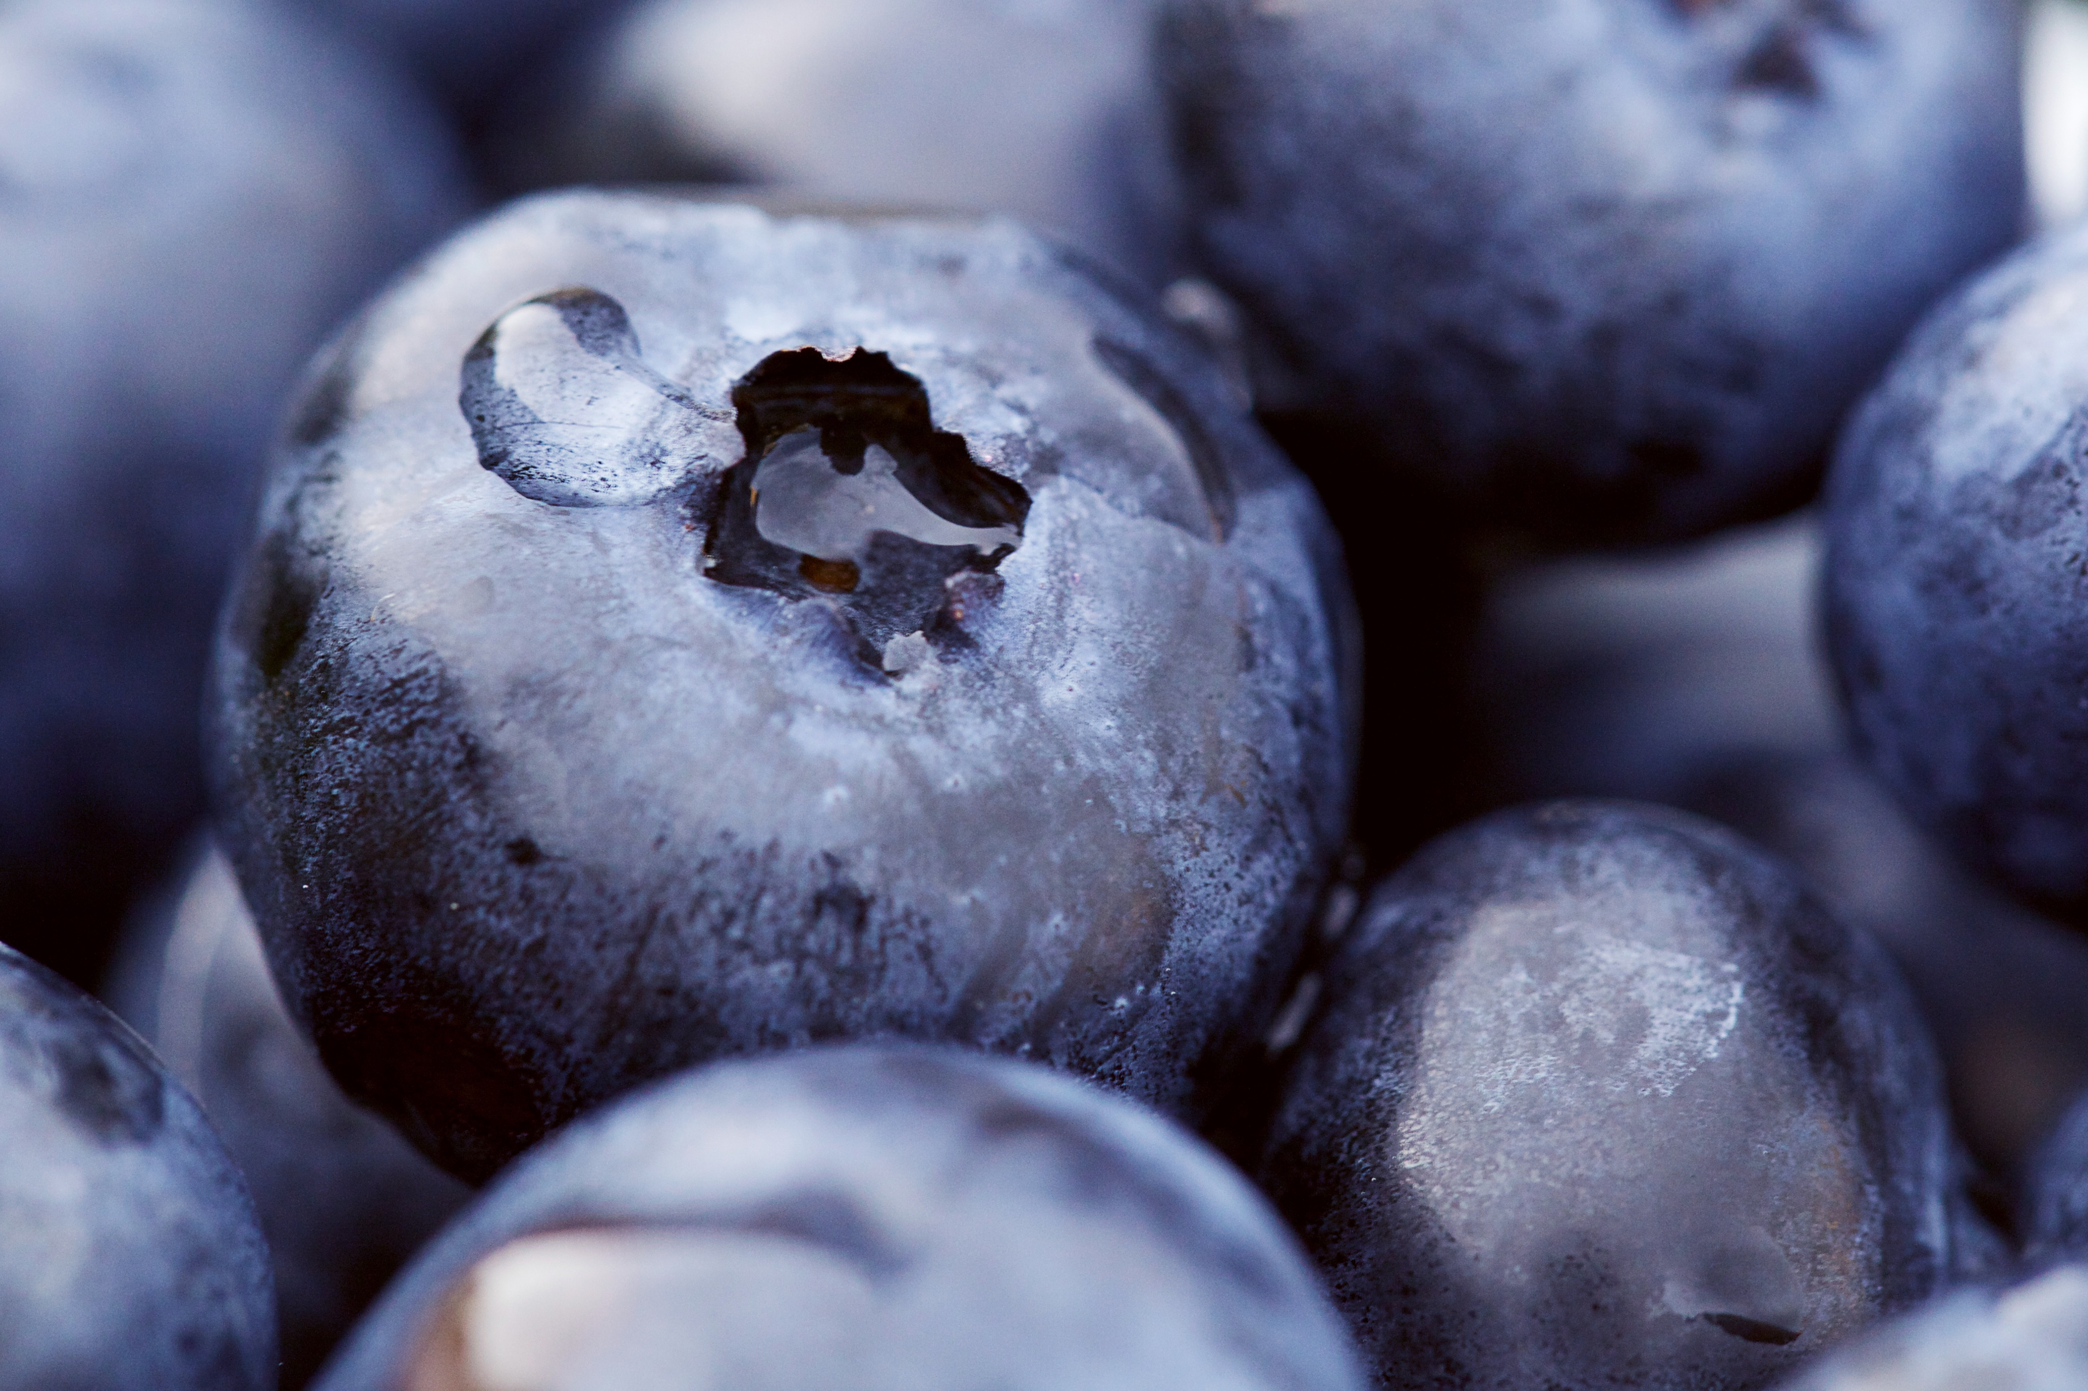
Some Ways
Finding gratitude
Feeling grounded in stillness
Rhythmic breathing, tapping, swaying
Following a wish for the innate order and healing of now
Appreciating self/selves
Allowing balance to occur
Caring for others

Slide 8
Thank you
Pat
Email address: phq1988@gmail.com

