Slide 1
Some Evidence-Based Practice Guidelines and Standards Relevant to the Psychological Care of Extreme Abuse Survivors
Randy Noblitt PhD
Alliant International University

Slide 2
Some Evidence-Based Practice Guidelines and Standards Relevant to the Psychological Care of Extreme Abuse Survivors
We will review the APA’s (2021) Professional Practice Guidelines for Evidence-Based Psychological Practice in Health Care, and discuss its relevance to the care of extreme abuse survivors. We will also critically examine Clinical Practice Guideline for the Treatment of Posttraumatic Stress Disorder (PTSD) in Adults (APA, 2017) and the ISSTD (2011) Guidelines for Treating Dissociative Identity Disorder in Adults, Third Revision. Included will be discussion of the roles of common factors and empirically supported treatments in implementing guidelines and standards.

Slide 3
Learning Objectives
Attendees will be able to
Identify the APA’s three components of Evidence-Based Practice in Psychology (EBPP)
Distinguish empirically supported treatments from common factors
Discuss Norcross & Wampold’s critique of Clinical Practice Guideline for the Treatment of Posttraumatic Stress Disorder (PTSD) in Adults.

Slide 4
Outline
A. Introduction to Professional Standards and Guidelines
B. APA’s (2021) Professional Practice Guidelines for Evidence-Based Psychological Practice in Health Care
C. Clinical Practice Guideline for the Treatment of Posttraumatic Stress Disorder (PTSD) in Adults (APA, 2017) Review and Critique
D. Guidelines for Treating Dissociative Identity Disorder in Adults, Third Revision.

Slide 5
Introduction to Professional Standards and Guidelines: Jurisdiction
This presentation addresses Standards and Guidelines published by the American Psychological Association (APA).
There are other mental health professions in the U.S. and throughout the world. The APA does not have jurisdiction over professions other than its own. Nevertheless, there is often some overlap among different mental health professions internationally.

Slide 6
Introduction: Professional Standards
Mandatory
Enforceable
Are enumerated in
American Psychological Association. (2017). Ethical principles of psychologists and code of conduct (2002, Amended June 1, 2010 and January 1, 2017). Retrieved from apa.org/ethics/code/index.aspx

Slide 7
Introduction: Professional Practice Guidelines and Clinical Practice Guidelines
Aspirational
Professional “practice guidelines provide psychologists guidance on roles, patient populations, or practice settings, whereas clinical practice guidelines systematically summarize the evidence base on the efficacy of treatments for specific health conditions” (2021, p. 9).

Slide 8
Three Components of Evidence-Based Practice
EBPP
Best Available Research
Patient Characteristics, Culture, and Preferences
Clinical Expertise
From APA (2021, p. 4)

Slide 9
Empirically Supported Treatments (ESTs) vs. Evidence-Based Practice (EBP)
EBP “involves a decision-making process for integrating research, clinical expertise, and patient characteristics, culture, and preferences to achieve the best outcome for the patient. In contrast, ESTs are specific treatment methods found to be efficacious for certain conditions or problems under specified circumstances in controlled clinical trials” APA (2021, p. 4).

Slide 10
Empirically Supported Treatments (ESTs) vs. Evidence-Based Practice (EBP)
Division 12 of the APA the Society of Clinical Psychology has supported and disseminated what they call empirically-supported treatments. Currently they list 88 different ESTs( see https://div12.org/treatments/), but much of their posted information about ESTs is equivocal and outdated. Their postings are characteristically manualized treatments with supportive RCTs. Many widely accepted treatments are not manualized, and have not been studied through RCTs, although they may have other evidentiary support.

Slide 11
Laska,Gurman, and Wampold’s (2014) “Expanding the Lens of Evidence-Based Practice in Psychotherapy: A Common Factors Perspective”
In their article the authors show at least two different pathways to Evidence-Based Practice through psychotherapy common factors and ESTs.
The authors cited surveys that showed that both clinical psychology graduate students and practicing psychologists conflated EBP and EST.

Slide 12
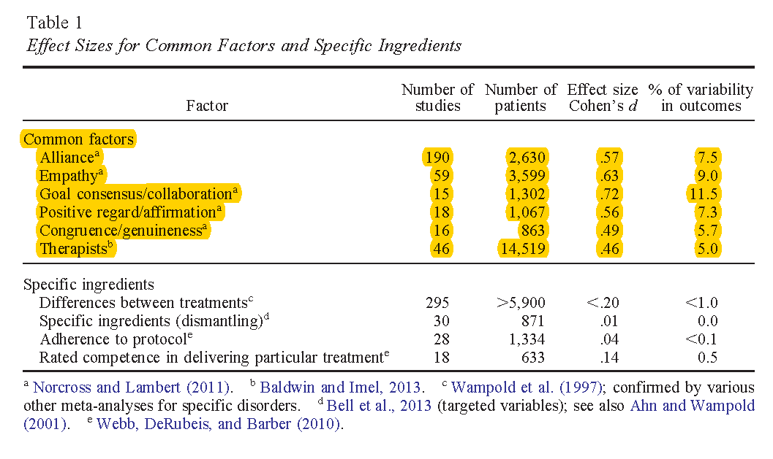
Laska,Gurman, and Wampold’s (2014) comparison of CF and ESTs

Slide 13
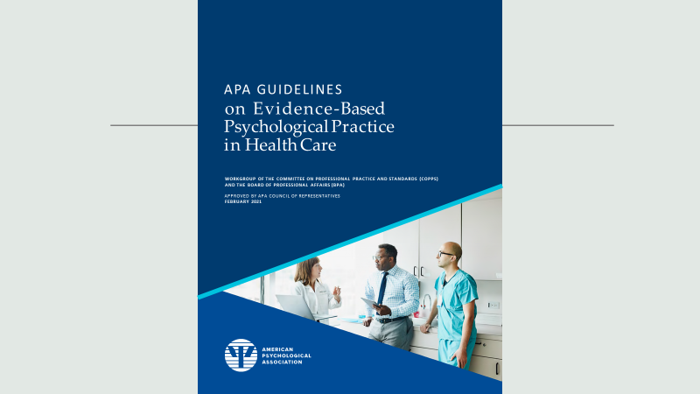

Slide 14
Overview of the Guidelines: THE INTERVENTION PROCESS
Guideline 1: Psychologists are mindful of the principles and importance of evidence-based practice.
Guideline 2: Psychologists strive to maintain and enhance their knowledge of the research and scholarly literature applicable to their practice.
Guideline 3: Psychologists endeavor to conduct assessments that are appropriate for the setting, purpose, and population.
Guideline 4: Psychologists seek to participate in collaborative treatment planning with patients and others when appropriate.

Slide 15
Overview of the Guidelines THE INTERVENTION PROCESS (continued):
Guideline 5: Psychologists aim to cultivate and maintain effective therapeutic relationships, therapist characteristics, and change principles.
Guideline 6: Psychologists endeavor to adapt their clinical approach to patient characteristics, culture, and preferences in ways that increase effectiveness.
Guideline 7: Psychologists aim to monitor the treatment process and clinical outcomes routinely.
Guideline 8: Psychologists seek to modify their clinical approach when appropriate and terminate treatment when the patient is no longer benefitting or when treatment goals have been met.

Slide 16
Overview of the Guidelines COLLABORATION AND WHOLE HEALTH
Guideline 9: Psychologists endeavor to collaborate with other professionals when appropriate to facilitate effective care.
Guideline 10: Psychologists strive to promote overall patient health, functioning, and well-being.

Slide 17
Guideline 1: Psychologists are mindful of the principles and importance of evidence-based practice.
Professional “psychology is deeply committed to EBPP in health care for several reasons. First, EBPP is grounded in reliable research evidence. This research evidence is not limited to therapeutic methods but extends to the entire treatment process including the therapeutic relationship, different facets of clinical expertise, and the patient’s biopsychosocial characteristics, intersecting identities, and circumstances” (APA, 2021, p. 8).

Slide 18
Guideline 1: Psychologists are mindful of the principles and importance of evidence-based practice.
“EBPP involves the development of effective therapist interpersonal skills that facilitate strong therapeutic relationships . . . EBPP entails flexibly tailoring services to patient characteristics, culture, and preferences, which minimizes dropout and improves outcomes (Swift, Callahan, Cooper, & Parkin, 2018) . . . . psychologists’ commitment to EBPP ensures that practice and training do not stagnate over time but rather continue to advance in accordance with the best available research, development of clinical expertise, and the field’s growing understanding of how to adapt treatment to each patient . . . . EBPP has the potential to enhance health by increasing societal access to effective care” (APA, 2021, p. 8).

Slide 19
Guideline 1: Psychologists are mindful of the principles and importance of evidence-based practice.
“As psychologists strive to provide the most effective care, they have an important opportunity to identify and disseminate all of the active ingredients in evidence-based practice, enhance public health, influence mental health policies, and drive the field toward offering the best possible psychological services” (APA, 2021, p. 8).
[note the emphasis on “active ingredients].

Slide 20
Guideline 2: Psychologists strive to maintain and enhance their knowledge of the research and scholarly literature applicable to their practice.
This guideline discusses some of the limitations of scientific methods including RCTs, but they did not cite the publications of Alexander Krauss that rigorously conceptually and empirically critique RCTs (e.g., Krauss, 2018).
[They also do not discuss the recently identified research replication crisis (e.g., Open Science Collaboration, 2015) where the authors estimated that they were able to replicate the findings of less that 40% of their sample of 100 empirical studies investigated.]

Slide 21
Guideline 3: Psychologists endeavor to conduct assessments that are appropriate for the setting, purpose, and population.
“Assessment is often an ongoing process that occurs throughout treatment, from the initial intake through periodic progress monitoring [e.g., routine outcome monitoring] to evaluation of final therapy outcomes” (p. 10).
[What kind of assessments would likely be helpful with extreme abuse survivors?]

Slide 22
Guideline 4: Psychologists seek to participate in collaborative treatment planning with patients and others when appropriate.
“When recommending a treatment, they strive to rely on the best available research, their clinical expertise, applicability of the treatment to the setting and patient characteristics, as well as patient values and preferences” (p. 11).

Slide 23
Guideline 5: Psychologists aim to cultivate and maintain effective therapeutic relationships, therapist characteristics, and change principles.
They discuss the importance of common factors (sometimes identified as nonspecific factors; also see Laska et al., 2014).

Slide 24
Guideline 5: Psychologists aim to cultivate and maintain effective therapeutic relationships, therapist characteristics, and change principles.
[They mention trauma:]
“investment in the therapeutic relationship may be particularly critical in psychotherapy with individuals who have PTSD, other trauma-related disorders, attachment disorders, or personality disorders. These individuals often have difficulty trusting others (Zurbriggen, Gobin, & Kaehler, 2012), may have a history of invalidating interpersonal experiences, and might lack a foundation for secure attachments” (pp. 13–14).

Slide 25
Guideline 6: Psychologists endeavor to adapt their clinical approach to patient characteristics, culture, and preferences in ways that increase effectiveness. .
[Trauma is mentioned again:]
“patients with a trauma history often avoid thinking and talking about their trauma, and this avoidance impedes emotional processing and delays symptom resolution” (p. 14).
[Are trauma survivors an underserved population or culture?]

Slide 26
Guideline 7: Psychologists aim to monitor the treatment process and clinical outcomes routinely. .
[routine outcome monitoring]
“The emergence of additional presenting problems (e.g., revelation of trauma or substance misuse) or compelling research evidence may suggest that a change to the clinical approach is indicated” (p. 15).

Slide 27
Guideline 8: Psychologists seek to modify their clinical approach when appropriate and terminate treatment when the patient is no longer benefitting or when treatment goals have been met. .

Slide 28
Guideline 9: Psychologists endeavor to collaborate with other professionals when appropriate to facilitate effective care.

Slide 29
Guideline 10: Psychologists strive to promote overall patient health, functioning, and well-being.

Slide 30
APA’s (2021) Professional Practice Guidelines for Evidence-Based Psychological Practice in Health Care: Summary Comments
Devotes very little material to trauma, nothing about extreme abuse per se.
Clarifies that ESTs are not equivalent to EBP.
RCTs are not the only way to substantiate hypotheses.
The expectation is that EBP will reflect a broad and thorough knowledge of the literature including empirical research and that knowledge will be used by clinicians exercising clinical competence, with respect for the characteristics, culture(s) and preferences of “patients.”

Slide 31
The Professional Practice Guidelines for Evidence-Based Psychological Practice in Health Care make several references to
Recognition of Psychotherapy Effectiveness (APA, 2012, 2013)
This is a policy statement about psychotherapy effectiveness passed by the APA Council of Representatives in 2012 and published in Psychotherapy in 2013.

Slide 32
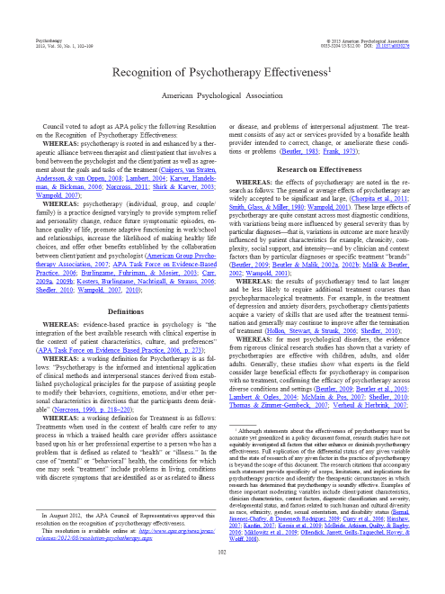

Slide 33
Recognition of Psychotherapy Effectiveness (APA, 2013)
“the effects of psychotherapy are noted in the research as follows: The general or average effects of psychotherapy are widely accepted to be significant and large, (Chorpita et al., 2011; Smith, Glass, & Miller, 1980; Wampold, 2001). These large effects of psychotherapy are quite constant across most diagnostic conditions, with variations being more influenced by general severity than by particular diagnoses—that is, variations in outcome are more heavily influenced by patient characteristics for example, chronicity, complexity, social support, and intensity—and by clinician and context factors than by particular diagnoses or specific treatment “brands” (Beutler, 2009; Beutler & Malik, 2002a, 2002b; Malik & Beutler, 2002; Wampold, 2001)”
APA 2012, p. 102)

Slide 34
Recognition of Psychotherapy Effectiveness (APA, 2013)
“comparisons of different forms of psychotherapy most often result in relatively nonsignificant difference, and contextual and relationship factors often mediate or moderate outcomes. These findings suggest that (1) most valid and structured psychotherapies are roughly equivalent in effectiveness and (2) patient and therapist characteristics, which are not usually captured by a patient’s diagnosis or by the therapist’s use of a specific psychotherapy, affect the results” (APA 2012, p. 103)

Slide 35
Recognition of Psychotherapy Effectiveness (APA, 2013)
There are no APA treatment guidelines for extreme abuse survivors, nor those with dissociative disorders. So we will review APA (2017) Clinical Practice Guideline for the Treatment of Posttraumatic Stress Disorder (PTSD) in Adults (https://www.apa.org/ptsd-guideline/ptsd.pdf) and the ISSTD’s Guidelines for Treating Dissociative Identity Disorder in Adults, third revision.

Slide 36
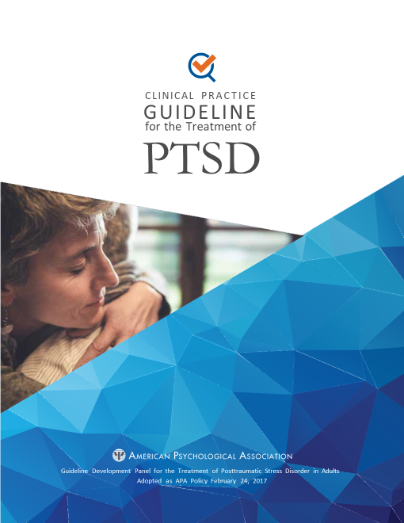

Slide 37
Clinical Practice Guideline for the Treatment of Posttraumatic Stress Disorder (PTSD) in Adults
“the APA Guideline Development Panel (GDP) strongly recommends the use of the following psychotherapies/interventions . . . for adult patients with PTSD: cognitive behavioral therapy (CBT), cognitive processing therapy (CPT), cognitive therapy (CT), and prolonged exposure therapy (PE). The panel suggests the use of brief eclectic psychotherapy (BEP), eye movement desensitization and reprocessing (EMDR), and narrative exposure therapy (NET). There is insufficient evidence to recommend for or against offering Seeking Safety (SS) or relaxation (RLX)” (2017, p. ES-2).

Slide 38
Clinical Practice Guideline for the Treatment of Posttraumatic Stress Disorder (PTSD) in Adults
“For medications, the panel suggests offering the following (in alphabetical order): fluoxetine, paroxetine, sertraline, and venlafaxine. There is insufficient evidence to recommend for or against offering risperidone and topiramate” (APA, 2017, p. ES-2).

Slide 39
Clinical Practice Guideline for the Treatment of Posttraumatic Stress Disorder (PTSD) in Adults
There have been a variety of criticisms of this clinical practice guideline. We will review
Dominguez S. K., & Lee C. W. (2017) Errors in the 2017 APA Clinical Practice Guideline for the Treatment of PTSD: What the data actually says. Frontiers in Psychology, 8,14–25. https://doi.org/10.3389/fpsyg.2017.01425
Norcross, J. C., & Wampold, B. E. (2019). Relationships and responsiveness in the psychological treatment of trauma: The tragedy of the APA Clinical Practice Guideline. Psychotherapy, 56(3), 391–399. https://doi.org/10.1037/pst0000228

Slide 40
Dominguez & Lee (2017) Errors in the 2017 APA Clinical Practice Guideline for the Treatment of PTSD: What the data actually says.
“The APA guidelines are utilized worldwide and the accuracy of the document and the data it contains is crucial. This review highlights some serious inaccuracies regarding the way studies were handled in the statistical review of papers particularly with respect to evidence concerning EMDR. Therefore, the subsequent conclusions of the draft guidelines are flawed. Such failure to acknowledge errors explains why the proposed 2017 guidelines are at odds with other best practice guidelines from other countries and international based guidelines such as the World health Organization in 2013 (World Health Organization, 2013)” (2017, p. 6).

Slide 41
Norcross & Wampold (2019) Relationships and responsiveness in the psychological treatment of trauma: The tragedy of the APA Clinical Practice Guideline
“In the biomedical tradition, the APA (2017) Guideline for PTSD in adults looked vainly for differences in effectiveness among treatment methods. The guideline developers did so knowing in advance that the randomized controlled trials (RCTs) on psychotherapy for trauma and the multiple meta-analyses of those RCTs produced little evidence for any meaningful outcome differences” (2019, p. 393).
“The decision in the APA Guideline to focus on RCTs conducted on particular treatment methods derives, we believe, from a fruitless attempt to impose a biomedical model onto psychological healing” (2019, p. 393).

Slide 42
Norcross & Wampold (2019) Relationships and responsiveness in the psychological treatment of trauma: The tragedy of the APA Clinical Practice Guideline
“In this regard, it should prove unsurprising that treatment guidelines around the world are not consistent (Moriana, Gálvez-Lara, & Corpas, 2017), although the research evidence is the same. The reality is that guidelines are produced within a political, not only scientific, context” (2019, p. 398).

Slide 43
ISSTD (2011) Guidelines for Treating Dissociative Identity Disorder in Adults, Third Revision
“Treatment should always be individualized, and clinicians must
use their judgment concerning the appropriateness for a particular patient
of a specific method of care in light of the clinical data presented by the
patient and options available at the time of treatment” (2011, p. 117).

Slide 44
ISSTD (2011) Guidelines for Treating Dissociative Identity Disorder in Adults, Third Revision
“The most commonly recommended treatment orientation is individual psychodynamically oriented psychotherapy, which often eclectically incorporates other techniques (Putnam & Loewenstein, 1993)” (2011, p. 146). .

Slide 45
The language of extreme abuse.
I recommend using the language of the individual survivor client.
Aside from that, I prefer the term ritual abuse. I define this as abuse that is repeated in a circumscribed manner. For some reason the term ritual abuse is often conflated with satanic ritual abuse. The two terms have different meanings. Not all ritual abuse is necessarily satanic. Fraternal organizations and others sometimes engage in ritualistic practices including initiations and ordeals without necessarily invoking satan.

Slide 46
ISSTD (2011) Guidelines for Treating Dissociative Identity Disorder in Adults, Third Revision
“A substantial minority of DID patients report sadistic, exploitive, and coercive abuse at the hands of organized groups. This type of organized abuse victimizes individuals through extreme control of their environments in childhood and frequently involves multiple perpetrators. It may be organized around the activities of pedophile networks, child pornography or child prostitution rings, various “religious” groups or cults, multigenerational familysystems, and human trafficking/prostitution networks” (2011, P. 168).

Slide 47
ISSTD (2011) Guidelines for Treating Dissociative Identity Disorder in Adults, Third Revision
“There is a divergence of opinion in the field concerning the origins of patients’ reports of seemingly bizarre abuse experiences such as involvement in occultist or satanic “ritual” abuse and covert government sponsored mind control experiments” (2011, P. 169).
This document takes a skeptical perspective on the prevalence and credibility of ritual abuse allegations, but does not actually cite the research evidence.
I have attempted a comprehensive review of the literature on the topic of the credibility of RA allegations to therapists:

Slide 48
Method
Goal: To develop a comprehensive review of empirical research on the topic of the believability of RA allegations to therapists

Slide 49
Method
Procedure:
Reviewed all relevant studies cited in the most recent comprehensive review (Noblitt & Noblitt, 2014)
Used the PsycINFO search engine to look for any additional empirical studies, but found none.

Slide 50
Seven studies were identified and reviewed (listed chronologically)
Perry (1992)
Goodman, Qin, Bottoms, & Shaver (1994); and Bottoms, Shaver & Goodman (1996)
Andrews, Morton, Bekerian, Brewin, Davies & Mollon, (1995)
Schmuttermaier & Veno (1999)
Norcross, Koocher & Garofalo (2006)
Becker, Karriker, Overkamp, & Rutz (2008). Rutz, Becker, Karriker & Overkamp (2008); and Becker, Karriker, Rutz & Overkamp (2013)
Ost, Wright, Easton, Hope & French (2013)

Slide 51
Perry (1992)
In a survey of members of the International Society for the Study of Multiple Personality and Dissociation, Perry (1992) found that 88% of 1185 “respondents reported belief in ritual abuse, involving mind control and programming” (p. 4).
Strengths: a survey of qualified professionals
Weaknesses: possible biases of respondents

Slide 52
Goodman, Qin, Bottoms, & Shaver (1994); and Bottoms, Shaver & Goodman (1996)
These researchers conducted 5 studies that were summarized in Goodman, Qin, Bottoms, & Shaver (1994);. Only the first of the studies addressed the question of perceived credibility.

Slide 53
Goodman, Qin, Bottoms, & Shaver (1994); and Bottoms, Shaver & Goodman (1996)
In a national survey of 2,709 clinical psychologists who were members of the American Psychological Association, the authors investigated the frequency of RA allegations made to psychologists. This study showed that within their sample of psychologists,70% denied 70% denied and 30% acknowledged seeing at least one case of “ritualistic or religion-related abuse since January 1, 1980” (Bottoms, Shaver, & Goodman, 1991, p. 6). (Cited in Noblitt & Noblitt, 2014, pp. 53‒54)

Slide 54
Goodman, Qin, Bottoms, & Shaver (1994); and Bottoms, Shaver & Goodman (1996)
Strengths: Large samples, well designed, multidisciplinary clinicians
Weaknesses: Bias evident in failure to cite authors with alternate data or perspectives, interpreting their outcomes critically of RA credibility when they could be interpreted as supportive, and their stating:
“Most clients who allege ritual abuse are diagnosed as having multiple personality disorder or post-traumatic stress disorder, two increasingly popular, but controversial psychological diagnoses” (Bottoms, Shaver & Goodman, 1996, p. 1)

Slide 55
Andrews, Morton, Bekerian, Brewin, Davies & Mollon, (1995)
The researchers collected data from 810 British Psychological Society practitioners who had seen sexually abused clients. Regarding these psychologists’ “belief in essential accuracy of reports of SRA,” 3% reported never, 54% sometimes, 38% usually, and 5% always. Fifteen percent reported that they had worked with clients reporting satanic ritual abuse (SRA). Eighty percent of the psychologists who had seen one or more individuals with a stated history of SRA believed the allegations.
(Cited in Noblitt & Noblitt, 2014, p. 55)

Slide 56
Andrews, Morton, Bekerian, Brewin, Davies & Mollon, (1995)
Strengths: Appears unbiased, used a Likert scale rather than dichotomous belief or disbelief
Weakness: ?

Slide 57
Schmuttermaier & Veno (1999)
They surveyed 74 Center Against Sexual Assault (CASA) workers, 48 psychologists, and 27 psychiatrists in the state of Victoria, Australia. (Cited in Noblitt & Noblitt, 2014, p. 55)
Eighty-five percent endorsed the belief that ritual abuse is “an indication of genuine trauma” (Cited in Noblitt & Noblitt, 2014, p. 55)
Strengths: Appears unbiased, multidisciplinary participants
Weaknesses: ?

Slide 58
Norcross, Koocher & Garofalo (2006)
This article begins by asking,
Which psychotherapies are effective? Psychologists have been inundated with lists of treatment guidelines, empirically supported therapies, practice guidelines, and reimbursable therapies. (Norcross et al. 2006, p. 515)
Paradoxically, John Norcross played a significant role in an American Psychological Association’s policy statement that “different forms of psychotherapy typically produce relatively similar outcomes” (APA, 2013a, p. 321; also see APA 2013b, Campbell et al., 2013).

Slide 59
Norcross, Koocher & Garofalo (2006)
The title of this article is “Discredited Psychological Treatments and Tests: A Delphi Poll.”
The authors selected a panel of 100 psychologists who were considered experts to rate a long list of psychological approaches 59 treatments and 30 assessment techniques (that included sand tray therapy, dream analysis, etc.) and “Treatments for mental disorders resulting from Satanic ritual abuse” (p. 518).
On a 1-5 Likert scale (represented as 1 not at all discredited, 2 unlikely discredited, 3 possibly discredited, 4 probably discredited, 5 certainly discredited) the SRA question was rate as 3.98 the first round and 4.28 the second round.

Slide 60
Norcross, Koocher & Garofalo (2006)
Strengths: The panel consisted of prestigious psychologists
Weaknesses: I reviewed the names of the experts on the panel and saw no one whom I recognized as having expertise in dissociative disorders or RA. The panel was likely biased, no other research was cited that was remotely associated with RA other than one article by a well-known FMS apologist. That article criticized treatment for DID as being inherently dangerous. It is not clear why an Adelphi method was used. If people are indeed suggestible as is proposed by the sociocognitive model this method would seem inappropriate do to its overt use of suggestion.

Slide 61
Becker, Karriker, Overkamp & Rutz (2008); Rutz, Becker, Overkamp, & Karriker (2008), and Becker, Karriker, Rutz & Overkamp (2013)
Developed the Extreme Abuse Survey (EAS) and collected data online.

Slide 62
Becker et al. (2008); Rutz et al.(2008), and Becker et al. (2013)
An international study of helping professionals was conducted by Becker, Karriker, Overkamp, and Rutz (2008) and Becker, Karriker, Rutz, and Overkamp (2013) and is part of their Extreme Abuse Survey (EAS) research series (http://extreme-abuse-survey.net/). The Professional Extreme Abuse Survey (P-EAS) is an online questionnaire with 215 questions (and 53 optional ones) that was available from April 1 to June 30, 2007. Four hundred fifty-one (451) helping professionals from 20 different countries responded to at least one of the questions.

Slide 63
Becker et al. (2008); Rutz et al.(2008), and Becker et al. (2013)
This survey shows that 86% of helping professionals who have worked with at least one extreme abuse survivor report having in their caseload at least one survivor of SRA.

Slide 64
Becker et al. (2008); Rutz et al.(2008), and Becker et al. (2013)
Some of their other findings are as follows: 61% saw clients who reported ritual abuse by clergy, 85% said the majority of adult ritual abuse/mind control (RA/MC) survivors with whom they worked were diagnosed with DID, 63% said that they always take a neutral stance regarding the truth of an adult survivor’s memories of RA/MC, 65% said that some of their clients’ reports of RA/MC were based on continuous, rather than dissociated, memories.

Slide 65
Becker et al. (2008); Rutz et al.(2008), and Becker et al. (2013)
Regarding belief in their clients’ stories, 3% of the helpers do not believe any of their clients who report RA/MC experienced ritual abuse, the rest reported belief in varying degrees concordant with the previous findings of Andrews et al. (1995) and Ost et al. (2013). There was a similar pattern where 5% did not believe any of their clients who report RA/MC experienced MC and the rest of the respondents indicated belief in varying degrees.
(Cited in Noblitt & Noblitt, 2014, p. 56)

Slide 66
Ost, Wright, Easton, Hope & French (2013)
Ost, Wright, Easton, Hope, and French (2013) collected responses to an online survey of 183 chartered clinical psychologists and 119 hypnotherapists. Among the chartered clinical psychologists, 37.9% indicated that they had seen one or more cases of individuals with satanic or ritualistic abuse. The researchers found that 24.5% of the hypnotherapists had seen one or more satanic/ritual abuse cases. Along the lines of the Andrews et al. (1995) study they asked, “Are reports of Satanic/ritualistic abuse essentially accurate?” Among the chartered clinical psychologists, 1.6% responded never, 11.5% rarely, 27.3% sometimes, 29.5% usually, and 2.7% always. The hypnotherapists answered 10.1% never, 15.1% rarely, 21.0% sometimes, 12.6% usually, and 5.0% always.
(Cited in Noblitt & Noblitt, 2014, p. 55)

Slide 67
Ost, Wright, Easton, Hope & French (2013)
Strength: In spite of their bias, the authors produced data that were more consistent with the other studies.

Slide 68
Critical review of the empirical studies and their outcomes

Slide 69
Summary
Empirical data can aid in understanding the credibility of RA survivors’ narratives

Slide 70
Discussion
Participants are invited to share their opinions about the topic and the research; including considerations of the community standard, professional ethics, related forensic questions, and advocacy for extreme abuse survivors.

Slide 71
References
American Psychological Association, Presidential Task Force on Evidence-Based Practice. (2006). Evidence-based practice in psychology. American Psychologist, 61(4), 271–285. https://doi.org/10.1037/0003-066X.61.4.271
American Psychological Association. (2013). Recognition of psychotherapy effectiveness. Psychotherapy, 50(1), 102–109. https://doi.org/10.1037/a0030276
American Psychological Association. (2017). Clinical practice guideline for the treatment of posttraumatic stress disorder (PTSD) in adults. https://www.apa.org/ptsd-guideline/ptsd.pdf
American Psychological Association. (2021). Professional practice guidelines for evidence-based psychological practice in health care. https://www.apa.org/about/policy/evidence-based- psychological-practice-health-care.pdf
Bailey, T. D.& Brand, B. L. (2017). Traumatic dissociation: Theory, research, and treatment. Clinical Psychology: Science and Practice, 24(2), 170-185. https://doi.org/10.1111/cpsp.12195

Slide 72
References
Dominguez S. K., & Lee C. W. (2017) Errors in the 2017 APA Clinical Practice Guideline for the Treatment of PTSD: What the data actually says. Frontiers in Psychology, 8,14–25. https://doi.org/10.3389/fpsyg.2017.01425
Duncan, B. L., & Reese, R. J. (2013). Empirically supported treatments, evidence-based treatments, and evidence-based practice. In G. Stricker, T. A. Widiger, & I. B. Weiner (Eds.), Handbook of psychology: Clinical psychology (pp. 489–513). John Wiley & Sons, Inc..
Farber, B. A., Blanchard, M., & Love, M. (2019). Telling lies and keeping secrets in psychotherapy. In B. A. Farber, M. Blanchard, & M. Love, Secrets and lies in psychotherapy (pp. 9–29). American Psychological Association. https://doi.org/10.1037/0000128-002
Halfond, R. W., Wright, C. V., & Bufka, L. F. (2021). The role of harms and burdens in clinical practice guidelines: Lessons learned from the American Psychological Association's guideline development. Clinical Psychology: Science and Practice, 28(1), 19–28. https://doi.org/10.1111/cpsp.12343

Slide 73
References
International Society for the Study of Trauma and Dissociation. (2011). Guidelines for treating dissociative identity disorder in adults, third revision. Journal of Trauma & Dissociation, 12(2), 115‒187. http://dx.doi.org/10.1080/15299732.2011.537247
Krauss A. (2018). Why all randomised controlled trials produce biased results. Annals of medicine, 50(4), 312– 322. https://doi.org/10.1080/07853890.2018.1453233
Laska, K. M., Gurman, A. S., & Wampold, B. E. (2014). Expanding the lens of evidence-based practice in psychotherapy: A common factors perspective. Psychotherapy, 51(4), 467– 481. https://doi.org/10.1037/a0034332
Noblitt, J. R., & Noblitt, P. P. (2014). Cult and ritual abuse: Narratives, evidence, and healing approaches (3rd ed.). Praeger.
Norcross, J. C., & Wampold, B. E. (2019). Relationships and responsiveness in the psychological treatment of trauma: The tragedy of the APA Clinical Practice Guideline. Psychotherapy, 56(3), 391–399. https://doi.org/10.1037/pst0000228

Slide 74
References
Open Science Collaboration. (2015). Estimating the reproducibility of psychological science. Science, 349(6251), 1–8.
Sakaluk, J. K., Williams, A. J., Kilshaw, R. E., & Rhyner, K. T. (2019). Evaluating the evidential value of empirically supported psychological treatments (ESTs): A meta-scientific review. Journal of Abnormal Psychology, 128(6), 500–509. https://doi.org/10.1037/abn0000421

