Slide 1
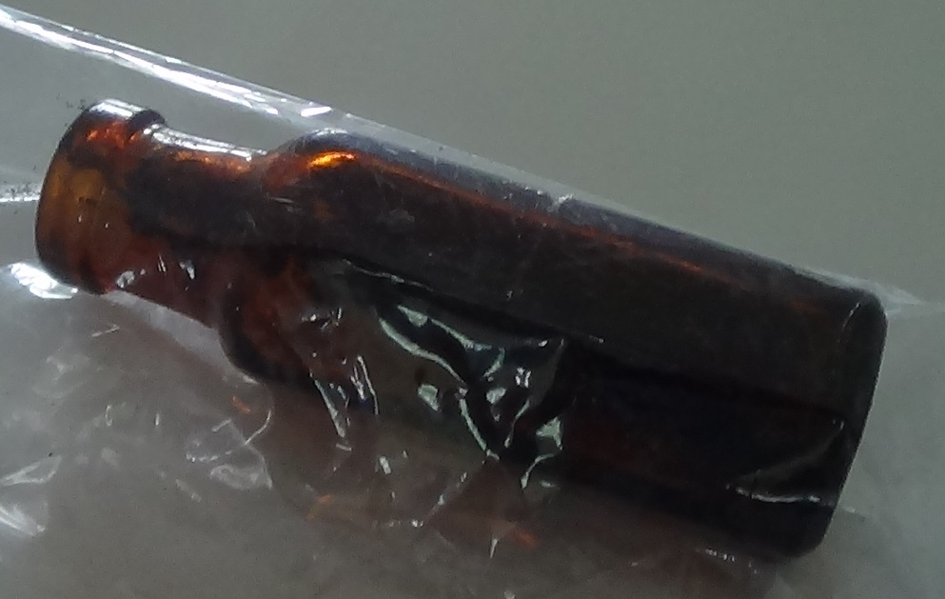
Survivorship of Extreme or Ritualistic Abuse 2023 Online Conference
Child Trafficking through Family Court Proceedings:
A UK Case Study
Dr Rainer Hermann Kurz
C.Psychol
ichinendaimoku@gmail.com
21st May 2023

Slide 2
Abstract
Child Trafficking through Family Court Proceedings: A UK Case Study –
Dr. Rainer Hermann Kurz
This presentation builds on a decade-long investigation into two index incidents that led to the transfer of parental responsibility for a toddler boy from a mother to a Local Authority, and eventually adoption by the foster carer in suspicious circumstances marred by procedural irregularities.
Index Incident 1, dismissed as untrue by a Family Court Judge, concerned the mother’s claim that she gave birth to a baby at age 14 that succeeded from incestuous rape by her father and ‘disappeared’.
Index Incident 2, that was also dismissed in the same judicial process, concerned a sexual assault on a toddler in broad daylight.
The presentation draws on a 60-minute audio recording describing the two index incidents and information submitted to a document review by complex trauma specialist in the process of preparing an appeal application. The content of the presentation is potentially triggering but provides rare insights into the workings of an Organized Ritual Crime Abuse Network (ORCAN) in the midst of society.

Slide 3
Introduction
1. UK Child Sexual Abusers in Entertainment
2. Violent Deaths 1&2 (?) +
3. Teenage Pregnancy
4. Lethal Disclosure
5. Persecutions
6. Family Court Gaming

Slide 4
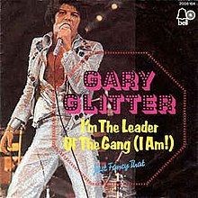
1. UK
Child Sexual Abusers
In Entertainment
Come on, come on, come on, come on Come on, come on Come on, come on, come on, come on Come on, come on, come on I say come on, come on, come on, come on Come on, come on Come on, come on, come on, come on Come on, come on, come on Do you wanna be in my gang, my gang, my gang? Do you wanna be in my gang, oh yeah? Do you wanna be in my gang, my gang, my gang? Do you wanna be in my gang? I'm the leader, I'm the leader, I'm the leader of the gang, I am I'm the leader, I'm the leader, well, there's no one like the man I am I can take you high as a kite every single night I can make you jump out of bed standing on my head Who'd ever believe it? Come on, come on Who'd ever believe it? Come on, come on Who'd ever believe it? Come on, come on Do you wanna be in my gang, my gang, my gang? Do you wanna be in my gang, oh yeah? Do you wanna be in my gang, my gang, my gang? Do you wanna be in my gang? I'm the leader, I'm the leader, I'm the leader of the gang, I am I'm the leader, I'm the leader, I'm the man who put the bang in gang I can take you over the hill, ooh, what a thrill I can make you sell me your soul for my rock and roll

Slide 5
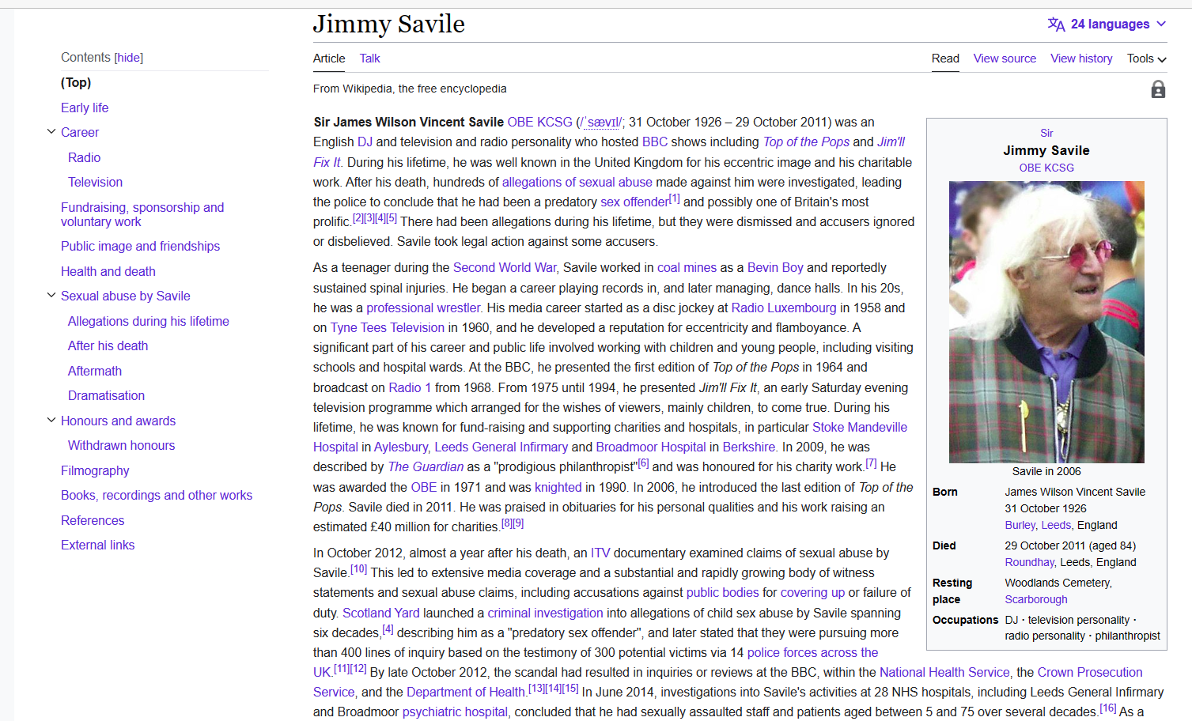
Serial Child Abuser
Jimmy Savile
http://downloads.bbci.co.uk/bbctrust/assets/files/pdf/our_work/dame_janet_smith_review/conclusions_summaries.pdf

Slide 6
Satanist
Jimmy Saville
http://www.express.co.uk/posts/view/371936/I-was-raped-at-13-by-Jimmy-Savile-in-satanist-ritual
A VICTIM of Jimmy Savile’s satanic abuse told yesterday of her sheer terror as she was tied to an altar and raped by the depraved star during a black mass. The girl, who we will call Paula to protect her true identity, was just 13 at the time of the -sickening attack in 1975. Now aged 50, Paula still suffers horrific flashbacks and cannot sleep properly. She decided to come forward after we revealed last week how Savile raped two women during satanic ceremonies in the Seventies and Eighties. Recalling her torment, Paula described how Savile was sitting on a throne wearing a mask and robes, clutching a trademark cigar. During her horrific ordeal, one of the devil worshippers sneered: “You definitely fixed this one, Jim!”
“I was brought in to a dark cellar and made to stand in front of three men in a circle, with the man in the middle sitting on a throne-like chair in a bright gown with a cigar in his mouth. A man stood on either side in blue cloaks and masks. I was made to stand in front of this chair dressed in only a white gown with nothing underneath and to just stand there while this man looked over me blowing cigar smoke into my face making me feel very sick and terrified. Around this slightly raised circle were men and women dressed in black cloaks wearing masks and various costumes.
“I was then taken by the man smoking the cigar, who I recognised as Jimmy Savile, to an altar table where I was stripped of my gown and tied to the altar. Savile then climbed on to the table and raped me. Others around him called out Satan’s name and laughed hysterically and were worked up into a frenzy.”
Paula said she was taken blindfolded to the ritual at a secret venue so she could not identify where she was attacked. She went with the consent of her family, who she said were well-known satanists.

Slide 7
Savile’s Mate
Ray Teret
http://www.express.co.uk/posts/view/371936/I-was-raped-at-13-by-Jimmy-Savile-in-satanist-ritual
Raymond "Ray" Teret (born 24 October 1941) is an English radio disc jockey who started his career in the 1960s. In December 2014 he was convicted of rape and indecent assault against children, and sentenced to 25 years in jail.
A lawyer for 169 of Savile's victims stated that Teret's conviction represents "the closest the victims of Jimmy Savile will get to a conviction against their attacker".
Raymond Teret (24 October 1941 – 5 May 2021)^{[1]} was an English radio disc jockey who started his career in the 1960s. In December 2014 he was convicted of rape and indecent assault, and was sentenced to 25 years in prison.^{[2]} He died in prison in May 2021 at the age of 79, having served just over six years behind bars.
https://en.wikipedia.org/wiki/Ray_Teret
https://www.bbc.co.uk/news/uk-england-manchester-30350179
https://www.bbc.co.uk/news/uk-england-manchester-30050989

Slide 8
Gary Glitter
Why has Gary Glitter been recalled to prison?
Gary Glitter, real name Paul Francis Gadd, has returned to prison on March 13, 2023, for breaching his licence conditions.
Police checked Glitter's phone after a tip-off from The Sun that he was talking about accessing the Dark Web.
The ex glam rocker, who sold millions of records in the 1970s, was first prosecuted after he took his laptop into a PC World for repair in 1997.
Why has Gary Glitter been recalled to prison? | The Sun
https://www.thesun.co.uk/news/21702848/gary-glitter-recalled-prison/
Fury as pop paedo Gary Glitter pictured browsing smartphone and asking about Dark Web | The Sun
https://www.thesun.co.uk/news/21679878/paedo-gary-glitter-browses-phone-talks-about-dark-web/

Slide 9
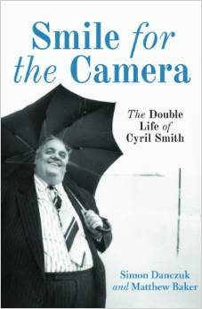
‘Sir’ Cyril Smith
MP
'This important book should be read by all those charged with delivering criminal justice, by all those interested in politics, but most importantly by those in every community motivated by a healthy and unstinting scepticism of authority.' Keir Starmer, Progress Magazine
No politician pandered to the media's appetite for personality more than Liberal MP Sir Cyril Smith during the 1970s and 1980s. With his remarkable girth and regular appearances on the chat show circuit, blurring the lines between politics and show business, Smith was a larger-than-life character in a landscape of dull, grey men. Yet 'Big Cyril' was anything but the gentle giant he sought to portray.
In November 2012, Rochdale's current MP Simon Danczuk outed Smith in the House of Commons as a serial child abuser. In Smile for the Camera, Danczuk tells how Cyril Smith rose from poor beginnings to become a dominating political figure in the Northwest and nationally, and used his extraordinary profile to conceal a spectacular abuse of power: systematically grooming and sexually abusing young boys, often in care homes he helped to establish.
Smith's story begins as an illegitimate child in the grinding poverty of post-war Rochdale. This background kindled a ruthlessness that drove him on to eventually take over his home town, running it as his own personal fiefdom in which he could do as he pleased. This is a story deeply rooted in time and place.

Slide 10
UK Cases
Rochdale:
http://www.mirror.co.uk/news/uk-news/pervert-mp-cyril-smith-was-pals-1546290 (1992)
http://en.wikipedia.org/wiki/Rochdale_sex_trafficking_gang (2012)
Colin & Elaine Batley, Kidwelly, Wales (March 2011):
http://www.bbc.co.uk/news/uk-wales-12703785
http://www.walesonline.co.uk/news/wales-news/satanic-sex-cult-paedophile-guilty-1845296
Cornwall (December 2012):
http://www.guardian.co.uk/uk/2012/dec/14/cornish-white-witches-guilty-ritual-abuse
Jimmy Saville (Oct 2012):
http://en.wikipedia.org/wiki/Jimmy_Savile_sexual_abuse_scandal
http://www.express.co.uk/posts/view/370439/Jimmy-Savile-was-part-of-satanic-ring
http://www.express.co.uk/posts/view/371936/I-was-raped-at-13-by-Jimmy-Savile-in-satanist-ritual
Ian Watkins (December 2013):
http://en.wikipedia.org/wiki/Woman_B#Sexual_offences
http://www.slideshare.net/slideshow/embed_code/29386021#

Slide 11
Continental
Europe
Germany:
www.vaterunserinderhölle.de (book by Ulla Fröhlich based on Adult Survivor’s Account)
Austria:
http://en.wikipedia.org/wiki/Natascha_Kampusch (2006)
http://www.scotsman.com/news/world/eight-year-kidnap-girl-s-mother-is-to-stand-trial-1-748999
http://en.wikipedia.org/wiki/Fritzl_case (2008) (see also Sheffield_incest_case 2008)
Belgium (1986 - 2004) Marc Dutroux
http://en.wikipedia.org/wiki/Marc_Dutroux
Italy (2005):
http://en.wikipedia.org/wiki/Beasts_of_Satan
http://news.bbc.co.uk/1/hi/programmes/this_world/4446342.stm
http://news.bbc.co.uk/1/hi/world/europe/4669944.stm
Portugal (2010):
http://en.wikipedia.org/wiki/Casa_Pia_child_sexual_abuse_scandal

Slide 12
2. Violent Death 1&2
(?) +

Slide 13
Couple
Middle-aged couple die in suicide pact before husband is charged with rape
By JAMES MILLS
Last updated at 09:03 12 April 2007
‘A husband committed suicide with his wife after a BBC Crimewatch appeal linked him to two unsolved rapes and a robbery dating back 20 years, an inquest has heard.
Christopher and Christine Downes were found dead in their fume-filled car with a hosepipe attached to the exhaust last October.
Days earlier, detectives had taken a DNA sample from Downes, 54, after his name was given to them by a Crimewatch viewer.
The sample was later found to match DNA from the scene of a knifepoint robbery at the home of a pregnant woman in Salisbury, Wiltshire, in November 1984.
Forensic evidence linked that crime to rapes at two hospitals in the area over the following two months.
Had he not killed himself, Downes would have stood trial with a 'realistic prospect of conviction', the inquest was told.
Downes, a delivery driver, slipped through the net during the original 12-month investigation because he was not at home when police officers tried to interview him after an anonymous tip off. ‘
The last time Mr March saw his sister alive was just a few hours before her death when she dropped off a birthday card.
He said: "She seemed very happy and talked about saving up for a foreign holiday. There was no indication about what was to come.
"I think this happened because of the police investigation. If Christopher had gone back into prison I don't think she would have coped and would have committed suicide herself.
"Her whole life was him and without him there was no Christine. She would not have survived without him.“
The couple, from Andover, Hampshire, were found dead in a car park on the Wherwell Estate near the town on October 9 at around 8am.
Estate workers removed the hosepipe and smashed the windows to let the fumes escape, but the couple were already dead.
Middle-aged couple die in suicide pact before husband is charged with rape | Daily Mail Online
https://www.dailymail.co.uk/news/article-447972/Middle-aged-couple-die-suicide-pact-husband-charged-rape.html

Slide 14
3. Teenage Pregnancy

Slide 15
Birth of Child Concealment
in Wales
While she had two children, no-one suspected she had also given birth to three stillborn babies, and then hidden their bodies.
In August she pleaded guilty to three counts of endeavouring to conceal the birth of a child.
She was given a 12 month community rehabilitation order by a judge at Merthyr Crown Court on Monday.
Once her secret was uncovered, Mahoney admitted her guilt when her case came to court in August. The prosecution accepted the babies were born dead.
Mahoney first gave birth when living with her parents at the age of 18 in 1959. She said the baby was stillborn and was taken away by her father for burial. She said she then had a daughter in 1965 and another in 1970 fathered by a doctor who worked at a local hospital. The court heard the doctor returned to India but was the father of the next stillborn baby. The other two babies were described as being "the product of one-night stands" in 1980 and 1981. Each time she decided to keep the baby's bodies rather than alert the authorities.
BBC NEWS | Wales | South East Wales | Secret babies of a public mother
http://news.bbc.co.uk/1/hi/wales/south_east/4303696.stm

Slide 16
Child Sexual Abuse
&
Index Incident 1
Abuse from birth
Rape
Pregnancy
Birth
Funeral

Slide 17
Extreme Abuse Memories
At age 24 she started to remember how she was abused as a toddler by a downstairs neighbour. She also relayed how a suicide attempt at 16 was preceded by incestuous abuse and an incident which was similar to the ‘Satanist Cult Show’ described in Epstein et al. (2011):
‘These were special shows and I remember one of many shows that I was involved with…I had been primed – I was probably eight at the time – to have sex with a boy who was around the same age as me, who was absolutely petrified.’ (p. 145).
Around the time of the alleged delivery of a baby girl that succeeded from incestuous rape there was a period without GP visits. The parents had applied for ‘home schooling’ and removed all calendars. Within a few days of the unregistered homebirth the baby reportedly ‘disappeared’ (see extreme abuse literature e.g. Miller, 2012).

Slide 18
Consultant Psychiatrist
Notes on Dissociation
• ‘He was very abusive to her and abused her. Following this experience she started cutting her upper arm and was doing so every evening for a period of time. She initially felt suicidal but felt that the tension she released by cutting herself was more helpful.’ • ‘She hears voices present in the room when there is nobody, but cannot describe these and they do not appear to be auditory hallucinations.’ • ‘She complained of panic attacks, and has had three attacks over a 2 year period.’ • ‘There were no abnormal perceptions. She described supernatural experiences such as shadows in the room at all times, day and night, but these did not seem to be psychotic.’ • ‘As far as I can ascertain from my assessment today, she does not have a major psychiatric disorder and her concerns and worries would be best dealt with the Primary Care psychologist.’ • ‘Recently assessed dyslexic by learning support team?’ • ‘Memory still poor.’; ‘Still some panic attacks.’; ’Becoming anxious that her
memory may not return – feels she is vulnerable as she can find herself locked
out of her flat, not knowing who she is.

Slide 19
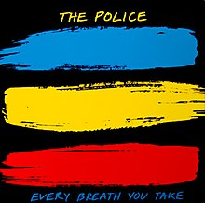
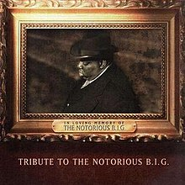
4. Lethal Disclosure
Every Breath You Take - Wikipedia

Slide 20
Violent Death 3 (?)
Community Police Officer
A vulnerable mother who escaped from an intergenerational abuse family was instructed by a clandestine police operation to delay reporting of any sexual assault on her child.
An officer explored the death of a couple who had lodged with this family and the ‘disappearance’ of their new born child.
The officer was also aware that the mother had reported a teenage pregnancy that succeeded from incestuous rape where the baby also ‘disappeared’, and that the colleague to whom the 14 year old made the disclosure had been found dead a few days later.
Three police officers advised the mother to delay reporting until injuries could not be proven as it would be ‘too dangerous to go up alone against the family member’. Police claimed that spotting individuals familiar from her childhood would indicate that the undercover operation was successfully underway.

Slide 21
5. Persecutions

Slide 22
Cremation of Care
The infamous ‘Cremation of Care’ play at the highly secretive annual ‘Bohemian Grove’ summer festival in the US features elaborate rituals with 'mock' human sacrifices pointing towards a pervasive and perverted interest in the occult in high society. This is further borne out in widespread shielding of such abuse groups as authority representatives appear determined to ‘look the other way’ e.g. coroner and police refuse to investigate ‘known’ crimes

Slide 23
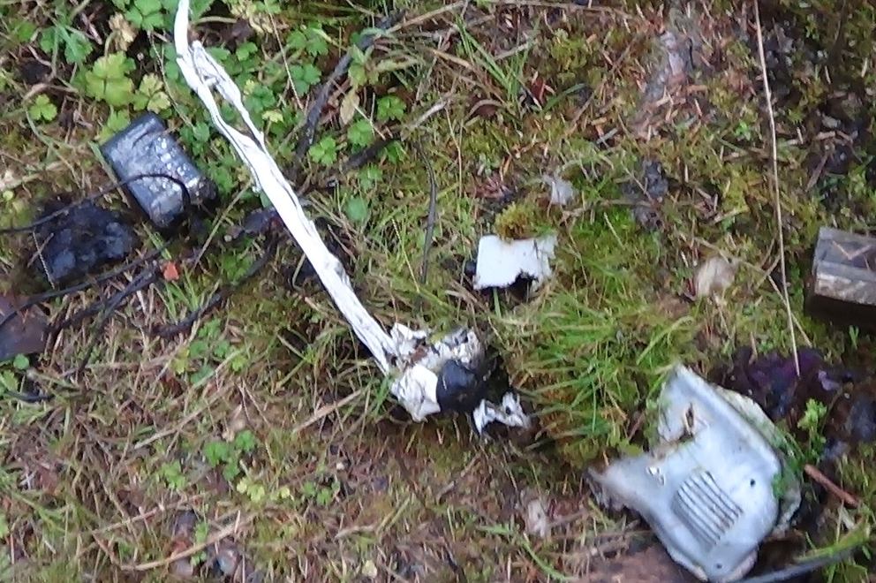
Puzzle
How do these artefacts relate?

Slide 24
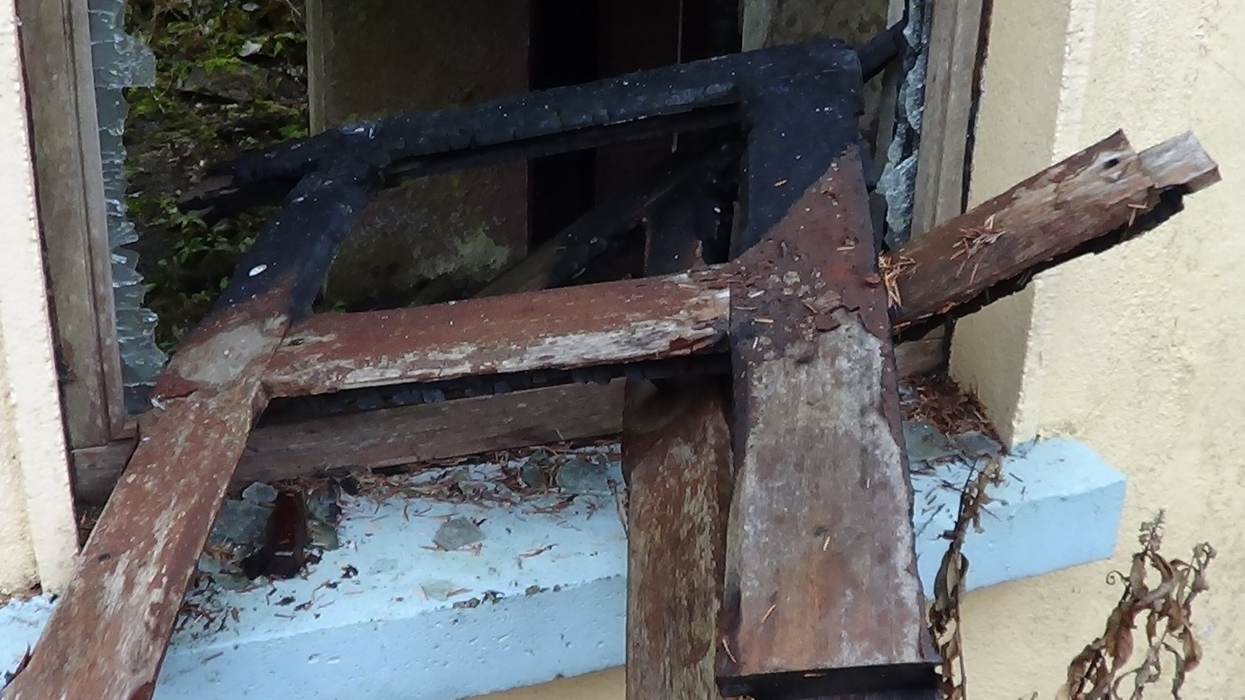
Field Dependence
Test
Low Alpha, High Beta?

Slide 25
Violent Deaths 4 (?), 5 & 6
In Vicinity
Within 6 months of the police briefing to delay reporting there were three violent deaths in the vicinity of the mother.
Violent Death 4 (?):
Mother of nephew (who had been according to NHS records raped at age 2) died
Violent Death 5:
Child carer’s friend found dead near home
Violent Death 6:
Friend found dead in burned out house

Slide 26
Stalking &
Defamation
Defamatory calls to police e.g.:
‘I saw her shop lifting’
‘There was a girl crying in the field’
Defamatory calls to social services e.g.:
‘Neglecting child’
‘Concerns about mental health’
Physical threats e.g.:
Driving up the pavement
Trying to wrestle buggy off mother
Enlisting members of the public / co-conspirators e.g.:
‘A rich benefactor would like to pay for the schooling of your child’
‘Yes. She is on the bus – she is carrying, ahem, a buggy’
‘She is feeding dog food to her child’
(police incident record)

Slide 27
Index Incident 2
I fairly regularly visited a friend.
On the way I noticed a man in front of me who then disappeared out of sight. When I took my child out of the buggy the Stalker grabbed my child and sexually abused him. I was in fear – in particular that he would abduct the child or drop the child.
Due to the threats he made I did not dare reporting the crime for several weeks. The reality is that even when convicted of the assault the perpetrator could have got away with a ‘community order’ sentence or a fine.

Slide 28
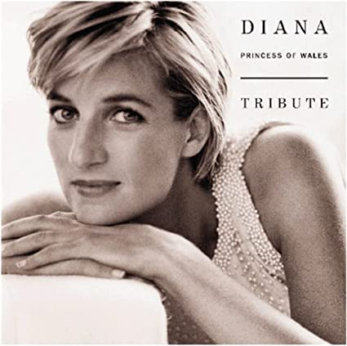
6. UK
Family Court
Gaming
I am in love with the world With its fires and its seas and its pain I am in love with the world As it spins round my soul again I fell in love with the world When it gave me a place to be (ooh) You cannot fall out of love With your world shining through (ooh) Let your world fall in love with you With you You think you're lost to the world With your life lived in shadows of fear (Shadows of fear) Days lost without you too long No-one close no-one kind no-one near (No-one near) You try to hide when your world dies inside Never fade away (ooh) Dreams turn to stars so you don't Lose the end of your day (ooh) Let your world fall in love with you With you
"I Am In Love With The World"
Chickenshed – Wikipedia
https://en.wikipedia.org/wiki/Chickenshed

Slide 29
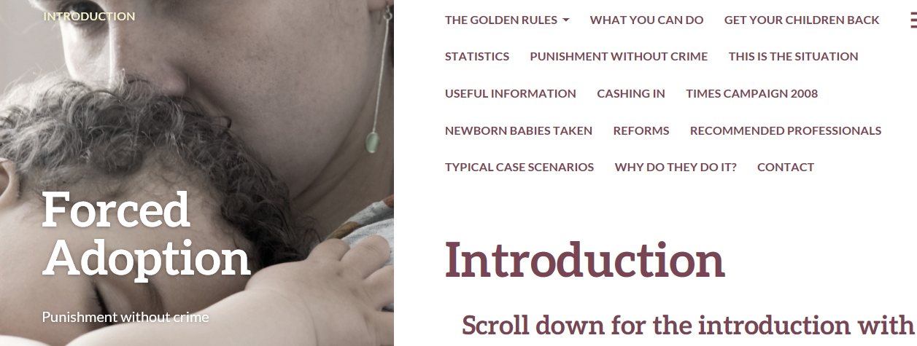
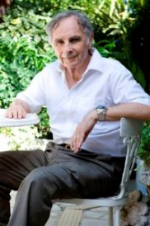
‘Forced Adoption’
http://forced-adoption.com/
Ian Josephs M.A. (Oxon)
2:- Borderline personality disorder or narcissistic traits ! Usually diagnosed by a psychiatrist or psychologist who habitually gives evidence to the family courts in favour of social services and with few if any private patients. Parents are routinely refused a second opinion and if they get a highly favourable report from a top expert paying privately it is usually ignored even when it is more up to date .

Slide 30
Court
Appointed
Experts
1. Mental Health Professional
2. Mental Health Professional
3. Mental Health Professional
4. Mental Health Professional

Slide 31
Mother’s Views on
Mental Health
Professionals (MHPs)
A series of ‘Mental Health Professionals’ interviewed me. They essentially accused me of lying and/or being delusional.
1. The medical examination of my boy came back with an Open Verdict – it could neither be proven nor disproven that the attack happened. In spite of this all MHPs ‘jumped’ to the conclusion that the attack did not happen. This is unscientific, unreasonable and deeply offensive. The sessions and reports lacked qualified discussion of the likelihood of the attack having had occurred or not.
2. Nobody followed up in a meaningful way on the severe child abuse I suffered. One MHP specifically said ‘we cannot talk here about your past as this would be counselling – which you would have to pay for’.
No psychological assessment can simply exclude childhood and youth! Approaching assessments in such a way sounds to me irresponsible, unprofessional and illegal. Any ‘severe childhood trauma’ diagnosis such as Structural Dissociation will be missed by design! Intentionally? One MHP refused to disclose the name of his line manager, and led people to believe that his first name was his last name. Another MHP failed to record the most serious abuse that I disclosed in that particular session. None of the MHPs interviews covered the most serious allegations that I made.
3. None of the MHPs considered Complex Post Traumatic Stress Disorder and/or Structural Dissociation as alternative explanations for my historical records.
4. None of the MHPs adequately registered and acknowledged that there were no mental health related entries in my file for the last few years.

Slide 32
Complex Trauma
Assessment Issues

Slide 33
MCMI Failings
Rogers, R. Salekin, R. T., & Sewell, K. W. (1999). Validation of the Millon Multiaxial Inventory for Axis II disorders: Does it meet the Daubert standard? Law and Human Behavior, 23, 425–443.
Rogers, R. Salekin, R. T., & Sewell, K. W. (2000). The MCMI-III and the Daubert Standard: Separating Rhetoric from Reality Law and Human Behavior, 24, 501–506.
‘The most judicious course of action is to consider the Millon et al. (1997) study to be fatally flawed. It is noteworthy that none of the three alternatives justifies the use of the MCMI-III in forensic cases. In closing, we reaffirm the conclusions
of Rogers et al. (1999): ‘‘The MCMI-III does not appear to reach Daubert’s threshold for scientific validity with respect to criterion-related or construct validity’’ (p. 438). Despite Dyer and McCann’s (2000) spirited defense, fundamental issues regarding validation (construct, criterion-related, and content), forensic applications, and unacceptable error rate argue against the use of its Axis II interpretations as scientific
evidence.’
http://youtu.be/YYX2tsqAU-8
Dr Lorandos cross-examines hapless Psychiatrist - accusing him of ‘misinforming and misdirecting the proceedings’- finding MCMI-III ‘markedly deficient on Construct and Criterion-related validity evidence’ quoting Rogers et al. (1999).

Slide 34
MCMI-III
Base Rate cut-offs:
60 Median
75 Significance
85 Prominence
‘General Factor of Demoralisation’ (MMPI2) low as indicated by the orange vertical line
Low scores on Schizoid, Depressive, Histrionic, Borderline, Anxiety, Somatoform, Thought Disorder
Abuse Survivor
Stalking
Crime Report
Misdiagnosis
Most healthy adults appear ‘Narcissistic’‘
‘Inter-generational abuse’
&
‘stalking’
victims
appear ‘Paranoid’ & ‘Delusional’

Slide 35
Somatoform
Dissociation
DSM-III (1980): Posttraumatic Stress Disorder (PTSD)
Putnam, F. (1989). Diagnosis and Treatment of Multiple Personality Disorder (Foundations of Modern Psychiatry)
Herman, J. (1993). Trauma and Recovery. (C-PTSD)
Nijenhuis, Spinhoven, Van Dyck, Van der Hart, & Vanderlinden (1996) SDQ20 Somatoform Dissociation Questionnaire:
Q11: ‘I cannot see for a while (as if I am blind)'
Q12: ‘I cannot hear for a while (as if I am deaf)'
Only the small secrets need to be protected.
The big ones are kept secret by public incredulity.
(Marshall McCluhan)

Slide 36
Delusion
Definition
A recent UK court custody case quoted ‘Blacks Medical Dictionary’ (Marcovitch, 2010):
‘Delusions An irrational and usually unshakeable belief peculiar to some individual. They fail to respond to reasonable argument and the delusion is often paranoid in character with a belief that a person or persona is/are persecuting them. The existence of a delusion, of such a nature as to seriously influence conduct, is one of the most important signs in reaching a decision to arrange for the compulsory admission of the patient to hospital for observation. (See Mental Illness).’
The DSM-V definition (American Psychiatric Association, 2013, p. 819) remains identical to the DSM-III (p. 765) and DSM-IV-TR (p.821):
delusion a false belief based on incorrect inference about external reality that is firmly sustained despite what almost everyone beliefs and despite what constitutes incontrovertible and obvious proof or evidence to the contrary.

Slide 37
Misdiagnosis Risk
Applying Lacter & Lehman (2008) Guidelines for Differential Diagnosis Schizophrenia vs Ritual Abuse / Mind Control

Slide 38
Persecution
Lacter, E. P. & Lehmann, K. (2008). Guidelines to Differential Diagnosis between Schizophrenia and Ritual Abuse / Mind Control Traumatic Stress. In Noblitt, Randy & Noblitt, Pamela Perskin (Eds): Ritual Abuse in the 21st Century. Robert D. Reed Publishers: Bandon, Oregon.

Slide 39
42 Indicators
Schizophrenia vs. Ritual Abuse / Mind Control Traumatic Stress
In one case NONE of the 42 left-hand descriptions indicative of Schizophrenia applied, and only about 1/3 of the right-hand descriptions indicative of Trauma / Mind Control

Slide 40
‘Child Protection’?
10. Battling a rigid system biased against abuse victims
3) If there is an ongoing custody dispute regarding the child, the adult party that alleges RA is usually viewed by the court as lying, crazy, or as having induced “parental alienation syndrome” (PAS) in the child. The court often orders that this alleging party lose custody and if visitation is allowed at all, it is only under supervision. And the court generally grants full physical custody, sometimes full legal custody, to the alleged abuser, or other family members who may be abusing the child. All of this generally occurs without any reasonable investigation or evaluation of the allegations (a family court-ordered custody evaluation of all family members by a court-appointed psychologist does not constitute an adequate forensic evaluation specific to child abuse).
4) Negative attributions are ascribed to alleging adults, including “delusional” and this causes psychological consequences, fear of being institutionalized involuntarily for being “crazy,” etc.
5) In some rare cases, especially if a parent alleges RA and there is an ongoing custody dispute, the alleging parent may be viewed as an immediate danger to his/her children, and is involuntarily institutionalized in a psychiatric facility.
Lacter, E. (2014). Risks Involved in Making Suspected Reports of Ritual Abuse of Children or Dependent Adults. Draft Manuscript: San Diego.

Slide 41
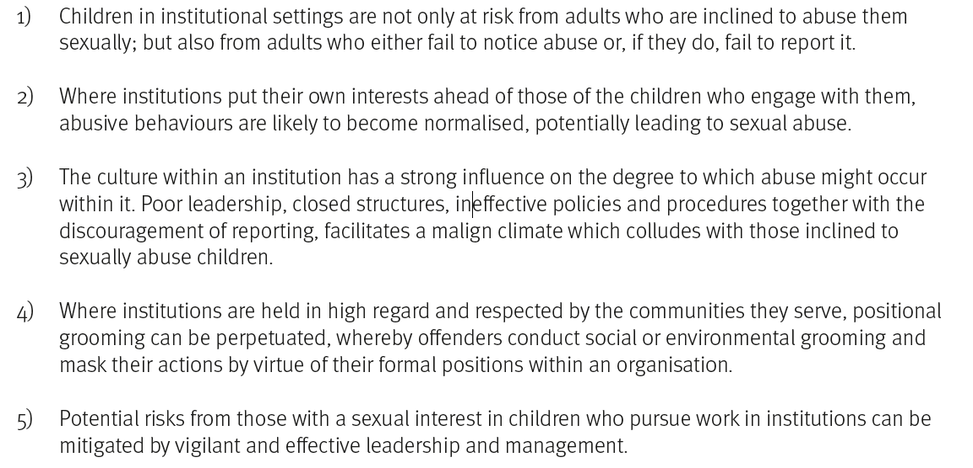
Abuse in Care
CEOP (2014). CEOP Thematic Assessment The Foundations of Abuse.

Slide 42
Medical Checks
Extract of a submission to authorities in a different case:
‘To illustrate the nature of the failing it is helpful to consider a different case of successful ‘Family Court gaming’ that involved a report to police about an anal rape of a young child (by a person who closely resembled a male relative). The grandparents of the small child had previously tried to coerce their estranged daughter (who reported incestuous abuse by her father ‘from birth to 20’ but was disbelieved by authority representatives) into giving up the young child for adoption. Through trickery the mother was forced to witness the assault. She had been manipulated (through ‘trauma-based mind control’) to delay reporting of any sexual assault on herself or the young child ‘for four weeks or one month’ by a serving police officer in a Metropolitan Police station. Later this officer, accompanied by two other police officers, approached her in a different area 200 miles away and asked her to report any sexual assault on her or the young child ‘after two weeks’. In the end she reported the sexual assault after three weeks. A seemingly compromised Psychiatrist misrepresented the facts and claimed she was ‘delusional’ and that ‘a false memory had implanted itself’ (nonsense). The mother maintained the truthfulness of her allegation and revealed specific details (too sensitive to share here) from her own childhood in line with instructions she had received at the Metropolitan Police station by the serving Sapphire officer (see above). The mother insisted on medical checks as she feared that sexually transmitted diseases could jeopardise the health of the young child. Nothing remarkable was found. The family court judge went along with the (false) claims of Paranoid Personality Disorder proffered by four mental health professionals and removed parental rights from the mother (in the end the child was ‘adopted’ by the foster carer – possibly following sustained organised CSA of the ‘unimaginable’ kind that the girl did not witness but ‘heard about’). The judge castigated the mother for ‘unnecessarily subjecting the young child to unnecessary medical tests’.
This is the topsy-turvy (dysfunctional) world of Child Protection!’

Slide 43
Epilogue
I was barely able to survive outside the home with no family and with no career that took off, or anything. You know – it did not work.
And I do contribute this to him. If I had had a happy home I would not have left it, I would not have been homeless, probably would not have got fired, I would not have been assaulted, would not have been drugged, I would not have been raped, my throat would not have been slit on a bus in London, I would not have been ganged. You know - a lot of things would not have happened.
And I am happy for my life, and I am proud of myself. I am quite hard and I do not mind. That’s my life and it is no good wishing or wanting anything else.
I do not want or wish for anything else, because I am sure that if I use everything I got and I have faith, this was the best existence I could have asked for. And that everything I believe in, that everything I go through is useful. So - I need these experiences that I have gone through and will go through.
And that is the only attitude I want to have, that I am up for it - take life by the horns – that’s fine.
But on a kind of diplomatic level – it is like: I would have liked stability – I cannot have that when I am stalked. And that is what I want to stand up to now. I do not want to hurt my kid. I cannot do both. I cannot do both. I got to ‘run or fight’ kind of thing. I really have not been able to run away.
And my kid - I am really not going to settle for someone going through what I went through. My only child going through what I went through – no.
Because he can stalk me.
It is like - I guess because I was in his home - I blamed myself for that. Being dependent on him. I really blamed myself.
I was really, really angry when I discovered that he could do that - outside of the home.
That he can just hunt me down.
It does not matter where I am, or what life I am living, I am never going to be important enough or valid enough, my kid is never going to be innocent or pure enough or loveable enough - that he won’t come looking.
Just to hurt us.
And all my self-hatred was in vain – you know what I mean?

