Slide 1
Survivorship Conference
19th May 2023
The Enmeshment of the British False Memory Society
and the British Psychological Society
Dr Rainer Hermann Kurz
C.Psychol
ichinendaimoku@gmail.com
Adapted from Kurz (2015). A discourse of disbelief? Reader’s Letter in The Psychologist, 12, BPS: Leicester.

Slide 2
Abstract
The Enmeshment of the British False Memory Society and the British Psychological Society
- Dr. Rainer Hermann Kurz
This presentation builds on an article ‘The Policy Alignment of the British False Memory Society and the British Psychological Society’ published in 2022 by Dr Ashley Conway and Prof David Pilgrim in the Journal of Trauma & Dissociation. It outlines the exemplary response of the British Psychological Society (BPS) in 1995 to the ‘Memory Wars’, subsequent ‘policy capture’ in 2008 through individuals associated with the British False Memory Society (BFMS), and the ongoing battle to restore a credible position on Memory-Based Evidence that moves from a biased ‘false-positive-only‘ view of the uncertainties about testimonies involving historical trauma to equally consider ‘false-negatives’.
The presentation will feature examples where a Discourse of Disbelief derailed proper procedures in the UK. Furthermore, the practical relevance of the questions raised will be illustrated with the analysis of 27 US cases in Silberg & Dallam (2019) where allegations of child sexual abuse were initially dismissed by family courts but the custody decisions that followed overturned later on. In 67% of the cases the rationale of the judge not protecting at Time 1 was ‘Pathology’ of the protective parent leveraging the ‘Discourse of Disbelief’ propelled by False Memory research claims. Based on their analysis they offer 9 recommendations to improve outcomes for children who have the misfortune to be both abused and entangled in a custody dispute several of which relate to trauma-informed practice. Most central is their call that ‘all evidence admitted in custody and parenting adjudications should be subject to evidentiary admissibility standards and courts must reject pseudoscientific concepts that pathologize parents seeking to protect children’. Brewin, Li, McNeilis, Ntarantana, & Unsworth (2020) warn in a similar vein about the increasing bias towards invalid false memory arguments and assumptions that sway medico-legal decision making.

Slide 3
Dr Rainer Kurz
BPS Letter & Article

Slide 4
Presentation
Structure
1. BPS & UK Historical Context
2. Memory Wars – Exemplary BPS Response 1995
3. Dr Ashley Conway Book Chapters on ‘False Memories’
4. Successful UK Prosecutions
5. BPS Policy Capture by BFMS
6. Child Protection & Family Court Issues
.

Slide 5
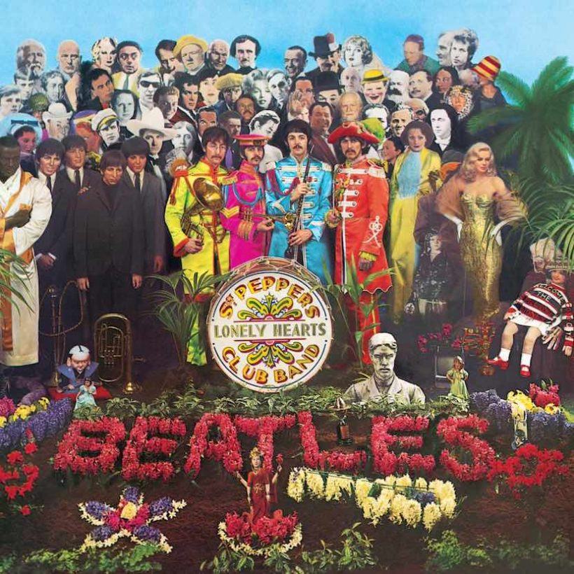
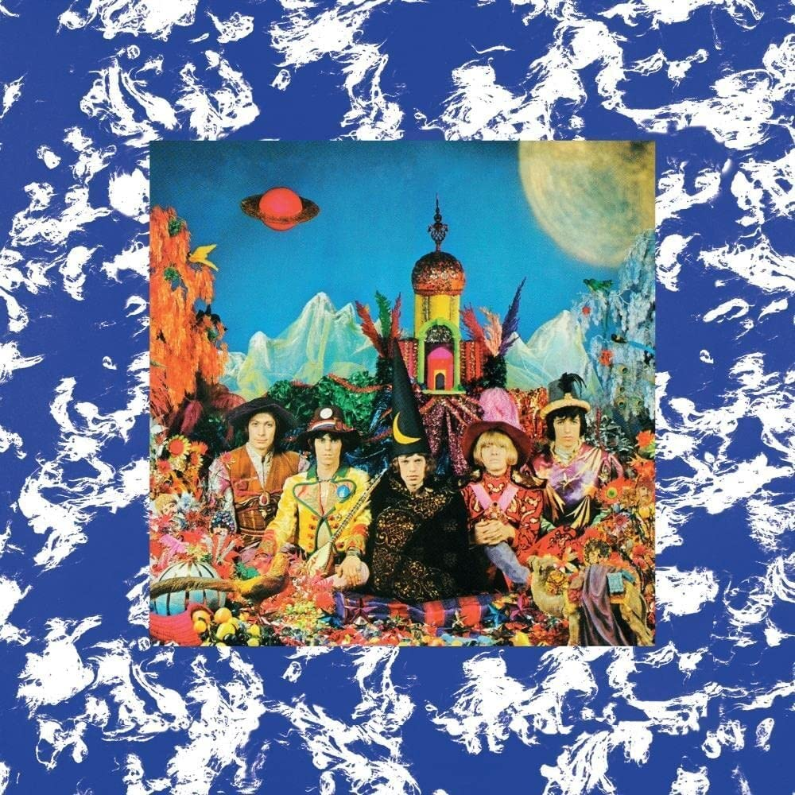
BPS & UK Historical Context
1960s UK Music
Counter Culture
The Beatles (1967)
https://www.udiscovermusic.com/stories/whos-who-on-the-beatles-sgt-peppers-lonely-hearts-club-band-album-cover/
2: Aleister Crowley
A hugely prolific occultist and author who formed his own religion, Thelema, Crowley’s central tenet was, “Do what thou wilt shall be the whole of the law. Love is the law, love under will.”
‘Their Satanic Majesties Request’ https://en.wikipedia.org/wiki/Their_Satanic_Majesties_Request
‘The album's title is a play on the "Her Britannic Majesty requests and requires" text that appears inside a British passport.’
An Amazon review:
‘… the Stones lost something a good deal more than a blond guitarist when Brian Jones left the stage…

Slide 6
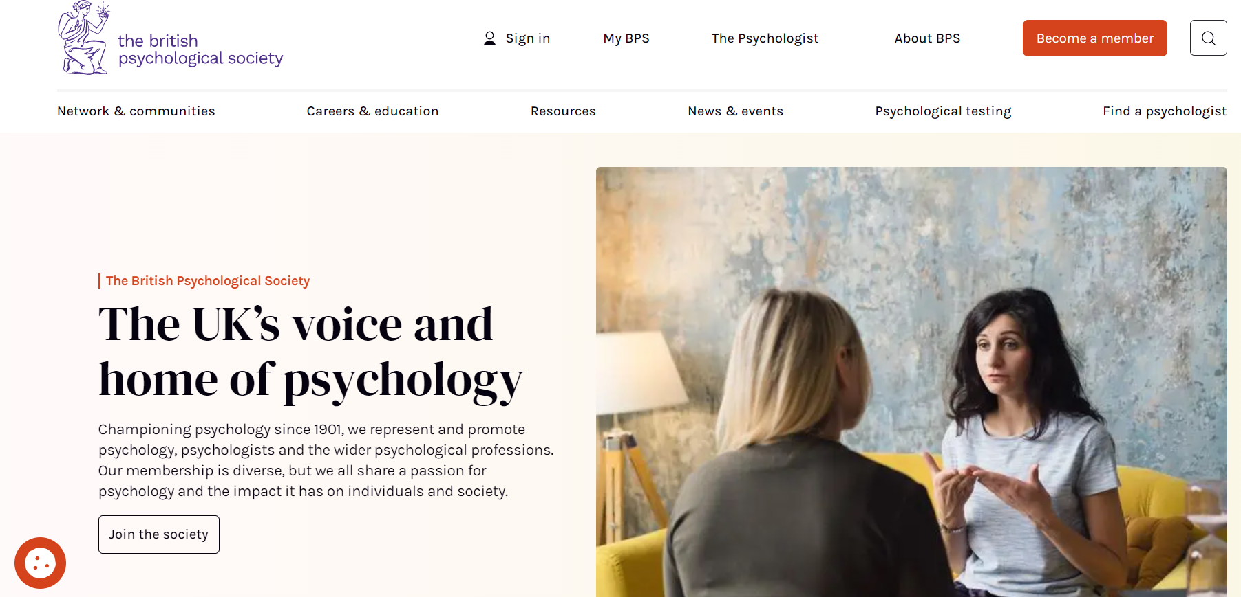
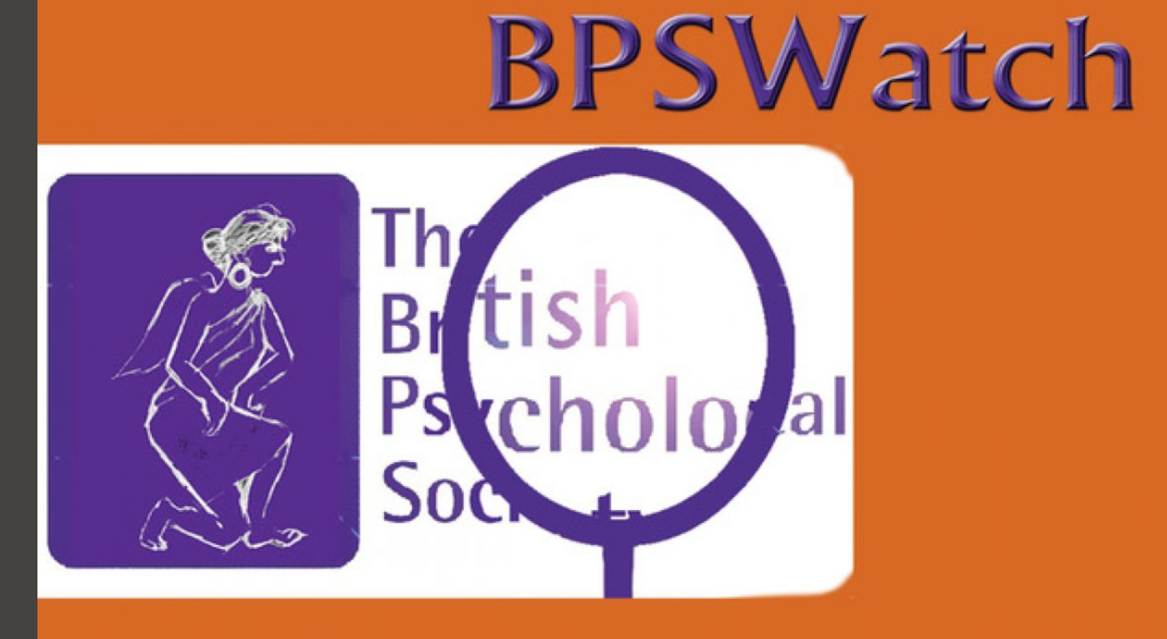

Slide 7
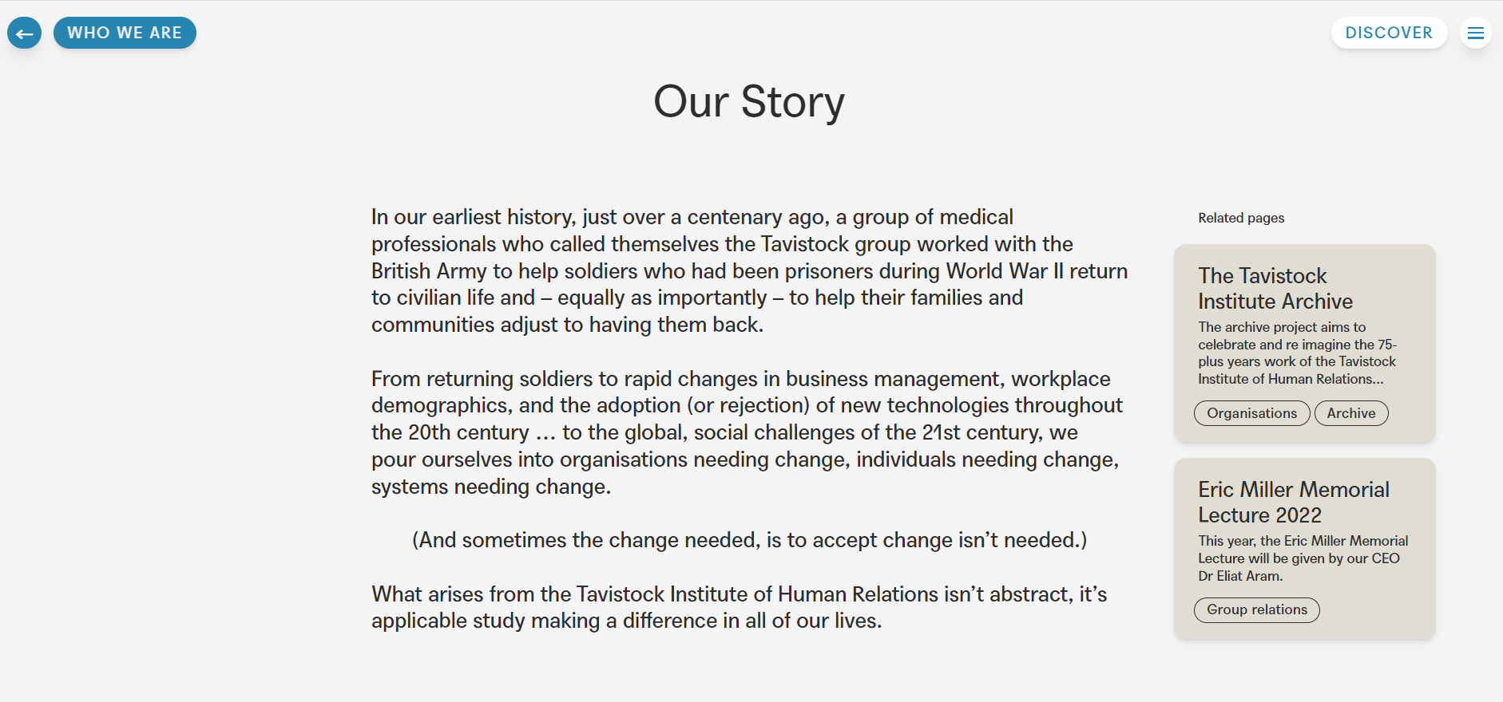
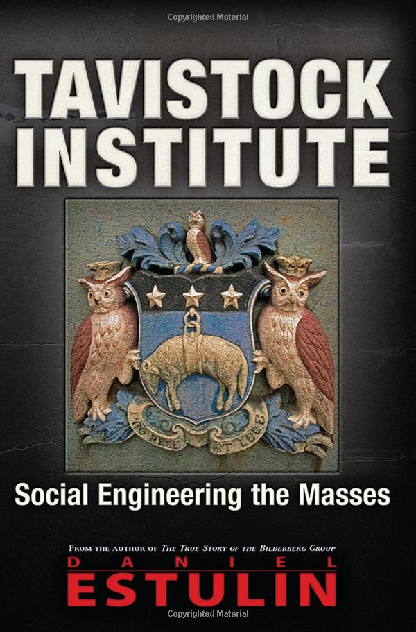

Slide 8
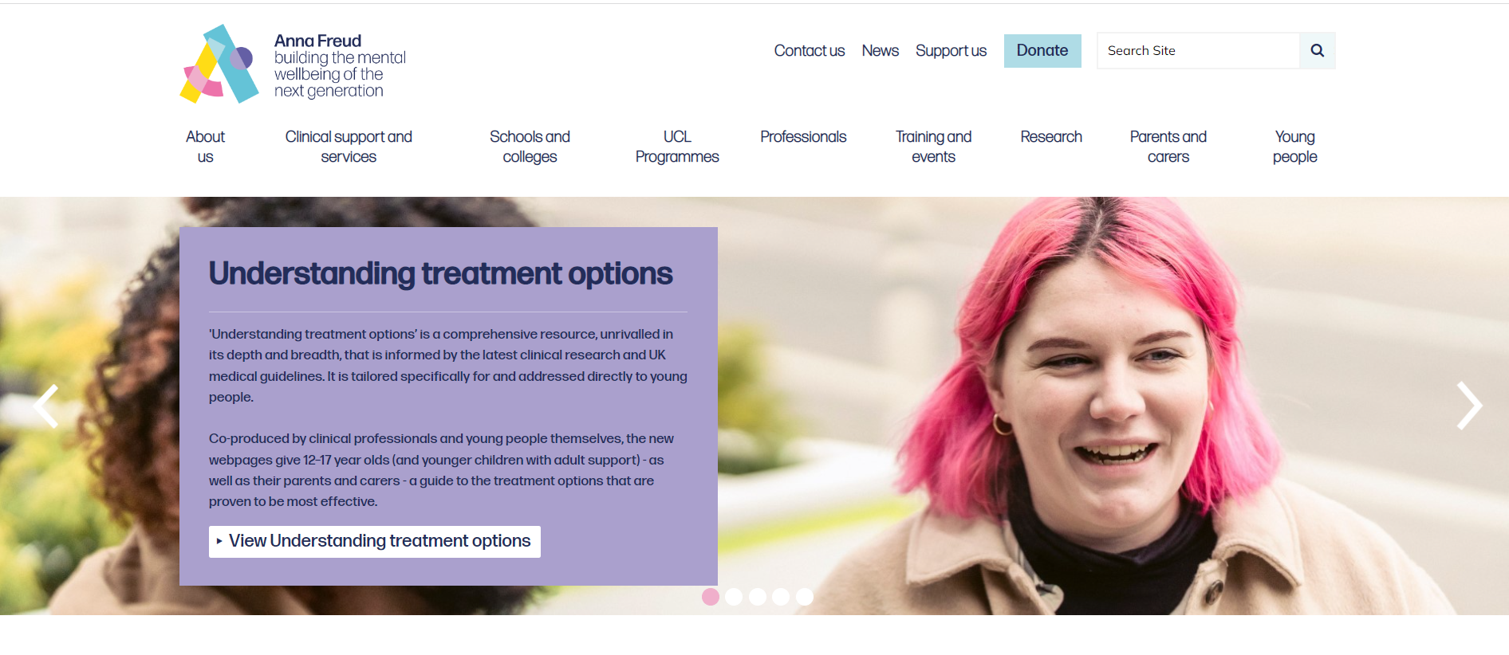
Sigmund Freud’s Nephew: Edward Bernays
https://www.youtube.com/watch?v=eJ3RzGoQC4s The Century of the Self (Full Documentary 4h)

Slide 9
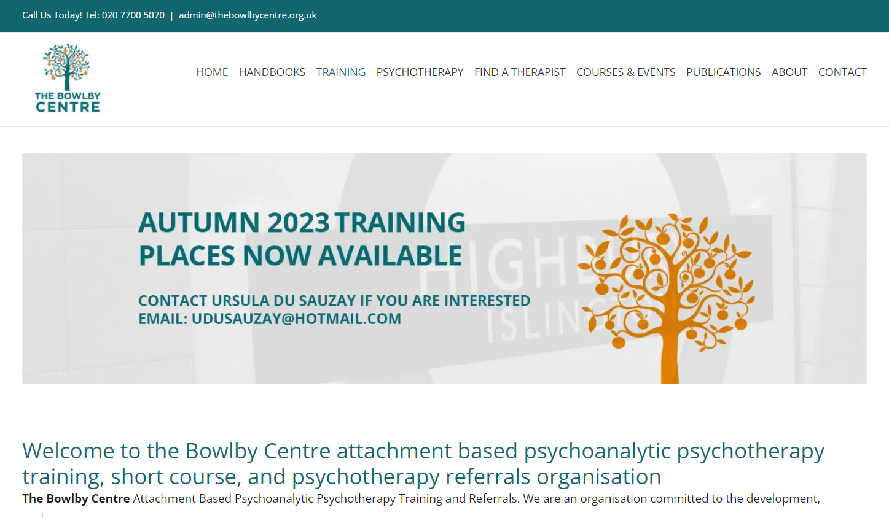
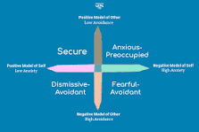
https://onlinelibrary.wiley.com/doi/10.1111/bjp.12149
The Unacknowledged History of John Bowlby's Attachment Theory Joseph Schwartz
‘Victims of abuse can mistakenly be encouraged to remain in abusive relationships in the name of attachment because trauma bonds can be strong even though they are harmful. This is a dangerous misreading of attachment theory stemming from the marginalization and ignorance of Bowlby's work.’

Slide 10
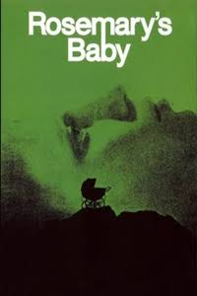
2. BPS &
Memory Wars
Rosemary's Baby is a 1968 American psychological horror film written and directed by Roman Polanski, based on Ira Levin's 1967 novel of the same name. The film stars Mia Farrow as a young (soon pregnant) wife living in Manhattan who comes to suspect that her elderly neighbors are members of a Satanic cult and are grooming her in order to use her baby for their rituals.
https://en.wikipedia.org/wiki/Rosemary%27s_Baby_(film)

Slide 11
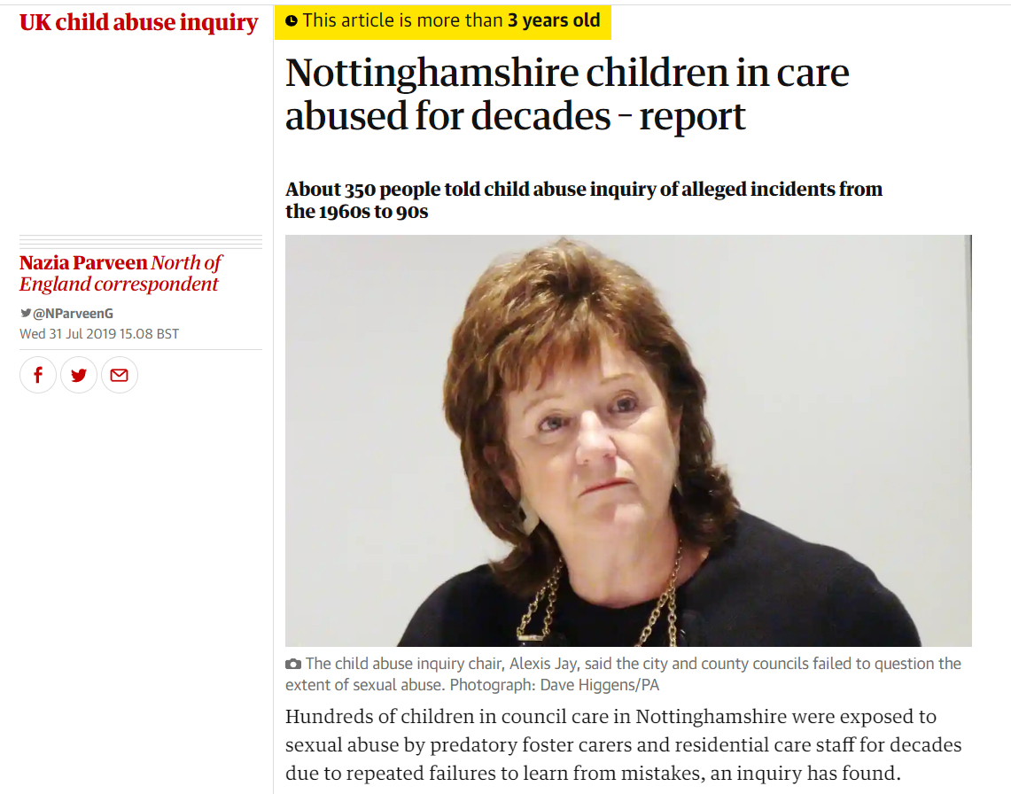
UK Organised
Child Sexual Abuse
Broxtowe
In October 1987 children were removed from their families in Nottingham, and in February 1989 a Broxtowe family was charged with multigenerational child sexual abuse and neglect.
https://en.wikipedia.org/wiki/List_of_satanic_ritual_abuse_allegations
https://endritualabuse.org/?s=wikipedia
https://www.theguardian.com/uk-news/2019/jul/31/nottinghamshire-children-in-care-abused-for-decades-report#:~:text=Hundreds%20of%20children%20in%20council,mistakes%2C%20an%20inquiry%20has%20found.

Slide 12
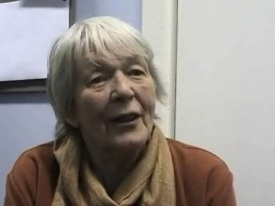
Intergenerational
Abuse
Please ignore the Wikipedia entry under my name for the time being. I find it extremely useful for many subjects but for some, especially contentious areas that involve forensic issues, as fast as colleagues try to correct and add material it is damaged by other editors who are not following Wikipedia guidelines, e.g. they rely on unchecked newspaper articles and unvalidated or old and biased quotes. It is therefore of interest that whilst my disability work gets a small mention, most space is given to sceptical or downright attacks on the existence of ritual abuse and especially abuse by Satanist pedophiles.
Prof Jean La Fontaine is an Anthropologists trained in Cambridge who taught at the LSE where she is Professor Emeritus. She has written extensively on ritual, gender and kinship, witchcraft and satanism, child abuse and incest. She made front-page headlines in mid-1994, when she found herself in the centre of a public furore over her research into child sexual abuse ‘The Extent and Nature of Organised and Ritual Abuse’, commissioned by the Department of Health, was widely read as denying the existence of satanic abuse.
Dr Valerie Sinason is a British poet, writer, psychoanalyst and psychotherapist who is known for promoting the idea that people with a developmental disability can benefit from psychoanalysis and that satanic ritual abuse is widely practiced in the UK. In 1994, Sinason edited a collection of essays entitled Treating Survivors of Satanist Abuse that claimed satanic ritual abuse existed in the United Kingdom and that she had treated victims.
http://elearning.lse.ac.uk/dart/interviews/lafontaine.html
http://valeriesinason.co.uk/allpublications.html
http://www.timeshighereducation.co.uk/94959.article 28/08/1995
http://clinicds.co.uk/
http://www.theguardian.com/uk/2000/feb/10/davidbrindle# 2000

Slide 13
“Recovered Memories. The Report of the Working Party of The British Psychological Society” (1995)
Covers full spectrum from complex trauma through to false memories
Mentions Dissociative Disorders (formerly Multiple Personality Disorder)
UK Psychologists: Bernice Andrews, John Morton, Debra A. Bekerian, Chris R. Brewin, Graham M. Davies, Phil Morton
In line with Trauma literature
Not on BPS website – request from BPS Office or ichinendaimoku@gmail.com
Article in The Psychologist May 1995 (pp. 209-214):
https://thepsychologist.bps.org.uk/volume-8/edition-5
Across 1083 survey respondents (overall responsive rate: 27%) 13% of respondents worked with clients reporting SRA and believed them (15% had clients reporting SRA)

Slide 16
3. Dr Ashley Conway
Book Chapters
Die Toten Hosen:
Bad Wolf (1996)
She likes to draw pictures of herself
And giant men in a dwarf world
She knows stories she never tells
Most of them she has experienced herself
Like the one about the big bad wolf
Who comes now and then
And every time he asks her
That she should never say a word
Or he'll punish her terribly
When her mommy takes her in her arms
She wants to cry and confess everything
But she's afraid and ashamed
She doesn't know what to do and tries to look away
When the bad wolf comes every now and then
And asks her every time
That she never say a word
Because he'll punish her terribly if she does
She's as shy as a deer
You hardly notice her, because she doesn't talk much She prefers to keep to herself
Prays to God and wishes
That the wicked wolf never comes again
And with a firm grip around her neck demands
That she never says a word to anyone
Because otherwise he will punish her terribly
That she never says a word to anyone
Because he'll punish her terribly if she does

Slide 17
3. Dr Ashley Conway
Book Chapter 1998

Slide 18
TRAUMA & MEMORY
(2021)

Slide 19
TRAUMA & MEMORY
Content & Dedication

Slide 20
Dr Ashley Conway
Publications
Books
Dr Ashley Conway (2014). A Short Book on Child Sexual Abuse (and how men can overcome the effects of it). London: Short Books.
Dr Ashley Conway (2014). A Short Book on Child Sexual Abuse (and how women can overcome the effects of it). London: Short Books.
Dr Ashley Conway (2013). A Short Book on Trauma and Post-Traumatic Stress Disorder (and how to overcome it). London: Short Books.
Chapters
Conway, A.V. (2021) The abuse of science to silence the abused. In: Sinason, V. (Ed) Memory and Trauma: Who’s Dispute? Routledge.
Conway, A.V. (1998) Recovered Memories: Shooting the messenger. In: Sinason, V. (Ed) Memory in Dispute. London: Karnac.
Conway, A.V. (1997) Trauma, hyperventilation & memory In: Read, J.D., & Lindsay, D.S. Recollections of Trauma: Scientific evidence and clinical practice. NATO ASI Series. New York: Plenum.
Conway, A.V. (1994) Trance-formations of abuse. In: Sinason, V. Treating Survivors of Satanist Abuse. London: Routledge.
Letters
Conway, Ashley et al. (2018). False Memories – A call for clarity. The Psychologist, 31, p. 4
Conway, Ashley (2017). No Congratulations Here. The Psychologist, 30, p 3.
Conway A.V. (2015). Memory recovery and therapy. New Scientist, 228, No. 3046, p52
Conway A.V. (2014). BPS – Obsessed with the False Memory Syndrome. The Psychologist, 27, 302 - 303
Conway, A.V. (2008). One on One raises Two. The Psychologist, 21, p 1071.
Conway, A.V. (2002). A forgotten subject (Re. the so-called False Memory Syndrome). The Psychologist, 15, p 56.

Slide 21
Topics
I False Memories Discourse of Disbelief (Revisited)
Theme 1: False + vs – Memories
Theme 2: Bias about Beliefs in Abuse Reports
Theme 3: Hypnosis Research
Theme 4: Retraction Complexities
Theme 5: Cop-out vs. Denial
Theme 6: Complex Trauma Memory Fragmentation
II Obfuscation of Complex Trauma
The Nature of Traumatic Memories
British False Memory Society (BFMS) Position
‘False Memory Syndrome’ Position

Slide 22
Theme 1:
False + vs –
Memories
1. One person can have pseudo-memories implanted by another person.
This is true. Memory is unreliable, and it is the case that people can have mistaken memories implanted or enhanced by an­ other. However, there is a logical flaw that occurs repeatedly in the false memory syndrome message--because some people under some circumstances can have some memories implanted, there is an implicit assumption that where individuals and their alleged abusers disagree over “the truth", then the accuser's memory must be false.
Now, I would ask why there is so little widely-known laboratory research looking at the other side of that coin. Whether false negative memories can be created as well as false positive, ie whether somebody can be persuaded that something did not happen, when actually it did. Such research might help to inform us more about failure to recall. This avoidance of looking at false negative memories maintains a bias in this research. Twenty years on my perception of this is not complicated. The False Memory Syndrome (FMS) advocates do not want evidence of false negatives – that we can experience something and then be persuaded that it did not happen, because that would not suit their narrative.

Slide 23
Theme 2:
Bias about Beliefs
in Abuse Reports
2. Because they are gullible, deluded, have axes to grind, or are greedy, therapists persuade clients to have false beliefs of having been sexually abused in childhood.
There is no evidence that anyone has ever had a false belief implanted that they were sexually abused as a child. Such evidence is not possible to acquire, as it is not possible to know for sure that a person has not been sexually abused, and it would not be ethical to conduct research attempting to implant such a belief.
…
As I pointed out 20 years ago, and I feel even more strongly about this now, bias about beliefs in reports of abuse still frequently occur in the opposite direction - there are groups of people who do seem to have a fixation on avoiding the evidence and denying the reality of the incidence of child sexual abuse.
The other point in this section was whether therapists make significant financial gain from creating a belief in CSA. In reality, working clinically with survivors of CSA is not a smart way to get rich - survivors are not usually a good source of income. What I would add now, however, is that the accused are likely to be willing to spend a large amount of money to walk free. So, in my opinion, if someone wants to get rich in the field of CSA, working in therapy is not the best option - If making money is the primary goal, work as a witness for the defence.

Slide 24
Theme 3:
Hypnosis
Research
3. Hypnosis makes inaccuracies more likely and increases confidence in these inaccuracies.
It is sometimes true that hypnosis can be used to increase confidence in inaccurate memories. But it is also true that there is considerable evidence that hypnosis can also enhance accu­rate recall (e.g. Ewin, 1994; Nenliah, 1985). Again, the other side of the story is omitted by the false memory syndrome advo­cates. It would seem sensible to suggest that nothing about the truth or falsehood of hypnotically recovered memory can be assumed without corroborating evidence.
Hypnosis can help induce a state of relative calm where clients can work through their traumatic experiences without being overwhelmed by them. Good clinical research, with carefully applied use of hypnosis, by trained clinicians, might reveal whether hypnosis has a positive role to play in recall and healing from trauma. The original American False Memory Syndrome Foundation advisory board included at least two experts on hypnosis: Martin Orne and Ernest Hilgard. I wonder why they did not promote such research?

Slide 25
Theme 4:
Retraction
Complexities
4. A number of accusers have retracted, therefore accusations are unre­liable.
It is true that accusers have retracted, but this does not mean that accusations are unreliable. In its statement on memories of sexual abuse, the American Psychiatric Association (APA, 1993) reports that retracting can follow an initial report of child­ hood abuse in victims with documented abuse. One of the few studies on retracting suggests that this is frequently part of the disclosure process, and the retraction is often subsequently withdrawn and the accusation maintained (Gonzalez, Water­ man, Kelly, McCord, & Oliveri, 1993).
Retraction, as I pointed out then, is a complex issue, and may be a part of the disclosure process for some, with the retraction being subsequently withdrawn. Oversimplifying this complex area leads to greater confusion and less understanding.

Slide 26
Theme 5:
Cop-out
vs. Denial
5. Having an explanation for one's problems by claiming child sexual abuse is an easy cop-out for the accusers - it means that they can blame someone else for their problems.
The suggestion that alleging child abuse is an easy option has no foundation in reality - it is simply untrue. Coming to terms with childhood abuse is a long and painful process. On the other hand, it could be argued that denial is a much more comfortable (but perhaps ultimately less sane) option both for victims and for their families.
My original thoughts about an abuse explanation being a cop-out are unchanged. Denial is a much less stressful route than reporting abuse.

Slide 27
Theme 6:
Complex Trauma
Memory Fragmentation
6. There is no such thing as traumatic amnesia, repression, and therefore recovered memory, and greater levels of trauma are more likely to be remembered.
It is clearly untrue that there is no such thing as traumatic amnesia. Inability to recall important aspects of a trauma is a diagnostic criterion for post-traumatic stress disorder and dis­sociative amnesia (DSM IV: APA, 1994).
…
This sixth point is the one that I would pick out now as perhaps the most important. One of the biggest changes in my awareness of the field in recent years has been seeing how data derived from experimental research, often with students, has been inappropriately and misleadingly assumed to inform us about memory processes involved in recall of abuse during childhood. Since the 1990's it has become clearer that trauma has a significant impact on memory. Neuroscience advances have shown us that brain activity can be grossly disrupted by trauma. Memory processes during and after traumatic experiences are unlike memory processing during non-traumatic times. Van der Kolk (2014) is an excellent source on the development of this new understanding: “The imprints of traumatic experiences are organised not as coherent logical narratives but in fragmented sensory and emotional traces: images, sounds and physical sensations … when people fully recall their traumas, they “have” the experience. They are engulfed by the sensory or emotional elements of the past.” …

Slide 28
The Nature of
Traumatic Memories
Traumatic memories are fundamentally different from other kinds of memory from the past, they are dissociated. That is, there is a disruption of the normal integration of consciousness, memory, emotion, perception and behaviour. As van der Kolk says: "Dissociation is the essence of trauma". Dissociative symptoms can potentially disrupt every area of psychological functioning. He also points out that childhood trauma is radically different from traumatic stress in adults, and that different forms of abuse have different impacts on various brain areas at different stages of development.
With regard to recall of abusive childhood experiences: “There have in fact been hundreds of scientific publications spanning well over a century documenting how the memory of trauma can be repressed, only to resurface years or decades later…. Total memory loss is most common in childhood sexual abuse, with incidence ranging from 19 percent to 38%”. And "Every single scientific study of memory of childhood sexual abuse, whether prospective or retrospective, whether studying clinical samples or general population samples, finds that a certain percentage of sexually abused individuals forget, and later remember, their abuse." (Van der Kolk, 2014, Note on p.398 re p.190). And Ross Cheit, (2015) has provided us with a remarkable online resource of over one hundred corroborated cases of recovered memory.

Slide 29
At the time of writing The British False Memory Society supported by its scientific advisors states on its website (bfms.org.uk)
“… sexual abuse is easy to remember and extremely difficult to forget. Genuine victims unfortunately cannot repress or forget what has happened to them.”
But, as noted above, inability to remember an important aspect of traumatic events, typically due to dissociative amnesia, has long been a diagnostic criterion for post-traumatic stress disorder. Is the suggestion from the advisory board of the BFMS that trauma experts have got this wrong for decades? Or that sexual abuse is not traumatic? And is the implication of the BFMS statement that those who have experienced traumatic amnesia are not “genuine victims”? These are all extreme minority opinions that appear to be presented as facts.

Slide 30
‘False Memory
Syndrome’ Position
The demands of the position of the false memory syndrome groups are tricky: we are asked to believe that memory is unreli­able, but in only one direction - that we can have false positive memories (we can be led to believe that something did happen, when in fact it did not), but not false negatives (we cannot appar­ently be amnesic about something that did happen), and that false memories can be implanted in adults by persuasive therapists, but not, apparently, in children by persuasive adults (see e.g. Marsden, 1994).
Additionally, a claim of abuse is considered incredible, whereas a retraction by the same person is credible. When indi­viduals re-accuse, do they become incredible again?
Both the American Psychiatric Association (APA, 1993) and the British Psychological Society (Morton et al., 1995) statements on recovered memories acknowledge the possibility of dissociative amnesia.
In good science data is gathered and a theory is formed. In bad science a theory is formed and the evidence is gathered to fit the theory. Now, after 20 years, I think that my 1998 chapter was naïve. I thought that there was a debate about matters of fact, of science. Now, I don’t think that the conflict has much to do with fact or science. I think that the problem is to do with the dogma of those who aim to deny the incidence and consequences of CSA.

Slide 31
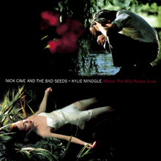
4. Successful
UK Prosecutions
"Where the Wild Roses Grow" is a murder ballad^{[2]} by Australian rock band Nick Cave and the Bad Seeds and pop singer Kylie Minogue. It is the fifth song and lead single from the band's ninth studio album, Murder Ballads (1996), released on Mute Records. It was written by the band's frontman Nick Cave and produced by Tony Cohen and Victor Van Vugt.
https://ew.com/article/2006/05/12/darker-side-nick-cave/
https://www.theguardian.com/music/2023/may/03/nick-cave-reveals-inexplicable-attachment-to-british-royals-ahead-of-attending-kings-coronation

Slide 32
Successful UK
Prosecutions
(20th Century)
1988 Old Bailey Hazel Paul plus 2 other offenders performed ritual abuse
1989 Nottingham Crown Court, 10 intergenerational family offenders abused 21 children
1989 St Albans Crown Court, Peter MacKenzie plus one other satanic offender (includes babies being abused and killed)
1990 Worcester Crown Court, Reginald Harris abused two sisters 15 years and younger
1992 Liverpool Crown Court; uncle raped niece three times a week between 10 and 12
1993/93 Manchester Crown Court, Michael Horgan (mate of Cyril Smith) raped daughter & and stepson and let others rape them
1993 Ealing Old Bailey Case, four family members abused 7 children
1994 Pembrokeshire, Swansea Crown Court, 6 men abused 13 children
1998 A West Country Crown Court, 6 men and 3 women in intergenerational abuse family; case had been reported 30 years earlier but not taken seriously; one dedicated police officer persevered; 300 interviews

Slide 33
Successful UK
Prosecutions
(21th Century)
Organised Child Sexual Abuse:
2011 Kidwelly, Swansea Crown Court, Colin and Elaine Batley and two other women
Pontypool: Ian Watkins
2012 Cornwall Peter Petrauske & Jack Kemp
2015 Carolee & Albert Hickman
Public Sector:
2012 Derek Osbourne (former leader of Kingston Council)
2012 Police Officer Ryan Coleman-Farrow jailed for faking rape case records

Slide 34
Kidwelly: Colin &
Elaine Batley
Imagine the shock then at news of an occultist group operating behind the doors of seemingly normal new-build houses. Shock, the locals say, is something of an understatement.
As residents went about their daily life, they could not have imagined that Colin Batley, described as an "evil paedophile", was running a satanic sex cult from his home.
The self-styled high priest of the group, headed a paedophile ring run like a "quasi-religion".
Cult ringleader Colin Batley has been told he faces a lengthy prison sentence.
One victim, who was repeatedly abused by Batley, told how he treated women like slaves. Batley would wear a hood to abuse his victims.
Once in their grasp, he would call the children to his service by clicking his fingers.
Batley and three other members of the cult were found guilty of more than 40 sexual offences against children and young adults.

Slide 35
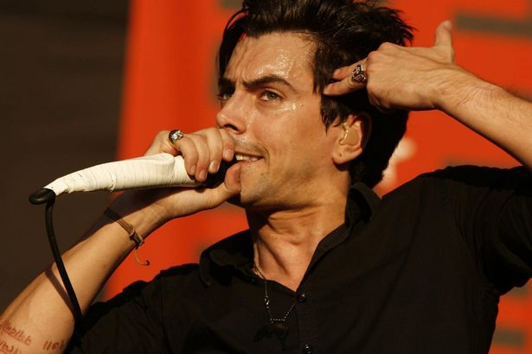
Pontypool:
Ian Watkins
UK media coverage of the Ian Watkins case was extremely muted. Wales Online was seemingly the only media outlet providing clues that Ian Watkins may well have fallen under the spell of a ‚devil worshipping sex cult‘:
http://www.walesonline.co.uk/all-about/ian%20watkins?pageNumber=1
Starstruck youngsters even offered to worship Satan if he wanted them to.
He had some weird sociopathic tendency to think he was above the law and everything. He didn’t come across as horrible. He came across as charismatic, charming and into the person he was talking to. He was just very confident and believed that whatever he did he would be okay. He thought he was a rock god and he thought he would get away with everything.
He wanted to rape and kill children. He wanted to rape newborns. He liked bestiality.
He described himself openly as ‘evil’.
The criminal investigation recovered abuse massive amounts of pornographic images. The computer password cracked by security services was ‚If***kids‘. Among the damning evidence presented by the prosecution were email exchanges between Watkins and the ‚Superfans‘ setting up planned abuse sessions in a hotel, and video-taped evidence of the attempted baby rapes. The ruling gives graphic details of the abuse acts.

Slide 36
Cornwall
Peter Petrauske &
Jack Kemp

Slide 37
Bridgend,
South Wales

Slide 38
Ideologically
Motivated Crimes
Extreme Abuse Survey:
EAS - Adult Survivors
P-EAS - Professionals
C-EAS - Children
Becker, T., Karriker, W., Overkamp, B. & Rutz, C. (2008). The extreme abuse surveys: preliminary findings regarding dissociative identity disorder. In Sachs, A. & Galton, G. (Eds.): Forensic aspects of dissociative identity disorder. Karnac Books: London.

Slide 39
Inadequate
Child Protection
Kingston council has reportedly been stripped of its child protection responsibilities following an unannounced Ofsted inspection. According to the Evening Standard, the unpublished inspection report rated the authority’s children’s services department ‘inadequate’ and came as a big shock to the director of children’s services, who has since stepped down.
Responsibility for children’s services has reportedly been passed to neighbouring Richmond council.
Council leader Derek Osbourne told the Standard: “Given Kingston’s track record of excellence in children’s services the Ofsted report was both a terrible shock and blow. We are committed to address the shortfalls in our performance to provide quality safeguarding for all.”
http://www.standard.co.uk/news/london/london-council-loses-control-of-child-protection-7932131.html

Slide 40
Inadequate
Council Leader

Slide 41
Inadequate
Values
Former council leader jailed for two years for 'appalling' child pornography offences
Derek Osbourne's computer contained images of 'stomach churning' child abuse, bestiality and severe violence against women. Derek Osbourne, 59, who stepped down as leader of Kingston upon Thames, south west London, in June, was told that the public interest “cries out for custody”. He was also told he must register as a sex offender for the next 10 years.
Judge Alistair McCreath, sitting at Southwark Crown Court, told him: “This imagery is of real children, suffering real abuse. “ “Of course you did not perpetrate that abuse directly yourself, but you and others like you are complicit it, because without people to look at it, there would be no point in doing it.”
Osbourne, of Burlington Road, New Malden, pleaded guilty at an earlier hearing to seven counts of making indecent images of children, four counts of possession of indecent images of children and six counts of distributing indecent images of children.
The judge said he had to deal with him for downloading 2,844 still images, and 293 movies, of children. He also had to deal with him for the distribution of 23 stills and seven movies. Osbourne had also accessed 152 extreme images, either in still form or as movies, showing “revolting images of deviant sexual practices”, including depiction of sexual behaviour between humans and animals, and depictions of serious violence being inflicted on women.

Slide 42
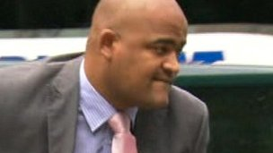
Rogue Copper
Ryan Coleman-Farrow jailed for faking rape case records
Coleman-Farrow pleaded guilty to 13 counts of misconduct.
A former Metropolitan Police detective constable who specialised in rape cases has been sentenced to 16 months in prison for faking police records. Ryan Coleman-Farrow, 30, from East Sussex, admitted 13 counts of misconduct in a public office, at Southwark Crown Court in September.
He failed to investigate rape and sexual assault cases and falsified entries on a police computer system. The convictions relate to 10 rape cases and three sex assault cases. The 13 cases included a 96-year-old woman who witnesses said had been raped, a 49-year-old severely brain damaged care home resident who alleged she was raped by a member of staff, two 15-year-old girls, a 14-year-old schoolboy, and a vulnerable woman patient at a specialist unit for sexual abuse.
The offences he should have investigated were committed between January 2007 and September 2010, while he was an officer at Kingston-upon-Thames, south-west London, working for Scotland Yard's specialist Sapphire unit.
http://www.bbc.co.uk/news/uk-england-london-19906619

Slide 43
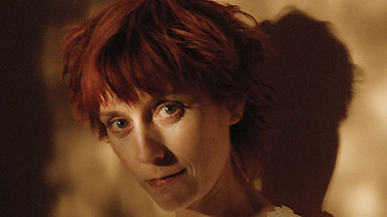
5. BPS
Policy Capture
by BFMS
May 33rd (BBC - Drama )
directed by David Attwood
written by Guy Hibbert
When Ella visits an osteopath to relieve physical trauma, the therapy triggers a devastating fragmentation of her already fragile personality.
http://www.imdb.com/title/tt0406984/
While trying to escape her family - a small group of relatives and their friends who have abused her since childhood - Ella visits Edward, an osteopath, to relieve the pains in her body.
http://www.bbc.co.uk/drama/may33rd/

Slide 44
Guidelines on Memory and the Law
Revised April 2010 (I)
Description: The Society is minded to ensure that legal professionals and the courts are appropriately advised as to the type of evidence-based psychological expert evidence than can be provided and whom is appropriately competent to provide such advice. Please therefore note that since the publication of this report, the Society’s guidance for psychologists as expert witnesses is being updated in conjunction with a broader review of what is meant by an “expert witness”.
Author: Psychology Research Board
Publication date: 2010
Size: 51 pages
BPS Guidelines are due to be reviewed after 5 years and put into the Archive section.

Slide 45
Guidelines on Memory and the Law
Revised April 2010 (II)

Slide 46
Guidelines on Memory and the Law
Revised April 2010 (III)

Slide 47
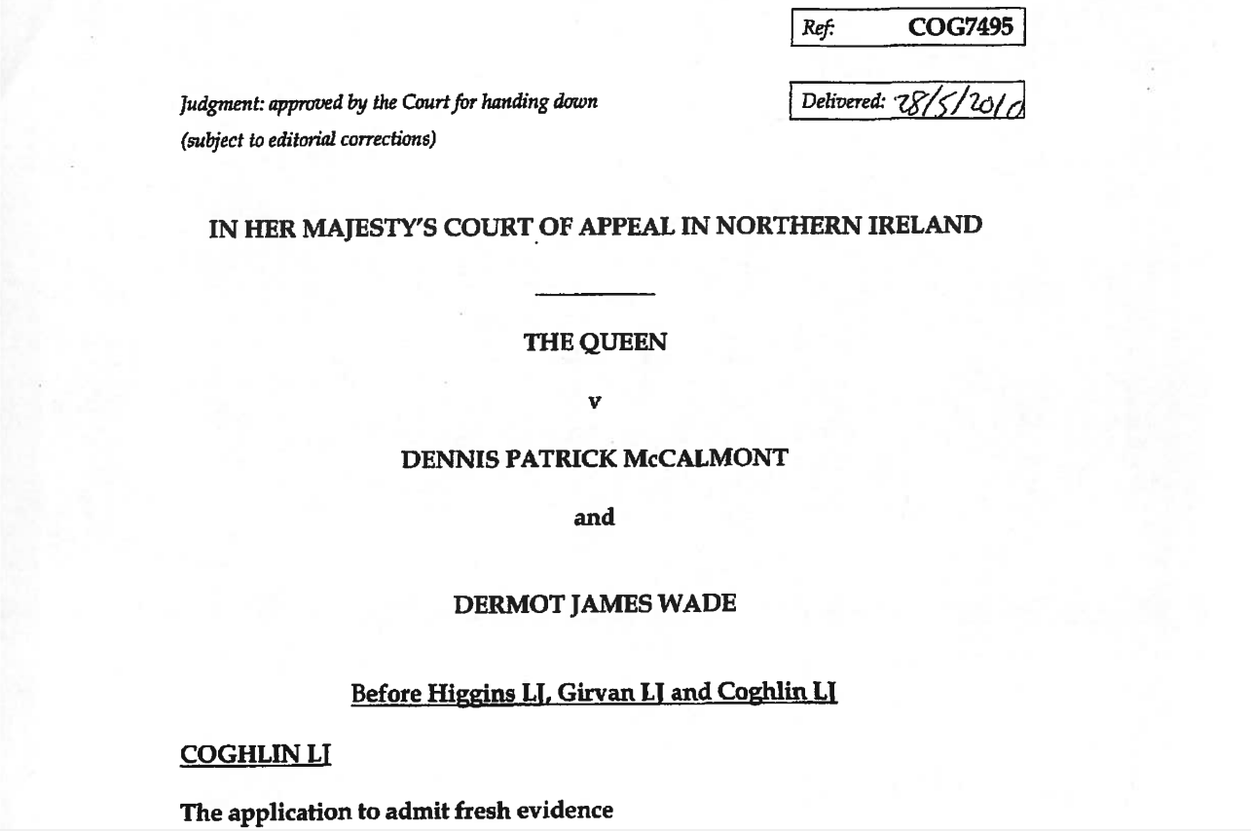
Guidelines on Memory and the Law
Revised April 2010 (IV)
28th May 2010
Court of Appeal Northern Ireland Judgement

Slide 48
Guidelines on Memory and the Law
Revised April 2010 (V)

Slide 49
Guidelines on Memory and the Law
Revised April 2010 (VI)
20th July 2012
RCJ Court of Appeal Criminal Division

Slide 50
https://onlinelibrary.wiley.com/doi/full/10.1002/acp.3220

Slide 51
https://onlinelibrary.wiley.com/toc/10990720/2017/31/1

Slide 52
Conway & Pilgrim (2022) Article

Slide 53
Advocacy &
Shut Down

Slide 55
6. Child Protection
& Family Court
Issues
https://www.youtube.com/watch?v=2wPj1lSkaKU

Slide 56
Prof Jane Ireland
(2012)
Evaluating Expert Witness Psychological Reports: Exploring Quality
‘Dubious 'experts' are paid to tear families apart
A new report condemns the shoddy standards of psychologists' reports in our family courts.‘
A study by Professor Jane Ireland, a forensic psychologist, for the Family Justice Council examined 126 psychological reports trawled at random from family court documents. It found that two thirds of them were “poor” or “very poor” in quality
‘Another woman was found by a psychologist to be “a competent mother” – so the social workers went to a second witness, who found the same. They then commissioned a third, who at last came up with what they wanted: that the mother had, again, “a borderline personality disorder”. On that basis, her three children were sent for adoption.’

Slide 57
Two-thirds (67%) of the mothers were pathologized for advocating for the safety of their children. Pathologizing the mother often occurred in the context of psychological testing results which were then echoed by the other professionals involved. Many mothers were termed “narcissistic” and “histrionic,” and behaviors such as taking notes on their children’s behaviors were categorized as pathological or “obsessive.” The word “enmeshment” was used to describe the close bond between the child and PP and the PP’s strong advocacy for her child’s safety. Thus the normal
dependence an abused child might feel on a safe parent was misperceived as a pathological trait. Without specific evidence of this behavior, many mothers were accused of “coaching” the child, particularly mothers who videotaped disclosures, or wrote down word for word what the children
disclosed. These pathological labels discredited the mother’s legitimate concerns about the children and were compounded by accusations of PAS or parental alienation which appeared to be the evaluator’s attempt to explain why a mother would report abuse that the evaluator contended had not
happened. All of these various labels were used to call the mother’s credibility into question and blame her for their child’s disclosure of abuse.

Slide 62
Metropolitan Police
Child Protection
2016 Report

Slide 63
Metropolitan Police
Child Protection
2023 Report

Slide 64
Survivorship Conference
19th May 2023
The Enmeshment of the British False Memory Society
and the British Psychological Society
Dr Rainer Hermann Kurz
C.Psychol
ichinendaimoku@gmail.com
Adapted from Kurz (2015). A discourse of disbelief? Reader’s Letter in The Psychologist, 12, BPS: Leicester.

