Slide 1
Introduction to session
Brief look at prevalence of CSA
Discuss experiences of 2 survivor led non-profit organisations based in Scotland.
Share several case studies
Findings from research about survivors’ experiences when seeking help from agencies
Research about needs of young abuse survivors for confidential services.
Talk about some problems faced by survivors and those trying to help
What might help make change possible?

Slide 2
Prevalence of CSA/ORA/RA
36% of girls and 23% of boys (Kloppen et al., 2016)
girls 2/3 time more at risk (Stoltenborgh et al., 2011)
21.1% of females and 9.7% males (Cyr et al., 2009)
20% females and 11% males (Cawson et al., 2000)
11.3% of 18-24-year olds (Radford et al., 2011)
Globally, one in eight (12.7%) children
Sexual exploitation by organised networks >21% children in care. (Research review Scotland, 2015)
Increase risk if in care/disabled (UK govt report 2022)

Slide 3
Eighteen And Under (18u) www.18u.org.uk
Non profit based in Scotland since 1994
Highly confidential
Child led, consultations, shadow management
Long-term support & information
Online forum
Research, awareness, lobbying
Develop & deliver evidence-based abuse prevention programmes (V.I.P. Programme)

Slide 4
18u experiences
Exploitation, trafficking, organised, ritual abuse
Child protection ineffective
Justice system ineffective and harmful to survivors
Mothers/parents who try to disclose are high risk to lose custody (Mary’s story; Lyn’s story; Abbie’s story)
Care system harmful and infiltrated with abuser networks (Lil’s story; Jane’s story)

Slide 5
Ritual Abuse Network Scotland
Non-profit based in Scotland since 2002 (due to 18u increased demand)
Created by survivors for survivors
Long-term practical and emotional support by phone, text, email, social media
Online forum
Not counselling, advice, therapy
Research, awareness, training, publications

Slide 6
Experiences
Ignorance/ Fear/Denial/Cover ups…
Myths: RA doesn’t exist……
If it does exist… which it doesn’t… it only exists in Africa….
There’s no evidence…..
Survivors are dangerous/mentally ill/unstable……
Abusers (if they exist) are dangerous……
It is dangerous to support survivors…….

Slide 7
Common Issues
Abuse ongoing with or without awareness
D.I.D.
Programming/Mind control
Complex belief systems/trust
Disbelief
Isolation
Threats/fear
Abusers highly organised/have huge power (Rik’s story)
Powerful people involved. Government/police/etc
They know everything: There is a magical/mystical element

Slide 8
Young survivors Research (n=140)
8 Co-researcher, mhp’s, disability, low self-esteem: empowered, increased skilled, self-confidence, trust, disclosed abuse, reduced isolation
Why not tell?
Don’t want authorities to know(n=49): Don’t want parents to know (n=33)
Don’t trust anyone (n=32): Worried about what will happen (n=27)
Scared (n=18)
Views on confidentiality
100% - current confidentiality insufficient
77% - (n=106) want total confidentiality
90% - (n=45) of under 16’s and males want total confidentiality
14% - (n=19) want almost total confidentiality
9% - (n=15) want higher confidentiality than they currently receive

Slide 9
Experience of needing to talk (n=140)
96 remained silent: 81% feared the consequences, 30% feared loss of privacy, 24% feared a loss of control, 7% were protecting abuser, 5% had no one to trust
44 had their confidentiality breached after they thought they could talk in confidence (17 retracted abuse allegation): 35% fear consequences, 17% lost privacy, 16% lost all trust, 8% lost control, 6% protected abusers
42 had experienced confidentiality (18u): 71% had been able to openly talk about abuse, 48% build trust, 33% stayed in control, 28% were able to explore options, 24% were able to get abuse stopped, 24% had time to think, 14% felt respected, 12% felt less isolated

Slide 10
Conclusions
Young survivors silenced by lack of confidentiality and CP systems. Confidentiality key to disclosing. Particularly under 16’s and males.
With confidentiality young survivors can explore options, talk about abuse, stay in control, get help and end abuse.
Needs a shift in thinking about long-term needs of survivors rather than rushing and making things worse. Needs a power shift towards greater equality between young survivors and professionals.
Young people need recognised as having knowledge, ability and wisdom to be actively involved in making decisions about their own lives, rather than needing others to make important decisions for them.

Slide 11
Quotes from young survivors
“It got back to my parents who were the problem. I ended up in care and that's worse” (boy, 15).
“School, health, social work all took over my life. I got so depressed and had no privacy so I learned to stop talking to any of them” (girl, 16).
“You feel like you've lost all control just like when you get abused” (girl, 17).
“You can’t tell them anything because they write it down and share it with everyone without even asking. I went back to school and the teachers all knew. Nothing is private!” (girl, 13).
“I would never have told anyone as more than 15 staff could access information in my file or be told by other staff.” (girl, 16).
“You can't say anything. It gets back to social work and used against you” (boy, 15)
“You can't trust people especially not police, social work or teachers” (girl, 14).
“I told my friend and she told school and they told social services, then social work got involved, and it was just awful” (girl, 15).
“It's my life, so why should someone else decide what happens with the things I tell them (girl, 14)
“When they share information, it goes too far damaging people and relationships. This has a serious effect on young people. It did me” (girl, 15).

Slide 12
Participatory Action Research 2012
68 RA survivors involved: 12 Co-Researchers aged 22-60
9 mental disability (PTSD, DID, Personality Disorder, Bipolar, Bulimia)
6 physical disability (FGM, Bowel Disorder, kidney & lung diseases)
All low self-esteem, poor confidence, poor education
All researchers empowered, gained confidence, expertise
Results…..
Needs from agencies: Support, Awareness, To be believed
Experienced disbelief, low or no awareness, prejudice, rejection, fear.
Service Quality? Police, education, rape and domestic abuse services judged very poor
Health & social services judged particularly poor
Fear and disbelief is embedded in agencies

Slide 13
Survivors words
“How can we safeguard children from something that is not known about or recognised”.
“I was given ECT age 13. They diagnosed PTSD, at 16 a counsellor diagnosed FMS”
“When I started to remember RA she didn't believe me. I was devastated. It is hard enough trying to cope with these very extreme memories without having professionals disbelieve”.
“You become defined by everyone’s world view. Your life story becomes an allegation. You no longer have a mum and a dad they are now called perpetrators.”
“There is so much fear around this. Workers fear for their jobs, professionals for their reputations and me for my life.”

Slide 14
Conclusions
PAR empowering for survivors with new skills, positive perceptions & life opportunities being developed also a promising approach to achieving social change.
Survivors still suffer backlash of 1980-90’s and continued discourse around belief, memory and mental illness.
Low awareness of R.A. results in poor services & silence… survivors reluctant to reveal histories due to negative reactions.
Only witnesses are abusers and survivors. Only survivors will try to tell, society needs to listen. Abusers will try to discredit, scare and silence anyone who tries to speak.

Slide 15
The problem
Survivors can’t tell particularly young survivors. There is a massive distrust of social services, police and criminal justice and research shows services have low awareness, offer poor services and are inadequate
CSA and RA are seldom stopped through reporting or placing a child in “care”. In care vulnerable children are failed, targeted by organised abusers and further abused
Prosecution rate in Scotland is really low showing that systems doesn’t work e.g. in 2017-18: there were 2,136 reported rapes resulting in 247 prosecutions: 107 convictions
Survivors are further damaged by systems that are supposed to protect them (care, justice)
Massive economical and human cost of this failure results in death, long-term illness, loss of earnings, lost relationships, loss to economy and cost of treating adult survivors while still creating the next generation of survivors through not protecting children now.

Slide 16
Part of the solution
Stop pretending that child protection and criminal justice works and begin to look at less harmful alternatives
Learn from the past through reviews and inquiries and start to investigate present abuse.
Work with agencies such as 18u and RANS and learn from them.
Learn from survivors, the experts. More survivor research. Learn from abusers. They seem able to easily identify vulnerable children e.g. disabled, lonely, in care, etc and build relationships with them.
Build relationships with vulnerable children before the abusers do it. Children need attention to thrive but are left vulnerable to predators.
Give survivors confidential help when they need it. Build trusting relationships with them and between agencies especially survivor agencies who have the expertise.
Deliver evidence-based abuse prevention programmes e.g. V.I.P. One of the most effective prevention programmes to date

Slide 17
Violence Is Preventable (V.I.P) Programme
Evidence-based abuse prevention programmes
Resources: Games, videos, songs, quizzes, stories, workbooks age 3 to adult, adapted for disabilities
Brings a ‘survivor perspective’ to school-based abuse prevention
Aims: Prevent abuse & violence. Increase knowledge & understanding of safety, abuse and violence. Understand & challenge root causes. Build relationships and encourage children to talk/share feelings and experiences of abuse and violence. Explore situations, options and alternatives.
Effective @ primary prevention - increases knowledge of personal safety.
Effective @ secondary prevention – children disclose abuse during and after receiving the programme.
Effective at a deeper level – provides strategies for children to avoid abuse; raising the issue of abuse, increasing empathy; focus on victim, abuser, bystander to challenge and change attitudes.
No negative impact

Slide 18
Mindset
Specific & explicit questions about harm/violence, “Has anyone ever hurt you?”
Belief survivors always present. Expectation children will disclose. Confident to notice & discuss disclosures.
Disclosures received without judgement or blocking
Active listening not controlling or saying to be quiet “Listen” Encouragement of story telling and disclosure. Encouragement to hear and empathise
Wide abuse definition. Quieter children supported to tell
Facilitation of ‘peer to peer’ talk
Space and time for longer stories and self discipline no active adult intervention
Responses received without judgement, “that’s very interesting. Can you tell me more?”
Validation of all viewpoints as right for individual child - no wrong answers
Responses summarised to enable children to reach their own conclusions

Slide 20
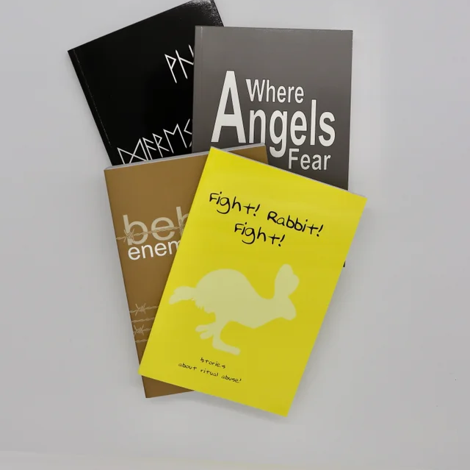
Publications
https://www.18u.org.uk/shop-vip.html
https://www.18u.org.uk/files--research.html
www.18u.org.uk
www.RANS.org.uk

