Slide 1
Extreme Abuse Survivors, Social Security Benefits, and Ethical Practice.
Randy Noblitt, PhD
Pamela Noblitt, EDPNA

Slide 2
Extreme Abuse and DID

Slide 3
General healthcare ethics
What can we say about it?
“First do no harm.”

Slide 4
American Psychological Association (2017). Ethical principles of psychologists and code of conduct.
https://www.apa.org/ethics/code/

Slide 5
APA (2017) Ethics Code
General Principles
Principle A: Beneficence and Nonmaleficence
Principle B: Fidelity and Responsibility
Principle C: Integrity
Principle D: Justice
Principle E: Respect for People’s Rights and Dignity

Slide 6
APA (2017)
Ethical Standards
How are they different from ethical principles?
Are there any that we should especially consider in the care of PWDs?
Let’s take a look at APA (2017)

Slide 7
Law
ADA
SSA

Slide 8
What is ADA?
Is the ADA definition of disability the same, or different with respect to the SSA definition?
In what ways do the ADA and SSA laws serve PWDs?

Slide 9
Most SSA applicants are not approved.
One of the most common reasons for non-approval is that their treating professionals do not adequately evaluate and document their health conditions and capacity for working.
The SSA uses diagnoses similarly to medicine and professional psychology, however their criteria for disability require thorough, precise, evaluations that are conceptually coherent and credible.

Slide 10
What Is Disability?
“The SSA defines disability as a medically determinable physical or mental impairment that is so severe it prevents an individual from engaging in full-time work in a competitive work setting at any job within the national economy” (Noblitt & Noblitt, 2020, p . 9).

Slide 11
Psychological and Medical Diagnoses vs. SSA criteria: Listing of Impairments (Adults)
Listing of Impairments (Adults)
Listing of Impairments (Children)

Slide 12
Listing of Impairments (Adults, continued)
1.00 Musculoskeletal System (see Appendix A, §1.00),
2.00 Special Senses and Speech (see Appendix A, §2.00),
3.00 Respiratory Disorders (see Appendix A, §3.00),
4.00 Cardiovascular System (see Appendix A, §4.00),
5.00 Digestive System (see Appendix A, §5.00),
6.00 Genitourinary Disorders (see Appendix A, §6.00),
7.00 Hematological Disorders (see Appendix A, §7.00),
8.00 Skin Disorders (see Appendix A, §8.00),

Slide 13
Listing of Impairments (Adults, continued)
9.00 Endocrine Disorders (see Appendix A, §9.00),
10.00 Congenital Disorders That Affect Multiple Body Systems (see Appendix A, §10.00),
11.00 Neurological Disorders (see Appendix A, §11.00),
12.00 Mental Disorders (see Appendix A, §12.00),
13.00 Cancer (Malignant Neoplastic Diseases, see Appendix A, §13.00), and
14.00 Immune System Disorders (see Appendix A, §14.00).

Slide 14
Listing of Impairments (Child)
100.00 Low Birth Weight and Failure to Thrive (see Appendix B, §100.00),
101.00 Musculoskeletal System (see Appendix B, §101.00),
102.00 Special Senses and Speech (see Appendix B, §102.00),
103.00 Respiratory Disorders (see Appendix B, §103.00),
104.00 Cardiovascular System (see Appendix B, §104.00),
105.00 Digestive System (see Appendix B, §105.00),
106.00 Genitourinary Disorders (see Appendix B, §106.00),

Slide 15
Listing of Impairments (Child, continued)
107.00 Hematological Disorders (see Appendix B, §107.00),
108.00 Skin Disorders (see Appendix B, §108.00),
109.00 Endocrine Disorders (see Appendix B, §109.00),
110.00 Congenital Disorders That Affect Multiple Body Systems (see Appendix B, §110.00),
111.00 Neurological Disorders (see Appendix B, §111.00),
112.00 Mental Disorders (see Appendix B, §112.00),
113.00 Cancer (Malignant Neoplastic Diseases, see Appendix B, §113.00), and
114.00 Immune System Disorders (see Appendix B, §114.00).

Slide 16
What Is Work?
“Work consists of combined mental effort and physical exertion resulting in an intellectual or tangible product” (N&N, 2020, p. 12).

Slide 17
Clinical Assessment of the Ability to Work
Residual functional capacity (RFC)
“A subjective assessment of the claimant’s ability to perform typical work activities despite physical or mental limitations due to illness or injury” (N&N, 2020, p. 537).
Mental RFC
Same as the above, but psychological

Slide 18
Mental residual functional capacity (MRFC)
“The SSA’s four general categories of MRFC include the ability to
(1) “understand, remember, or apply information;
(2) interact with others;
(3) concentrate, persist, or maintain pace; and
(4) adapt or manage oneself.” (N&N, 2020, p. 20).

Slide 19
SSA subdivides mental residual functional capacity (MRFC) into these 20 subcategories:
A. Understanding and Memory
1. The ability to remember locations and work-like procedures
2. The ability to understand and remember very short and simple instructions
3. The ability to understand and remember detailed instructions

Slide 20
Mental residual functional capacity (MRFC)
B. Sustained Concentration and Persistence
4. The ability to carry out very short and simple instructions
5. The ability to carry out detailed instructions
6. The ability to maintain attention and concentration for extended periods
7. The ability to perform activities within a schedule, maintain regular attendance, and be punctual within customary tolerances
8. The ability to sustain an ordinary routine without special supervision
9. The ability to work in coordination with or proximity to others without being distracted by them
10. The ability to make simple work-related decisions
11. The ability to complete a normal workday and workweek without interruptions from psychologically based symptoms and to perform at a consistent pace without an unreasonable number and length of rest periods

Slide 21
Mental residual functional capacity (MRFC)
C. Social Interaction
12. The ability to interact appropriately with the general public
13. The ability to ask simple questions or request assistance
14. The ability to accept instructions and respond appropriately to criticism from supervisors
15. The ability to get along with coworkers or peers without distracting them or exhibiting behavioral extremes
16. The ability to maintain socially appropriate behavior and to adhere to basic standards of neatness and cleanliness

Slide 22
Mental residual functional capacity (MRFC)
D. Adaptation
17. The ability to respond appropriately to changes in the work setting
18. The ability to be aware of normal hazards and take appropriate precautions
19. The ability to travel in unfamiliar places or use public transportation
20. The ability to set realistic goals or make plans independently of others

Slide 23
Disability Determination
“The determination of disability can only be conferred by the commissioner of the SSA or the commissioner’s designees, including Social Security field offices, state Disability Determination Services, administrative law judges, the Appeals Council, or federal courts. Clinicians’ opinions that a patient is disabled are not accorded any weight by Social Security in the disability determination process because clinicians’ definitions of disability are generally incompatible with that of the SSA” (Noblitt & Noblitt, 2020, p. 18).

Slide 24
Disability Determination: Measuring Disability
Treating “clinicians’ opinions can influence the disability determination process if their treatment records support their assessment of exertional or nonexertional limitations resulting from their patient’s condition and treatment. The opinion of the treating physician is not accorded any greater weight than the opinion of nontreating or examining-only clinicians unless treatment records are supportive of the doctor’s opinion” (Noblitt & Noblitt, 2020, p. 18).

Slide 25
Measuring Disability
“However, if the treating clinicians’ treatment records support their professional opinions and the Administration’s contracted examining or nonexamining clinical opinions result in substantially different conclusions, the Administration or administrative law judge is more likely to find the examining or nonexamining professionals’ opinions less credible and give the treating source greater influence in disability determination” (Noblitt & Noblitt, 2020, p. 18).

Slide 26
Measuring Disability
Clinicians “should consider recording progress notes that identify the patient’s job and describing any physical and mental limitations experienced as a result of injury, illness, or mental impairment. This note-keeping process would not only provide valuable information for insurers, agencies, and adjunctive health-care services that may be prescribed but would also benefit claimants by providing concrete examples of the effect of signs and symptoms of possible medically determinable impairments (MDIs)” (Noblitt & Noblitt, 2020, p. 19).

Slide 27
Diagnoses, Symptoms, and Limitations in the Assessment of Disability
“Diagnoses of severe medical or psychological conditions with their attendant symptoms and adverse effects of treatment may be considered disabling by clinicians, but treatment records often do not reflect the seriousness of the claimants’ disabilities because, as a general rule, clinicians do not equate symptoms and the effects of treatment with functional limitations” (Noblitt & Noblitt, 2020, pp. 26-27).

Slide 28
Contributing Factors in Disability Determination
“The Administration considers other factors in addition to the severity of the claimant’s impairments and functionality. These factors include age, obesity, education level, transferability of skills, and English fluency” (N&N, 2020, p. 27).

Slide 29
Psychological Disabilities: Adult Listings
12.02 Neurocognitive disorders (see Appendix A, §12.02);
12.03 Schizophrenia spectrum and other psychotic disorders (see Appendix A, §12.03);
12.04 Depressive, bipolar, and related disorders (see Appendix A, §12.04);
12.05 Intellectual disorder (see Appendix A, §12.05);
12.06 Anxiety and obsessive-compulsive disorders (see Appendix A, §12.06);

Slide 30
Psychological Disabilities: Adult Listings
12.07 Somatic symptom and related disorders (see Appendix A, §12.07);
12.08 Personality and impulse-control disorders (see Appendix A, §12.08);
12.10 Autism spectrum disorder (see Appendix A, §12.10);
12.11 Neurodevelopmental disorders (see Appendix A, §12.11);
12.13 Eating disorders (see Appendix A, §12.13); and
12.15 Trauma- and stressor-related disorders (see Appendix A, §12.15).1

Slide 31
Psychological Disabilities: Child Listings
112.02 Neurocognitive disorders (see Appendix A, §112.02);
112.03 Schizophrenia spectrum and other psychotic disorders (see Appendix A, §112.03);
112.04 Depressive, bipolar, and related disorders (see Appendix A, §112.04);
112.05 Intellectual disorder (see Appendix A, §112.05);
112.06 Anxiety and obsessive-compulsive disorders (see Appendix A, §112.06);
112.07 Somatic symptom and related disorders (see Appendix A, §112.07);

Slide 32
Psychological Disabilities: Child Listings
112.08 Personality and impulse-control disorders (see Appendix A, §112.08);
112.10 Autism spectrum disorder (see Appendix A, §112.10);
112.11 Neurodevelopmental disorders (see Appendix A, §112.11);
112.13 Eating disorders (see Appendix A, §112.13);
112.14 Developmental disorders in infants and toddlers (see Appendix A, §112.14); and
112.15 Trauma- and stressor-related disorders (see Appendix A, §112.15).

Slide 33
“SSA’s revised child and adult Listings of Mental Impairments are closer in similarity to the DSM-5 categories than previously, they are still not identical” (N&N, 2020, p. 59).
“The DSM-5 also lists an additional category, medication-induced movement disorders and other adverse effects of medication, that is not considered a mental disorder but is nonetheless important to assess and track” (p. 59).

Slide 34
Methods of Psychological Information Gathering?

Slide 35
Methods of Psychological Information Gathering?
Review of Records

Slide 36
Methods of Psychological Information Gathering?
Review of Records
Psychological Testing

Slide 37
Methods of Psychological Information Gathering?
Review of Records
Psychological Testing
Interviewing
Mental Status Exam
History

Slide 38
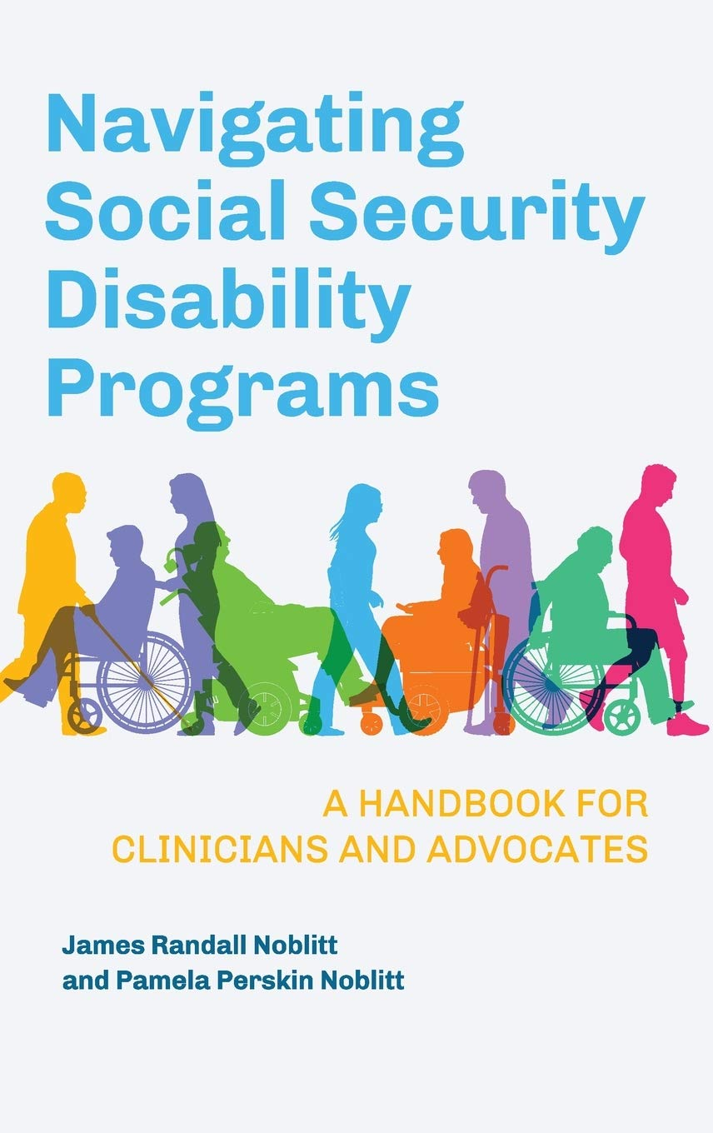
This is the textbook for the last four classes

Slide 39
An Overview of SSD Programs
The two main SSA programs that are important to clinicians and their patients:
Social Security Disability Insurance (SSDI)
Supplemental Security Income (SSI)

Slide 40
An Overview of Social Security Disability Programs: SSDI
Social Security Disability Insurance (SSDI) provides the following benefits:
Monthly income based on a complicated formula using the claimant’s earnings record for the prior 15 years.
Back-due benefits based on the monthly payment the claimant would have received had benefits been awarded at the time of application.
Medicare eligibility 29 months from the claimant’s alleged onset date. SSDI beneficiaries receive Medicare part A (hospitalization) at no cost but medicare parts Bprovider) and D (prescriptions) has a premium deducted monthly from the SSDI payment.

Slide 41
An Overview of Social Security Disability Programs: SSI
Supplemental Security Income (SSI) provides the following benefits:
Monthly income based on the federal benefit rate (FBR) for 2020 of $783 for an eligible individual and $1,175 for a couple.
Back-due benefits based on the monthly payment the claimant would have received had benefits been awarded at the time of application.
Medicaid (or state’s equivalent) available immediately upon approval of SSI claim.

Slide 42
An Overview of Social Security Disability Programs
SSDI claimants whose benefit is very low may also be entitled to SSI and receive both Medicare and Medicaid. A program, Qualified Medicare Beneficiary (QMB) may be applicable. QMB pays the beneficiary’s premium and co-pays so the claimant receives more cash.
SSI is available to disabled children and to adults over the age of 65.

Slide 43
An Overview of Social Security Disability Programs: SSDI Eligibility
Social Security Disability Insurance eligibility
Paid social security taxes for sufficient quarters during the past 15 years prior to disability
Not engaged in full-time competitive work since onset of disabling condition
Have severe impairment that has lasted or is expected to last 12 months or result in death
Physical or mental limitations preventing return to past relevant work (work performed during proceeding 15 years)
Limitations preventing any other work in national economy

Slide 44
An Overview of Social Security Disability Programs: SSI Eligibility
Supplemental Security Income Eligibility
Not engaged in full-time competitive work since onset of disabling condition
Have severe impairment that has lasted or is expected to last 12 months or result in death
Physical or mental limitations preventing return to past relevant work (work performed during proceeding 15 years)
Limitations preventing any other work in national economy
Meeting SSI financial criteria (See Noblitt & Noblitt, 2020)

Slide 45
What is disability according to The Social Security Administration?
The SSA defines disability as a medically determinable physical or mental impairment that is so severe it prevents an individual from engaging in full-time work in a competitive work setting at any job within the national economy, and where payment for such employment will average at least $1260 substantial gainful activity (SGA) for non-blind individuals in 2020. For blind individuals, the SGA is $2,110.

Slide 46
This definition is foundational in Social Security disability determination. Impairments that significantly limit an individual’s strength, endurance, mobility, intelligence, cognition, concentration, attention, persistence, and pace of performance would affect that person’s ability to perform any work. Furthermore, Social Security’s definition of disability requires that the impairment must have lasted or be expected to last at least 12 months or result in death.

Slide 47
How is disability defined for children?
Since most children do not work, the impact of their severe physical or mental impairments is considered relative to school performance at grade or age level, behavioral and social adaptation, and meeting developmental milestones appropriately and timely.

Slide 48
How is disability proven? Kinds of evidence (Stretton, 2017 cited in Noblitt & Noblitt, 2020)
Objective
Subjective
Opinion

Slide 49
Objective evidence
“Objective medical evidence is medical evidence that can be verified by other healthcare professionals using medically acceptable clinical or laboratory techniques” Stretton, 2017, p. 7).
Includes objective psychological testing and description of clinical signs.

Slide 50
Subjective evidence
The subjective statements of the claimant.

Slide 51
Opinion Evidence
Opinions by Acceptable Medical Sources (psychologists are included with physicians).
Opinions by examining acceptable treating sources (consultative examiner and independent or qualified medical examiner)
Opinions by non-examining acceptable treating sources (medical expert , social security, and department or disability determination)

Slide 52
How is disability proven? Sources of evidence
Documentary evidence
Testimony

Slide 53
Documentary evidence
Treatment notes
Operative notes
Diagnostic testing
School records for children and adults with intellectual challenges or lifelong behavioral, emotional, or cognitive impairments.

Slide 54
Testimony
Testimony of medical expert
Testimony of vocational expert
Testimony of treating clinician
Testimony of claimant
Testimony of 3rd party

Slide 55
More About Accepted Medical Sources
Licensed physicians (including MD and DO)
Licensed or certified psychologists at independent practice level (Ph.D. and Psy.D.)
School psychologists, or other licensed or certified individuals with other titles who perform the same function as a school psychologist in a school setting, are AMSs for impairments of intellectual disability, learning disabilities, and borderline intellectual functioning only.

Slide 56
Other Accepted Medical Sources
Licensed optometrists for impairments of visual disorders, or measurement of visual acuity and visual fields only, depending on the scope of practice in the state in which the optometrist practices.
Licensed podiatrists for impairments of the foot, or foot and ankle only, depending on whether the state in which the podiatrist practices permits the practice of podiatry on the foot only, or the foot and ankle.

Slide 57
Other Accepted Medical Sources
Qualified speech-language pathologists (SLPs) for speech or language impairments only. For this source, “qualified” means that the SLP must be licensed by the state professional licensing agency, or be fully certified by the state education agency in the state that he or she practices, or hold a certificate of clinical competence in speech-language-pathology from the American Speech-language Hearing Association.

Slide 58
The Role of Mental Health Professionals in Disability Determination
Duty to Respond to Requests for Treatment Records
Disabled People as an Underserved Community
Ethical Considerations
Documentation of Services

Slide 59
Complicating Factors in Disability Determination
Lack of Treatment
Drug Abuse and Alcoholism
Noncompliance with Treatment
Lack of Treating Clinician Support
Malingering
Credibility

Slide 60
Lack of Treatment
Why is this considered relevant by SSA?
What are some reasons claimants may be considered to have a “lack of treatment”?

Slide 61
Drug Abuse and Alcoholism
Is drug abuse and alcoholism a listing?
Is it an illness? A disabling condition?
To what extent do the models of disability discussed earlier apply to drug abuse and alcoholism?

Slide 62
Noncompliance with Treatment
How do we document compliance vs. noncompliance?
Would psychologists with different theoretical orientations view this differently? Why?
Is some treatment incapacitating? Examples?
Should all treatment be voluntary? Informed consent?

Slide 63
Lack of Treating Clinician Support
Does this happen sometimes?
How does it happen? Examples?
Do clinicians have different biases about disabilities?
Entitlements?

Slide 64
Malingering

Slide 65
Credibility

Slide 66
Who Is Eligible for Social Security Disability Programs?

Slide 67
Initial Application

Slide 68
Reconsideration

Slide 69
Exhibit File

Slide 70
Hearing Level

Slide 71
Representation for Disability Insurance Benefits

